Slide 1

Session 5
Your Own Show
Notes:
Session 5: Your Own Show
Take what the teams have learned and challenge them one stage further. Take notice in this session how they can apply prior knowledge of the functional elements in STEAM Park. Check out the Functional Elements lesson for more guidance.

Slide 2

Big Question
Can you create an innovation place to share your interests?
Outcomes
Teams will use imagination and creativity to create innovative moving ride designs.
Teams will apply knowledge of functional pieces to create a fun fair ride with moving parts.
Notes:
Outcomes
Teams will use imagination and creativity to create innovative moving ride designs.
Teams will apply knowledge of functional pieces to create a fun fair ride with moving parts.
Facilitator Tip
The children could identify what places they have in their community.
Each child on the team could design a different area of their innovative space.

Slide 3
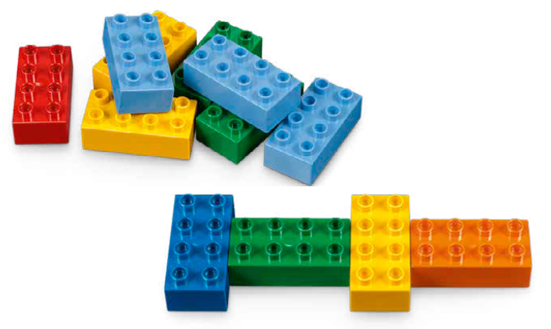
Warm-Up – Six Bricks
Notes:
Warm-Up: (10 minutes) Rhythms and Moves
Base Activity
1. Children will work together in teams to create a repeating pattern using the bricks.
2. Now assign a sound, clap, or dance move to each different colored brick. Practice a few times to see if they can consistently repeat the pattern.
3. Now change the pattern of the bricks but keep the same sound, clap, or dance move assigned to each color.
4. The children will understand how performers rehearse to perfect their performance.
Guiding Questions:
• How is your pattern different from other groups?
• Can you make your pattern more challenging?

Slide 4
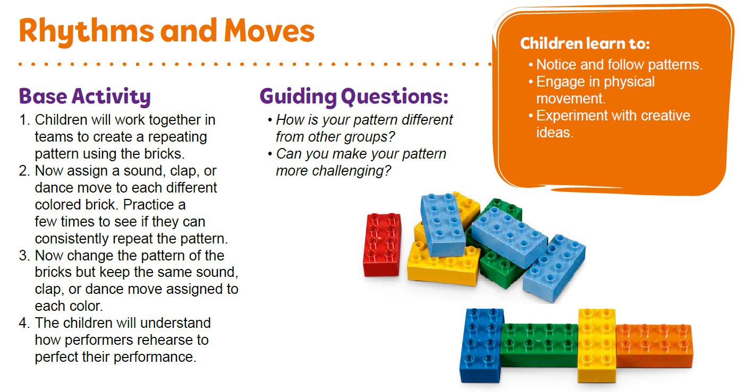
Warm-Up – Six Bricks
Notes:
Facilitator Tip – TMG Appendix (see page 27)

Slide 5
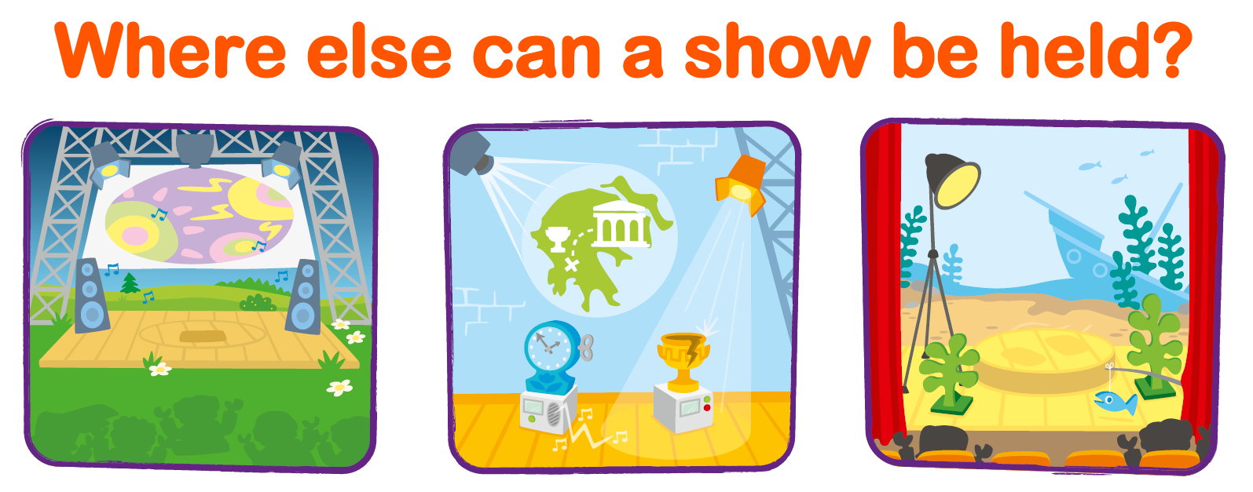
Explore Task
Notes:
Explore Task (1O minutes)
Have the children recall some of the different types of shows and places where people share their interests, talents, or hobbies. Identify different places that haven’t previously been discussed.
You could ask the teams:
• Do you display any of your art in your home?
• What places have you watched a movie (i.e., theater, drive-in, your television)?
• Have you seen a show at a fair or carnival?
• Where would you perform your show, concert, play, or display your exhibit?
Facilitator Tip
The children could identify what places they have in their community.

Slide 6
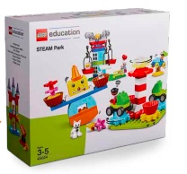
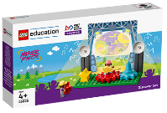
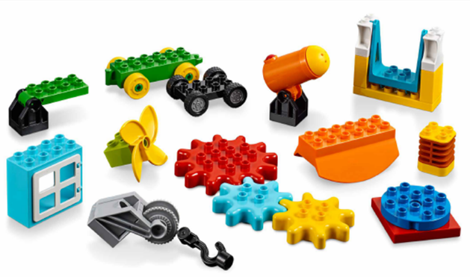
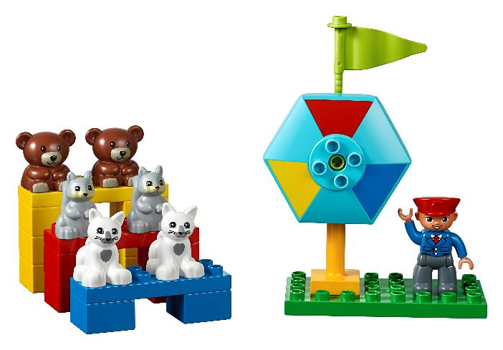
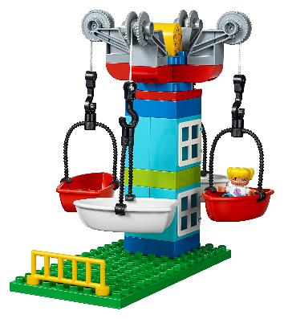
Create Task
You Need..
Build a new place for a show.
Notes:
Create Task (25 minutes)
Have the children build their own place using the Discover set. The place should use technology or innovation to showcase a hobby, special object, talent, or piece of art, in a different way than in previous sessions.
Have each team pick out the functional pieces in STEAM Park and show how they move. They should use them to create the place where their interests can be shared. They can use gears to help move an object or performer. The place can be assembled on the area of the mat that relates to what is being shared.
Check out the Functional Elements lesson plan - https://education.lego.com/en-us/lessons/preschool-steam-park/functional-elements
Playful Learning in Action – Teams will apply knowledge from previous sessions and use innovation to creatively build their designs.
Key Vocabulary – innovation, functional, movement
Facilitator Tip
Each child on the team could design a different area of their innovative space.

Slide 7

Playful Learning in Action
Teams will apply knowledge from previous sessions and use innovation to creatively build their designs.
Key Vocabulary
innovation, functional, movement
Notes:
Create Task (25 minutes)
Have the children build their own place using the Discover set. The place should use technology or innovation to showcase a hobby, special object, talent, or piece of art, in a different way than in previous sessions.
Have each team pick out the functional pieces in STEAM Park and show how they move. They should use them to create the place where their interests can be shared. They can use gears to help move an object or performer. The place can be assembled on the area of the mat that relates to what is being shared.
Playful Learning in Action – Teams will apply knowledge from previous sessions and use innovation to creatively build their designs.
Key Vocabulary – innovation, functional, movement
Facilitator Tip
Each child on the team could design a different area of their innovative space.

Slide 8
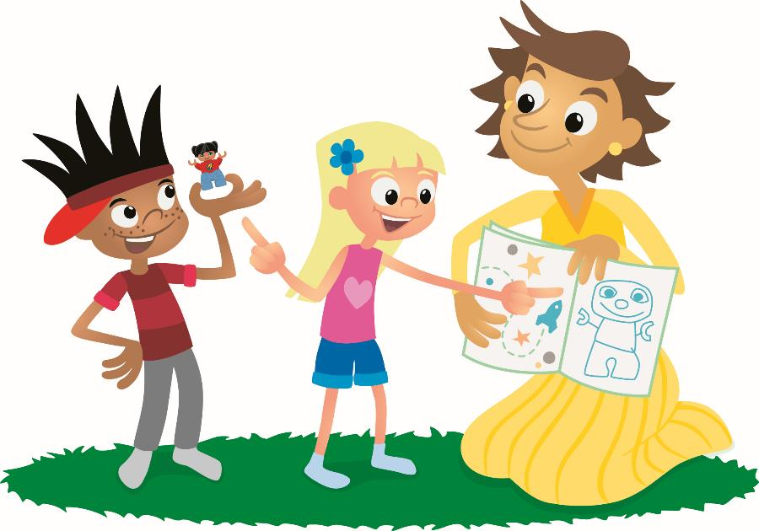
Share Task
Describe the movement in your builds.
Notes:
Share Task – (15 minutes)
Have the teams describe the movement in their builds. The teams could share together to give them more confidence in talking in front of people. They can talk about what is being shared but should focus on the place where the sharing is happening. Ask them to use the word innovative where possible.

Slide 9
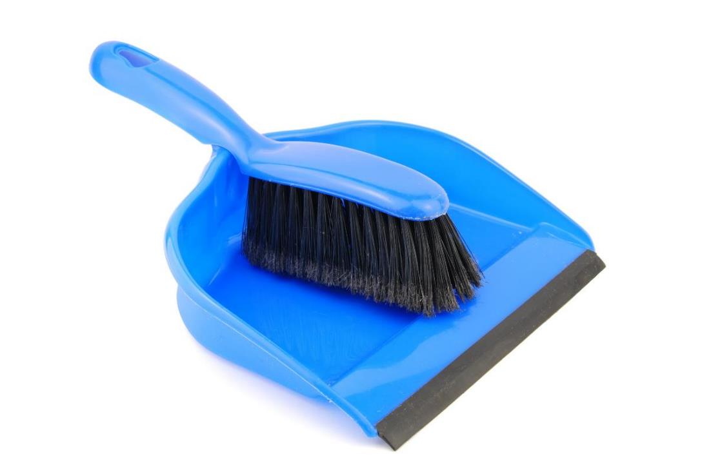
Clean Up
Notes:
You may wish to play a video or song during clean up time.
Link on GoNoodle: https://family.gonoodle.com/activities/clean-up
Link on YouTube Kids: https://www.youtubekids.com/watch?v=ZJFk87ZsHn0
Link on YouTube: https://youtu.be/ZJFk87ZsHn0

Slide 10


LEGO, the LEGO logo, DUPLO and the DUPLO logo are trademarks of the LEGO Group. ©2023 The LEGO Group. All rights reserved. FIRST®, the FIRST ® logo, and FIRST® in SHOWSM are trademarks of For Inspiration and Recognition of Science and Technology (FIRST). LEGO® is a registered trademark of the LEGO Group. FIRST ® LEGO® League and MASTERPIECESM are jointly held trademarks of FIRST and the LEGO Group. ©2023 FIRST and the LEGO Group. All rights reserved.

