Slide 1
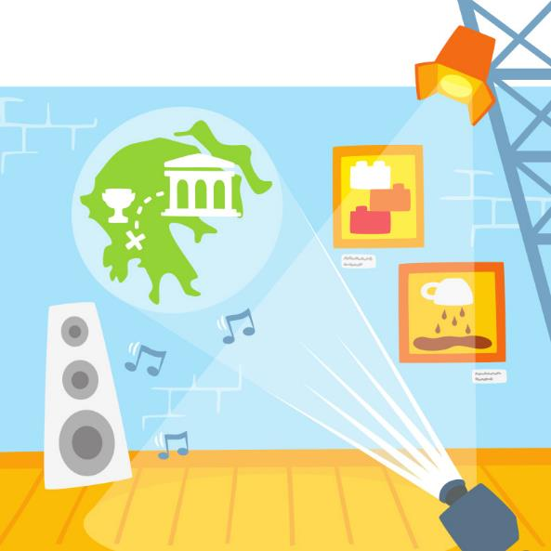
Session 3
Museum Exhibit
Notes:
Session 3: Museum Exhibit
This session introduces problem-solving tasks. Problem-solving is a habit of learning the children should practice. Encourage the teams to persevere in the creation of their solutions. Then the teams can communicate and share their solutions with others.

Slide 2
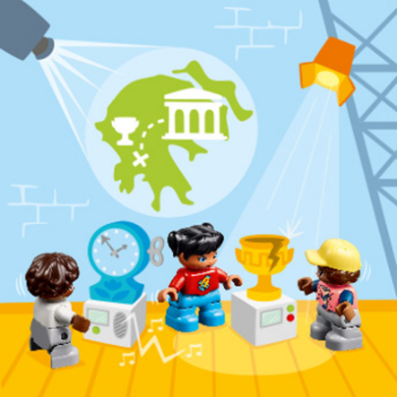
Big Question
What do you learn about when visiting a museum?
Outcomes
Teams will explore how museums display objects to teach visitors.
Teams will build a display for something that is important to them.
Notes:
Outcomes
Teams will explore how museums display objects to teach visitors.
Teams will build a display for something that is important to them.
Facilitator Tip
Children may be inspired to create their own designs different than what’s on the building cards.
Encourage the teams to talk about how they chose to display the object and how it helps engage people.

Slide 3
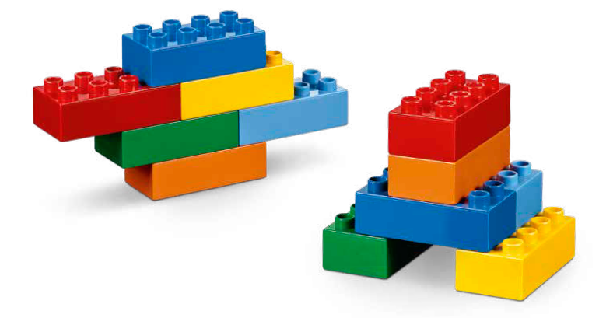
Warm-Up – Six Bricks
Notes:
Warm-Up: (10 minutes) What Can You Build?
Base Activity
1. In groups of 4, children mix their bricks together.
2. Have the children use their bricks build a model that represents a special object that will be displayed in a museum.
3. Then have them take turns and describe where the object came from and why it is important.
This activity can also be linked to a theme, story, or book.
Guiding Questions:
• Does your object need special protection?
• Who do you want to see the object?
• How does the object help to tell a story?

Slide 4
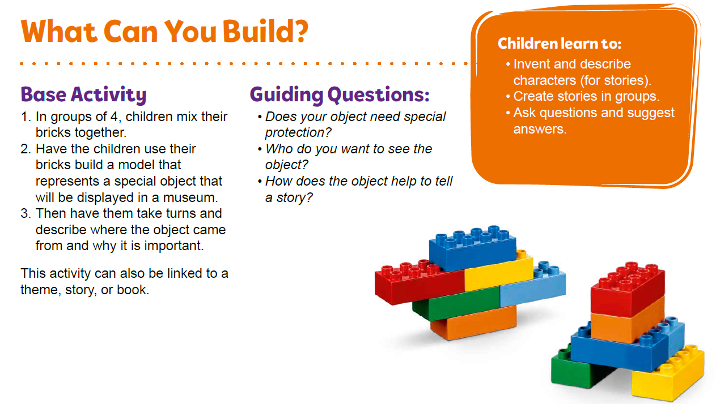
Warm-Up – Six Bricks
Notes:
Facilitator Tip – TMG Appendix (see page 26)

Slide 5
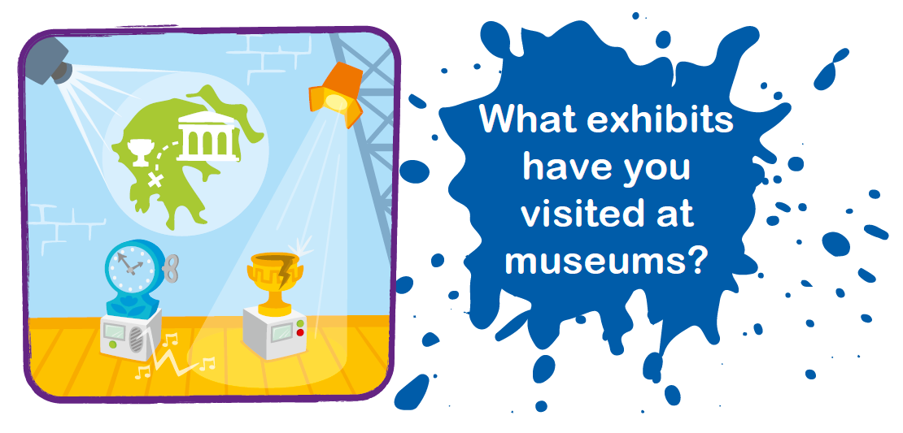
Explore Task
Notes:
Explore Task (1O minutes)
Museums are places that collect and display objects that people want to learn about.
Ask the children if they have ever visited a museum and have them share what types of exhibits they saw.
• Give examples of different kinds of museums (art, history, science).
• Give examples of different kinds of exhibits (paintings, sculptures, fossils, artifacts).
Locate the museum elements found on the mat (i.e., dinosaur bones, lights, speakers).

Slide 6
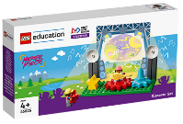

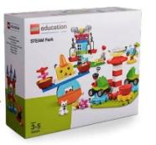
Create Task
You Need..
Build a display for a museum.
Notes:
Create Task (25 minutes)
Have each team build a place to display an object that is important to them and place the display on the mat. They can use the building card to help them get started. Use the Discover set and allow them to add pieces from the STEAM Park set.
Museums often create exhibit spaces that are fun, interesting, and interactive (i.e., touch screens, objects to touch, videos, and sound effects). Have the children consider how they might make their exhibit interactive and think about how it will help people learn.
Playful Learning in Action – Teams will use teamwork and problem-solving to build their solutions.
Key Vocabulary – museum, exhibit, artifact
Facilitator Tip
Children may be inspired to create their own designs different than what’s on the building cards.

Slide 7

Playful Learning in Action
Teams will use teamwork and problem-solving to build their solutions.
Key Vocabulary
museum, exhibit, artifact
Notes:
Create Task (25 minutes)
Have each team build a place to display an object that is important to them and place the display on the mat. They can use the building card to help them get started. Use the Discover set and allow them to add pieces from the STEAM Park set.
Museums often create exhibit spaces that are fun, interesting, and interactive (i.e., touch screens, objects to touch, videos, and sound effects). Have the children consider how they might make their exhibit interactive and think about how it will help people learn.
Playful Learning in Action – Teams will use teamwork and problem-solving to build their solutions.
Key Vocabulary – museum, exhibit, artifact
Facilitator Tip
Children may be inspired to create their own designs different than what’s on the building cards.

Slide 8




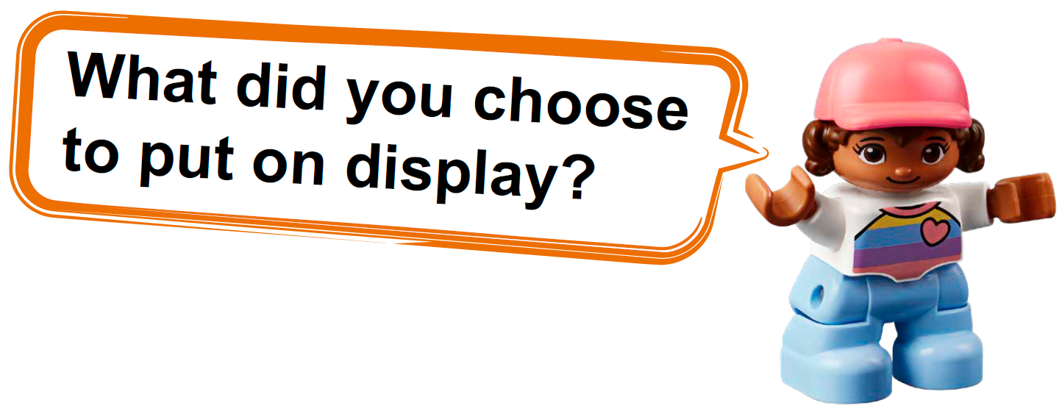


Share Task
Notes:
Share Task – (15 minutes)
Have each team share what they chose to put on display. They could explain why the object is important, what people should learn about it, and what technology might be needed to help t each people.
Facilitator Tip
Encourage the teams to talk about how they chose to display the object and how it helps engage people.

Slide 9
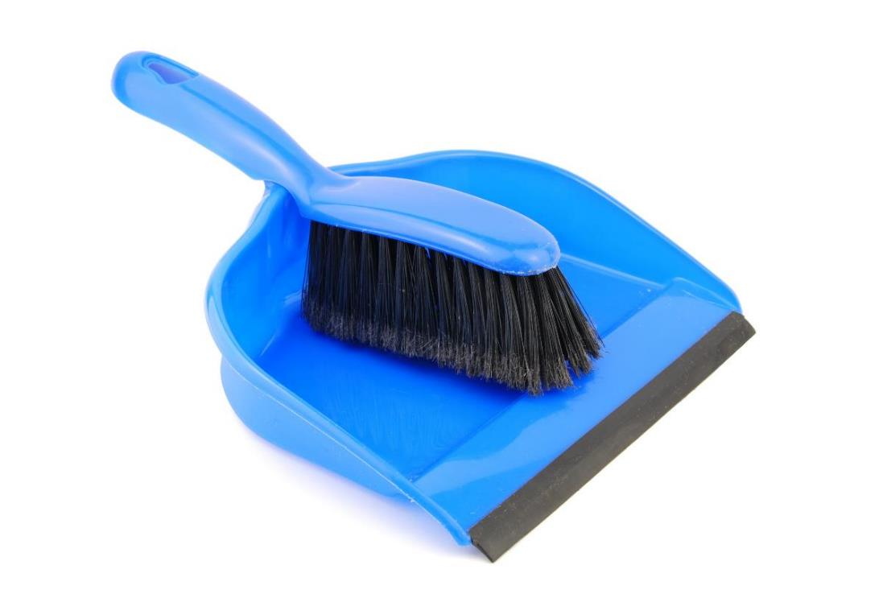
Clean Up
Notes:
You may wish to play a video or song during clean up time.
Link on GoNoodle: https://family.gonoodle.com/activities/clean-up
Link on YouTube Kids: https://www.youtubekids.com/watch?v=ZJFk87ZsHn0
Link on YouTube: https://youtu.be/ZJFk87ZsHn0

Slide 10


LEGO, the LEGO logo, DUPLO and the DUPLO logo are trademarks of the LEGO Group. ©2023 The LEGO Group. All rights reserved. FIRST®, the FIRST ® logo, and FIRST® in SHOWSM are trademarks of For Inspiration and Recognition of Science and Technology (FIRST). LEGO® is a registered trademark of the LEGO Group. FIRST ® LEGO® League and MASTERPIECESM are jointly held trademarks of FIRST and the LEGO Group. ©2023 FIRST and the LEGO Group. All rights reserved.

