Slide 1
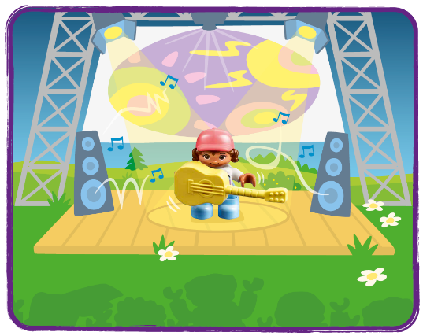
Session 2
Music Concert
Notes:
Session 2: Music Concert
Look at the discussion points in the Explore Task and see how they require different kinds of input from the children as they answer. Find ways to include different levels of questioning in all activities that lead children on their learning paths.

Slide 2
Big Question
What do musicians use to help an audience enjoy a show?
Outcomes
Teams will describe and build a concert stage.
The children will document features of a concert in their Engineering Notebooks.
Notes:
Outcomes
Teams will describe and build a concert stage.
The children will document features of a concert in their Engineering Notebooks.
Facilitator Tip
The Discover Story is found in the Engineering Notebook and on the mat.
Building cards in the Discover set provide visual instructions to make the different parts of the Discover model.

Slide 3
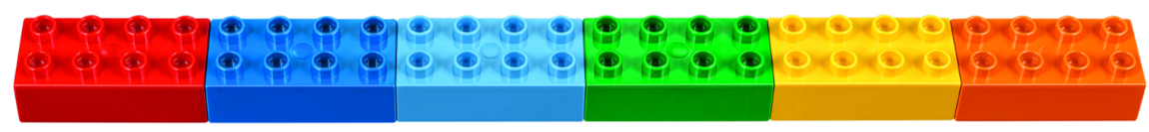
Warm-Up – Six Bricks
Notes:
Warm-Up (10 minutes) Discover Six Bricks II
Base Activity​
Children lay out their bricks in any order (see the picture).​
Then they put a finger on the red brick and move it left.​
They turn the dark blue brick upside down (or on its side).​
Children click the green brick on the red and cover all studs.​
​
Vary the instructions you give such as colors, moving bricks left/right, and positions.​
Guiding Questions
How did you keep attention (encourage some of the children to explain in turn)?​
How can we make this activity harder? (Give more instructions, say them faster…?)

Slide 4
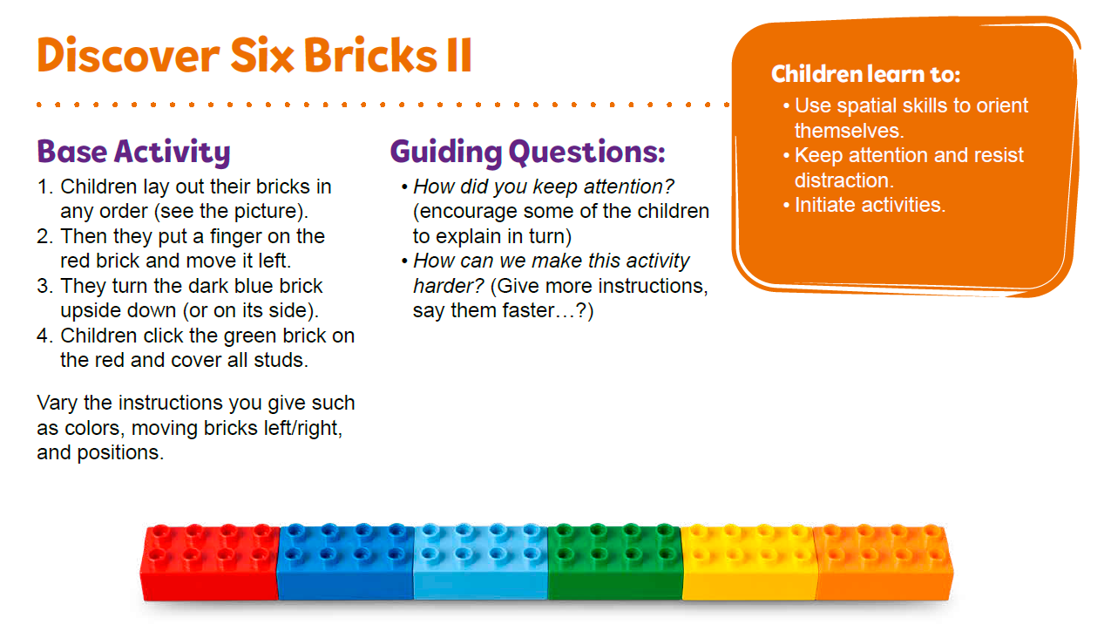
Warm-Up – Six Bricks
Notes:
Facilitator Tip - TMG Appendix (see page 25)

Slide 5
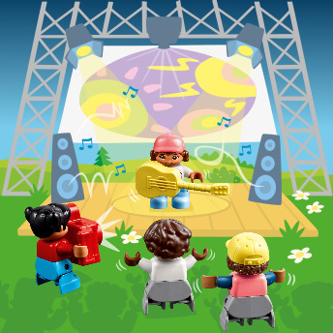
Discover Story
Izzy loves the sounds and lights at the music show.
Notes:
Explore Task (1O minutes)
Explain FIRST® LEGO® League Discover to the children.
Read the Discover Story to the group.
Tell them they will explore how musicians make an exciting concert.
Locate the music elements found on the mat (i.e., music notes, speakers, etc.). What does a musician need to make an entertaining show for the audience?
• Are there special lights on the stage?
• What instruments are used in the performance?
• Does the stage have a video screen?
• Where are the speakers located?

Slide 6
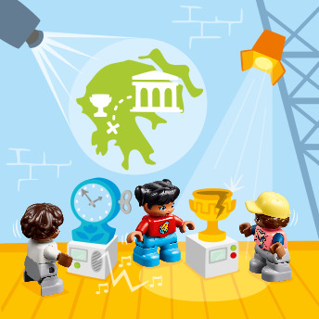
Discover Story
Izzy thinks it’s fun
to learn about art
and history at the
museum.
Notes:
Explore Task (1O minutes)
Explain FIRST® LEGO® League Discover to the children.
Read the Discover Story to the group.
Tell them they will explore how musicians make an exciting concert.
Locate the music elements found on the mat (i.e., music notes, speakers, etc.). What does a musician need to make an entertaining show for the audience?
• Are there special lights on the stage?
• What instruments are used in the performance?
• Does the stage have a video screen?
• Where are the speakers located?

Slide 7
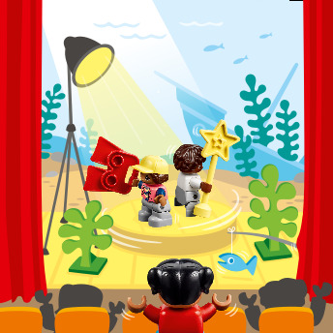
Discover Story
Izzy is amazed as
the stage moves and
turns at the theater.
Notes:
Explore Task (1O minutes)
Explain FIRST® LEGO® League Discover to the children.
Read the Discover Story to the group.
Tell them they will explore how musicians make an exciting concert.
Locate the music elements found on the mat (i.e., music notes, speakers, etc.). What does a musician need to make an entertaining show for the audience?
• Are there special lights on the stage?
• What instruments are used in the performance?
• Does the stage have a video screen?
• Where are the speakers located?

Slide 8
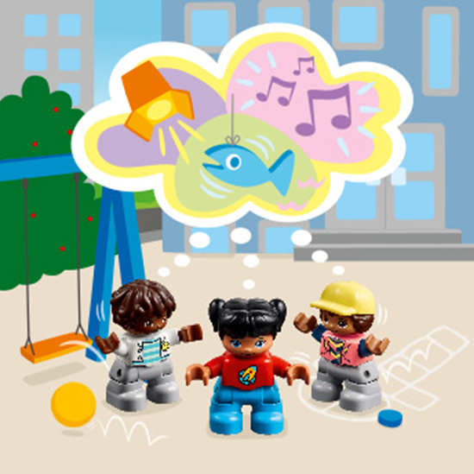
Discover Story
Izzy and her friends
have some great
ideas for their own
show!
Notes:
Explore Task (1O minutes)
Explain FIRST® LEGO® League Discover to the children.
Read the Discover Story to the group.
Tell them they will explore how musicians make an exciting concert.
Locate the music elements found on the mat (i.e., music notes, speakers, etc.). What does a musician need to make an entertaining show for the audience?
• Are there special lights on the stage?
• What instruments are used in the performance?
• Does the stage have a video screen?
• Where are the speakers located?

Slide 9
Explore Task
Locate the music elements found on the mat (i.e., music notes, speakers, etc.).
Notes:
Explore Task (1O minutes)
Explain FIRST® LEGO® League Discover to the children.
Read the Discover Story to the group.
Tell them they will explore how musicians make an exciting concert.
Locate the music elements found on the mat (i.e., music notes, speakers, etc.). What does a musician need to make an entertaining show for the audience?
• Are there special lights on the stage?
• What instruments are used in the performance?
• Does the stage have a video screen?
• Where are the speakers located?

Slide 10
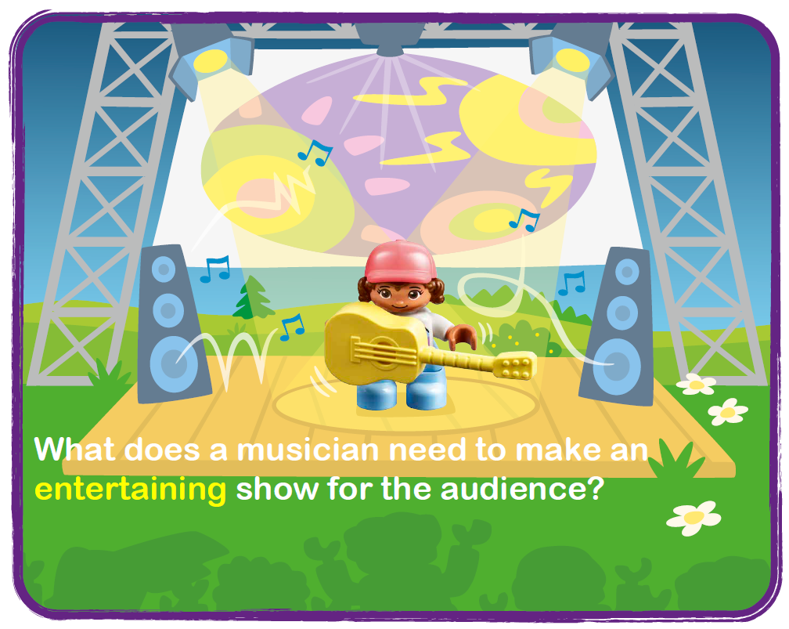
Explore Task
Notes:
Explore Task (1O minutes)
Explain FIRST® LEGO® League Discover to the children.
Read the Discover Story to the group.
Tell them they will explore how musicians make an exciting concert.
Locate the music elements found on the mat (i.e., music notes, speakers, etc.). What does a musician need to make an entertaining show for the audience?
• Are there special lights on the stage?
• What instruments are used in the performance?
• Does the stage have a video screen?
• Where are the speakers located?

Slide 11
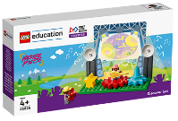
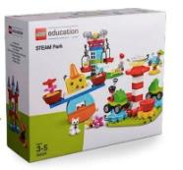
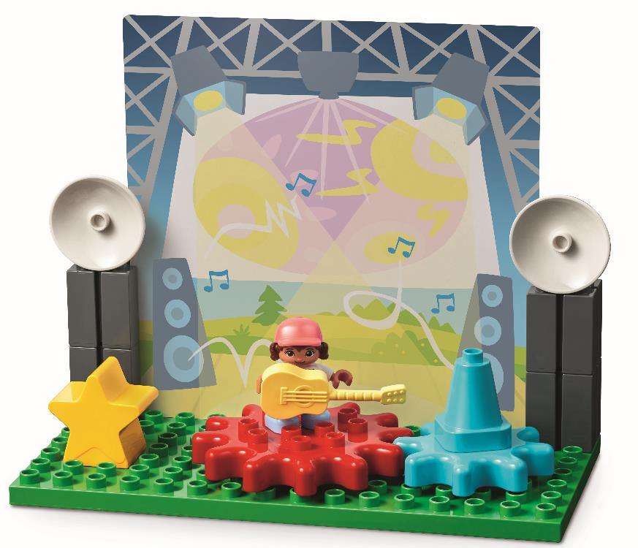
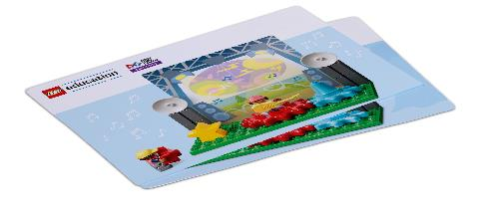
Create Task
You Need..
Build the stage.
Notes:
Create Task (25 minutes)
Have each team build the stage from the Discover set, using the building card. They can place the stage on top of the music area on the mat. Note: If space allows, the stage could remain assembled after this session to be modified in future sessions.
Then, they use the STEAM Park set to build additional effects for their concert or change the type of concert. Have them consider how many performers are on stage, what type of music is playing and where the show is taking place. As with Session 1, encourage them to build freely, using their creativity and imagination to create new amazing designs.
Playful Learning in Action – Teams will apply teamwork and discovery to explore the season topics.
Key Vocabulary – musician, concert, entertain
Facilitator Tip
Building cards in the Discover set provide visual instructions to make the different parts of the Discover model.

Slide 12
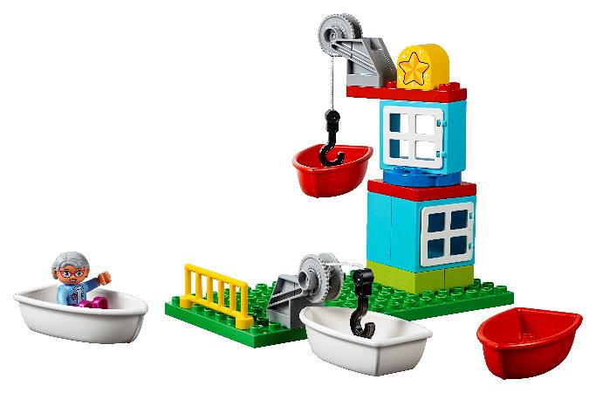
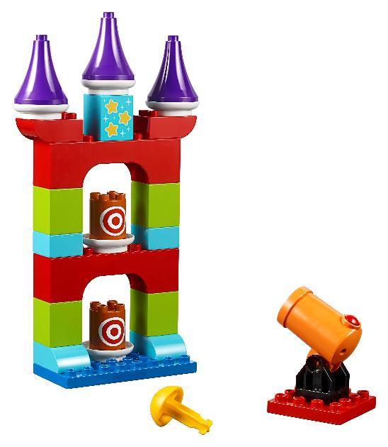
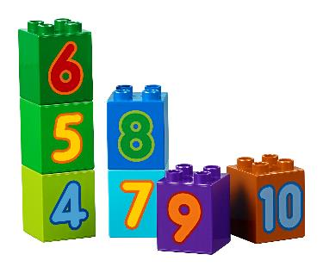
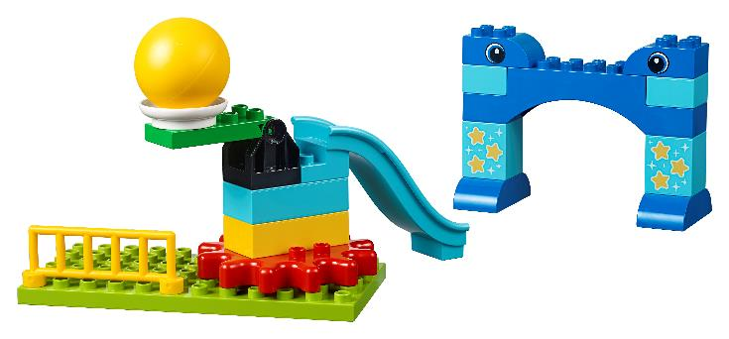
Create Task
Can you build additional effects for the concert?
Notes:
Create Task (25 minutes)
Have each team build the stage from the Discover set, using the building card. They can place the stage on top of the music area on the mat. Note: If space allows, the stage could remain assembled after this session to be modified in future sessions.
Then, they use the STEAM Park set to build additional effects for their concert or change the type of concert. Have them consider how many performers are on stage, what type of music is playing and where the show is taking place. As with Session 1, encourage them to build freely, using their creativity and imagination to create new amazing designs.
Playful Learning in Action – Teams will apply teamwork and discovery to explore the season topics.
Key Vocabulary – musician, concert, entertain
Facilitator Tip
Building cards in the Discover set provide visual instructions to make the different parts of the Discover model.

Slide 13

Playful Learning in Action
Teams will apply teamwork and discovery to explore the season topics.
Key Vocabulary
musician, concert, entertain
Notes:
Create Task (25 minutes)
Have each team build the stage from the Discover set, using the building card. They can place the stage on top of the music area on the mat. Note: If space allows, the stage could remain assembled after this session to be modified in future sessions.
Then, they use the STEAM Park set to build additional effects for their concert or change the type of concert. Have them consider how many performers are on stage, what type of music is playing and where the show is taking place. As with Session 1, encourage them to build freely, using their creativity and imagination to create new amazing designs.
Playful Learning in Action – Teams will apply teamwork and discovery to explore the season topics.
Key Vocabulary – musician, concert, entertain
Facilitator Tip
Building cards in the Discover set provide visual instructions to make the different parts of the Discover model.

Slide 14
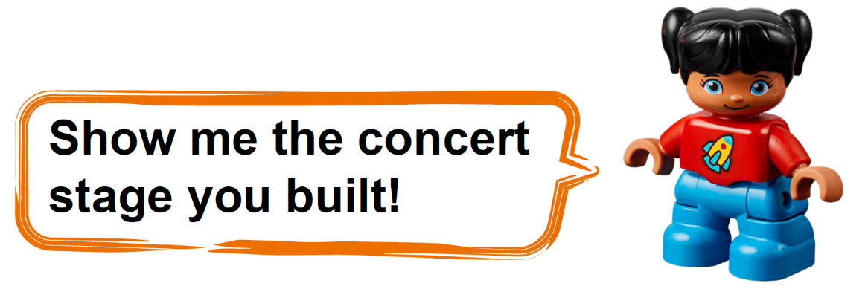
Share Task
Notes:
Share Task – (15 minutes)
In their Engineering Notebooks, have the children write about or draw a picture of their concert. The children could also share and describe what they built.

Slide 15
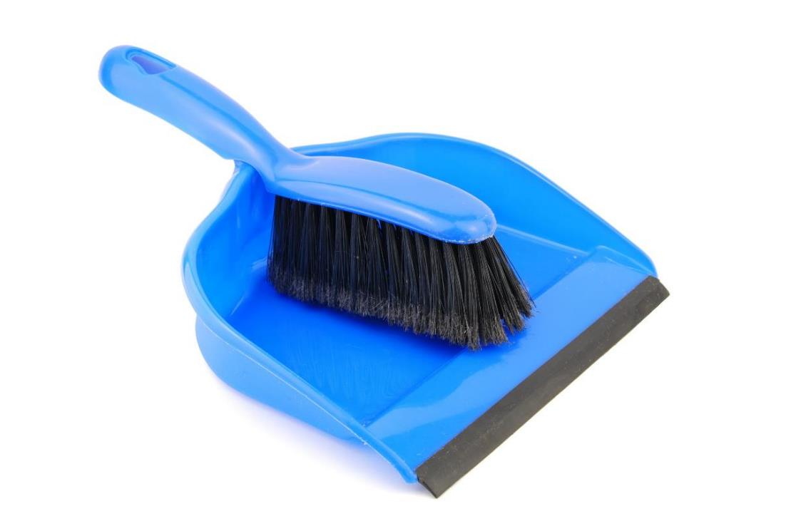
Clean Up
Notes:
You may wish to play a video or song during clean up time.
Link on GoNoodle: https://family.gonoodle.com/activities/clean-up
Link on YouTube Kids: https://www.youtubekids.com/watch?v=ZJFk87ZsHn0
Link on YouTube: https://youtu.be/ZJFk87ZsHn0

Slide 16


LEGO, the LEGO logo, DUPLO and the DUPLO logo are trademarks of the LEGO Group. ©2023 The LEGO Group. All rights reserved. FIRST®, the FIRST ® logo, and FIRST® in SHOWSM are trademarks of For Inspiration and Recognition of Science and Technology (FIRST). LEGO® is a registered trademark of the LEGO Group. FIRST ® LEGO® League and MASTERPIECESM are jointly held trademarks of FIRST and the LEGO Group. ©2023 FIRST and the LEGO Group. All rights reserved.

