Slide 1
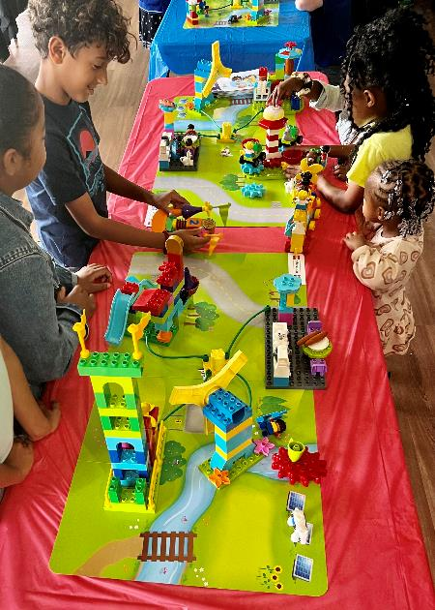
Session 10
Let’s Celebrate
Notes:
Session 1O: Let’s Celebrate
Facilitator Tip
It is important teams can relate what they do at the event to the sessions they have completed.
If possible, assign at least one adult to each pair of teams. They can help the teams stay on task and talk with them. The reviewers will decide on awards for each team. Reviewing questions are on page 24.
For the celebration, print certificates for every child. Have the children come up one at a time, or in their team, to be recognized and applauded. A great FIRST® LEGO® League Discover event always ends in a celebration.

Slide 2
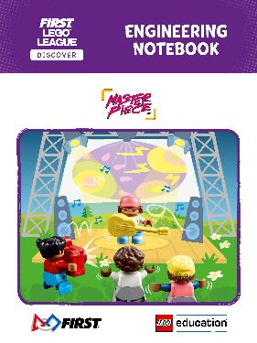
Get Ready
Today we will:
Use our ideas to build a team model.
Share our Engineering Notebooks.
Solve a special challenge.
Have fun!
Notes:
Preparing the Teams (10 minutes)
Welcome the children to the event and tell them what they will do during the session. They will use their ideas to build a model together during the special challenge and share their Engineering Notebooks. The reviewing questions will help ensure teams can relate what they do at the event to the sessions they have completed. . .
Facilitator Tip
It is important teams can relate what they do at the event to the sessions they have completed.

Slide 3
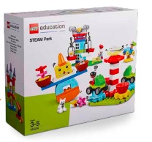
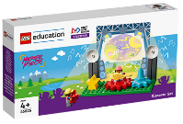
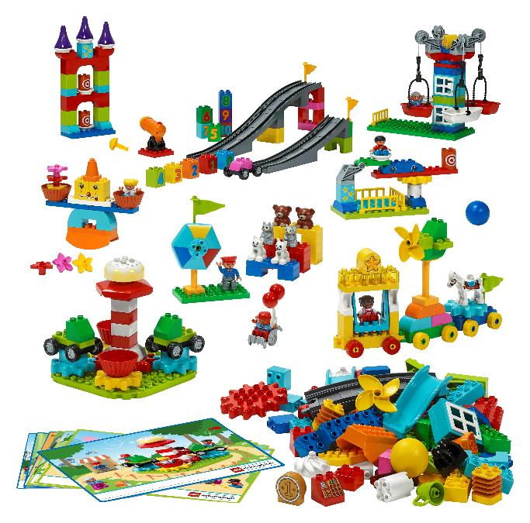
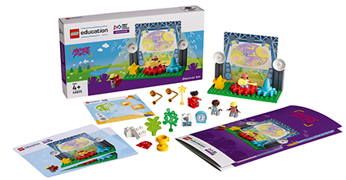
Challenge 1
You Need..
Notes:
Challenge 1 Task (1O minutes)
At the event, challenge the teams to build their team model on the Discover mat in 10 minutes or less.
• They should build the place they created in Session 9 to share an interest and include all parts from the Discover set.
• Use STEAM Park pieces to improve the space to make it more exciting and accessible to an audience.

Slide 4
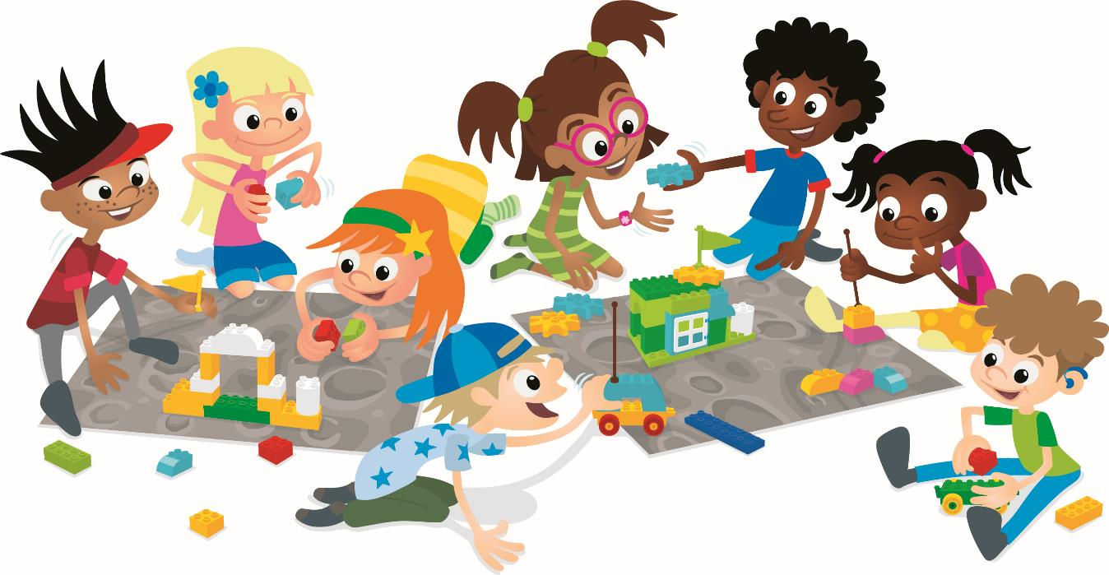
Challenge 2
You Need..
Notes:
Challenge 2 Task (1O minutes)
After 10 minutes, introduce a special challenge and have them update their team model. The challenge for this year is to:
• Create a stage where a skateboarding show could take place.
• Modify your team model so that it includes one or more functional pieces.
• Build a space to entertain a group of alien visitors from another planet.

Slide 5
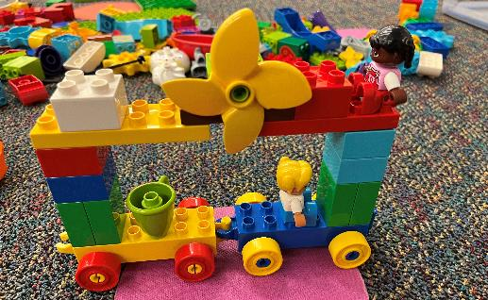
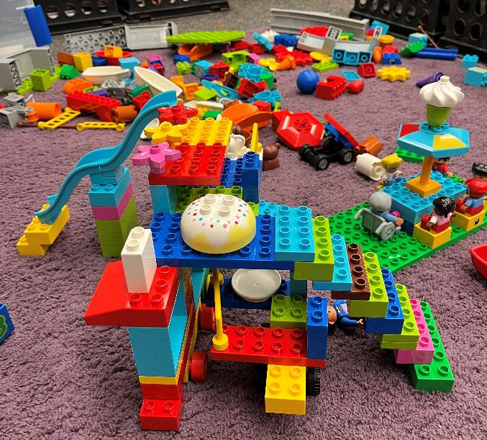
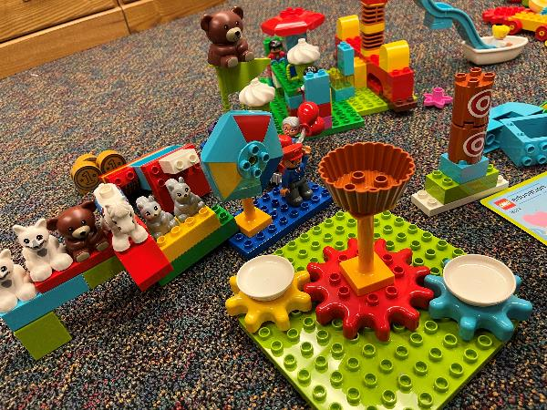
Create Task
What are your favorite parts of your model?
Notes:
Create Task (10+ minutes)
Have each team talk about how they updated their team model for the special challenge. They can describe their favorite parts of the model and explain how they came up with their ideas. If time allows, you can ask teams to iterate on their build after hearing ideas from other teams. Another optional activity could be to ask two or more teams to combine their team models into a larger place.
Reviewing the Teams (during the event)
The reviewers should visit the teams during the final challenge, talking with them, asking questions and seeing their Engineering Notebooks. Encourage the adults to interact with the children. They should ask about what the teams have done throughout the program.
Facilitator Tip
If possible, assign at least one adult to each pair of teams. They can help the teams stay on task and talk with them. The reviewers will decide on awards for each team. Reviewing questions are on page 24.

Slide 6

Celebrate
Notes:
Celebrate (10+ minutes)
While the building, problem-solving, and reviewing are the most important part of how the event works, you should allow plenty of time to celebrate each team’s achievements in front of everyone at the event. You could extend this time and allow time for the children to share and present what they learned.
Facilitator Tip
For the celebration, print certificates for every child. Have the children come up one at a time, or in their team, to be recognized and applauded. A great FIRST® LEGO® League Discover event always ends in a celebration.

Slide 7
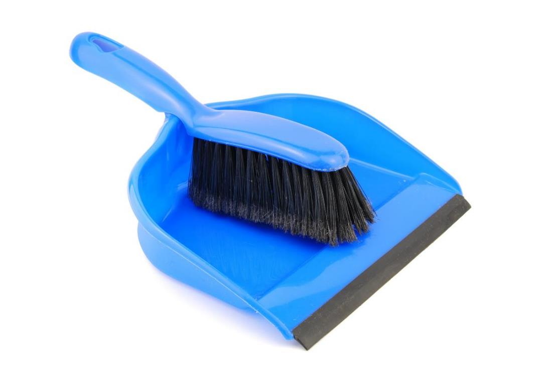
Clean Up
Notes:
You may wish to play a video or song during clean up time.
Link on GoNoodle: https://family.gonoodle.com/activities/clean-up
Link on YouTube Kids: https://www.youtubekids.com/watch?v=ZJFk87ZsHn0
Link on YouTube: https://youtu.be/ZJFk87ZsHn0

Slide 8


LEGO, the LEGO logo, DUPLO and the DUPLO logo are trademarks of the LEGO Group. ©2023 The LEGO Group. All rights reserved. FIRST®, the FIRST ® logo, and FIRST® in SHOWSM are trademarks of For Inspiration and Recognition of Science and Technology (FIRST). LEGO® is a registered trademark of the LEGO Group. FIRST ® LEGO® League and MASTERPIECESM are jointly held trademarks of FIRST and the LEGO Group. ©2023 FIRST and the LEGO Group. All rights reserved.

