Slide 1
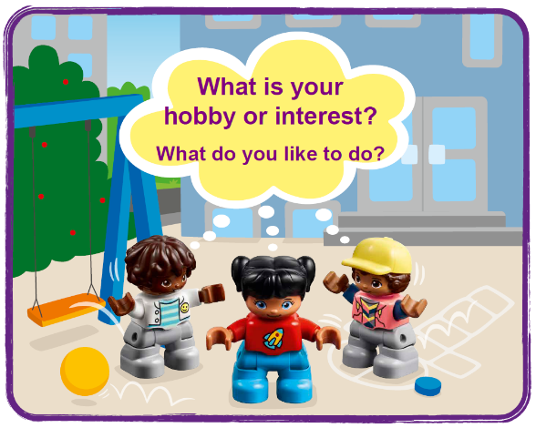
Session 1
Let’s Discover
Notes:
Session 1: Let’s Discover
As you go through these sessions, don’t worry if you don’t know all the answers – and remember, there is no such thing as failure! Also, know that the children will make mistakes and iterate on their designs.

Slide 2
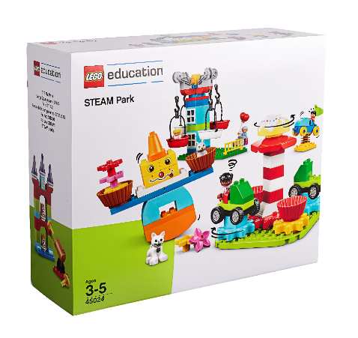
Big Question
What can we build with STEAM Park that helps show what we love to do?
Outcomes
The children will play with STEAM Park, building creatively and trying new things.
The children will identify LEGO® elements that relate to what they care about.
Notes:
Each session has a Big Question that can be shared to frame the session.​
Outcomes
The children will play with STEAM Park, building creatively and trying new things.
The children will identify LEGO® elements that relate to what they care about.
Facilitator Tip
Send home the Discover More game (see page 10) with the Discover More set with each child.
Check out the Functional Elements lesson for examples.

Slide 3
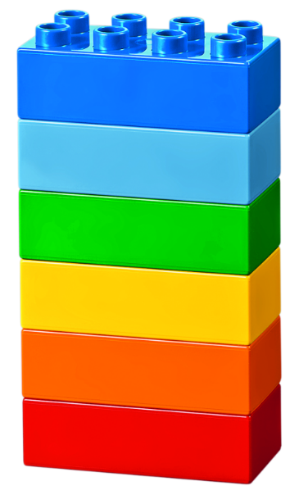
Warm-Up – Six Bricks
Notes:
Warm-Up: (10 minutes) Discover Six Bricks I The children will use the Six Bricks both in the classroom and at home with the Discover More set to learn new skills and explore new ideas.
Base Activity
1. Each child separates his or her bricks and spreads them out.
2. With closed eyes, they shuffle their bricks around.
3. Keeping their eyes closed, each child picks any brick and holds it up high.
4. Now they open their eyes and see what color they hold.
Part 2
5. Let them pick any brick, look at it carefully, and turn it around and over in their hands. Let them pick any brick, look at it carefully, and turn it around and over in their hands.
Guiding Questions:
• What color brick do you have?
• Can you name all the different colors?
• Can you sort the bricks into warm and cold colors?
• Can you create a rainbow with your bricks?
• What color is your brick? How does it feel (rough, smooth, hard, soft, shiny, dull, etc.)?
• What spaces and shapes can you see on your brick? How many studs does each brick have?

Slide 4
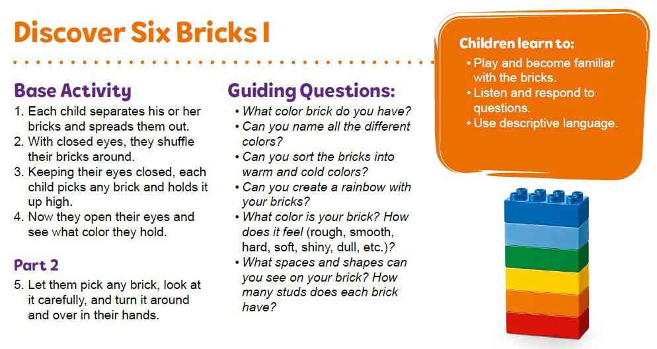
Warm-Up – Six Bricks
Notes:
Facilitator Tip -
Send home the Discover More game (see page 10) with the Discover More set with each child.

Slide 5

Explore Task
Notes:
Explore Task (10 minutes)
Introduce the idea of a hobby or an interest. Have a discussion to discover what the children like to do or what they are interested in and how they share it with others.
Imagine there is a school performance where the children get to choose what to share with the audience.
• What would you perform?
• What would it look like?
• What type of space would you need?
• Who would you like to share with?

Slide 6
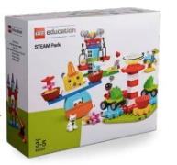
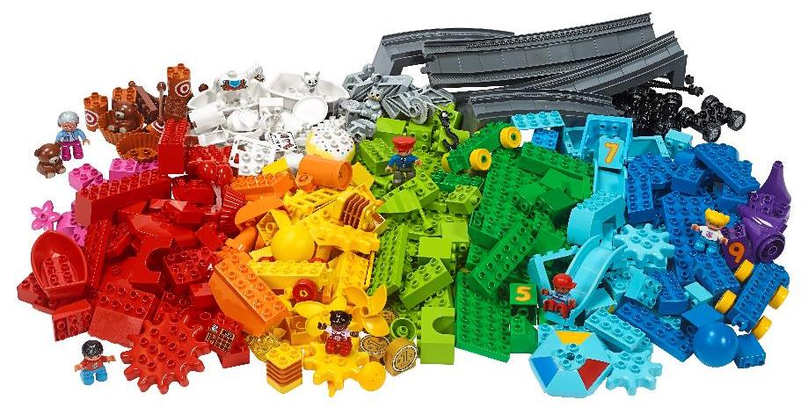
Create Task
You Need…
What can you build?
Notes:
Create Task (25 minutes)
Have the children build using the different pieces in STEAM Park.
Encourage them to play freely and build anything they want that relates to their hobby or interest and how or where it could be shared with others.
Playful Learning in Action – The children will use discovery to explore new ideas with STEAM Park. They will wonder and question what the pieces do.
Key Vocabulary – hobby, performance, audience
Facilitator Tip
Check out the Functional Elements lesson plan - https://education.lego.com/en-us/lessons/preschool-steam-park/functional-elements

Slide 7
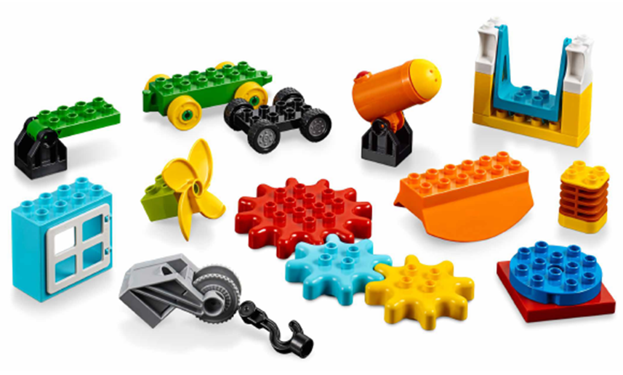
Create Task
Can you build your hobby or interest?
Notes:
Create Task (25 minutes)
Have the children build using the different pieces in STEAM Park.
Encourage them to play freely and build anything they want that relates to their hobby or interest and how or where it could be shared with others.
Playful Learning in Action – The children will use discovery to explore new ideas with STEAM Park. They will wonder and question what the pieces do.
Key Vocabulary – hobby, performance, audience
Facilitator Tip
Check out the Functional Elements lesson plan - https://education.lego.com/en-us/lessons/preschool-steam-park/functional-elements

Slide 8

Playful Learning in Action
The children will use discovery to explore new ideas with STEAM Park. They will wonder and question what the pieces do.
Key Vocabulary
hobby, performance, audience
Notes:
Create Task (25 minutes)
Have the children build using the different pieces in STEAM Park.
Encourage them to play freely and build anything they want that relates to their hobby or interest and how or where it could be shared with others.
Playful Learning in Action – The children will use discovery to explore new ideas with STEAM Park. They will wonder and question what the pieces do.
Key Vocabulary – hobby, performance, audience
Facilitator Tip
Check out the Functional Elements lesson plan - https://education.lego.com/en-us/lessons/preschool-steam-park/functional-elements

Slide 9
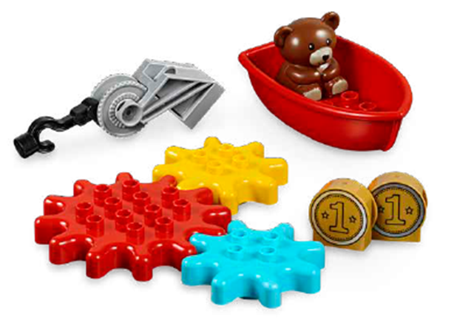

Share Task
Notes:
Share Task – (15 minutes)
Have the children share and explain what they built and how the pieces they identified relate to their interests.
They could share in pairs or in their teams if they aren’t comfortable sharing with entire class.
All the children’s builds will be correct and there is no one right answer to these sessions.

Slide 10

Clean Up
Notes:
You may wish to play a video or song during clean up time.
Link on GoNoodle: https://family.gonoodle.com/activities/clean-up
Link on YouTube Kids: https://www.youtubekids.com/watch?v=ZJFk87ZsHn0
Link on YouTube: https://youtu.be/ZJFk87ZsHn0

Slide 11


LEGO, the LEGO logo, DUPLO and the DUPLO logo are trademarks of the LEGO Group. ©2023 The LEGO Group. All rights reserved. FIRST®, the FIRST ® logo, and FIRST® in SHOWSM are trademarks of For Inspiration and Recognition of Science and Technology (FIRST). LEGO® is a registered trademark of the LEGO Group. FIRST ® LEGO® League and MASTERPIECESM are jointly held trademarks of FIRST and the LEGO Group. ©2023 FIRST and the LEGO Group. All rights reserved.

