Slide 1
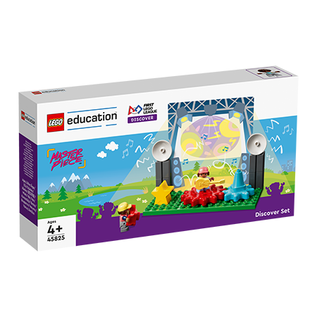
INTRODUCTION
Let’s Get Started
Notes:
Discover and Explore!
Welcome to MASTERPIECE! The children will explore how people share what they love to do with others. They will learn about the different places where ideas are shared, who they are shared with, and the people behind the scenes that make experiences happen.
Build and Create!
The children will build a stage that can be used to host a music concert or theatrical performance, or to display an object in a museum. They will use elements from the STEAM Park set to build their ideas. They will create their own place to share their interests and will consider the audience. They will test and improve their designs and creations.
Share!
The children will record their ideas and designs in their Engineering Notebooks. They will share their builds and what they learned with others. Finally, they will participate in the celebration event, to which you can invite their families and friends. Most importantly they will have fun!

Slide 2
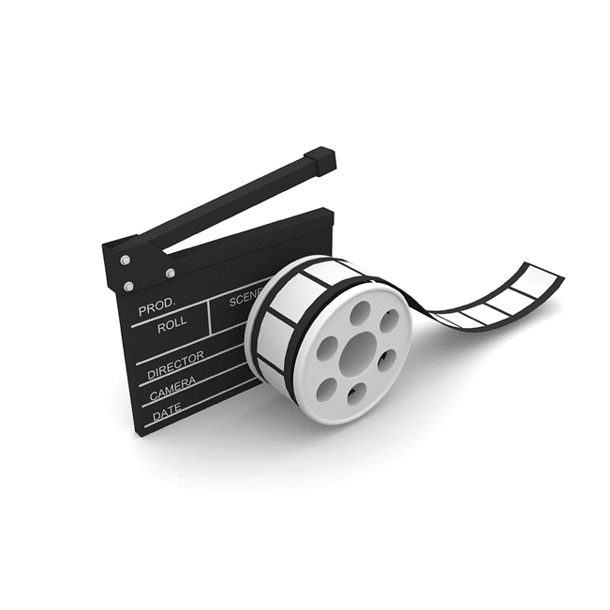
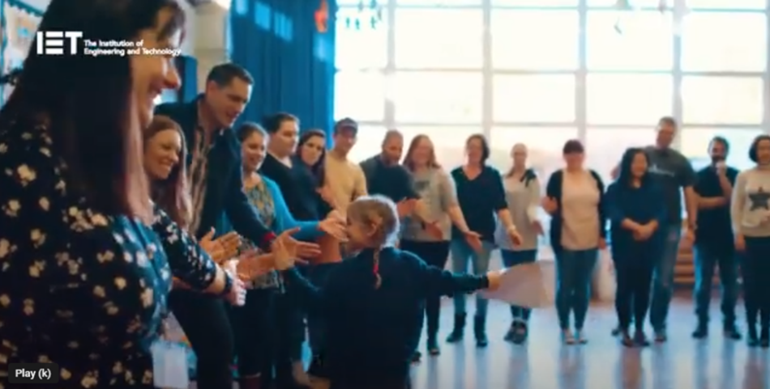
What is FIRST® LEGO® League Discover?
Notes:
Watch video - What is FIRST LEGO League Discover? – 2:51 mins – https://www.youtube.com/watch?v=Y_8xKTQFFHY
FIRST LEGO League Discover is a global STEM program for children and young people aged 4-6.
The IET are proud to be the delivery partners for FIRST LEGO League in the UK and Ireland, because FIRST LEGO League is the perfect program to start young people thinking about engineering as a potential career path.

Slide 3

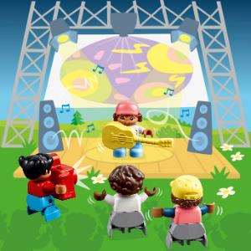
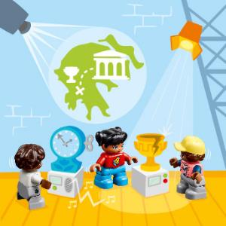
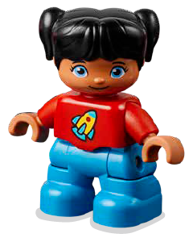
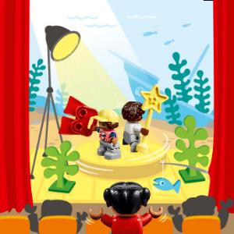
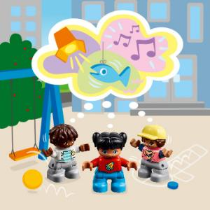
Izzy loves the sounds and lights at the music show.
Izzy thinks it’s fun to learn about art and history at the museum.
Izzy is amazed as the stage moves and turns at the theater.
Izzy and her friends have some great ideas for their own show!
Notes:
Discover Story - (TMG page 5)

Slide 4
Each Session has…
Big question
Six Bricks Warm-Up
Explore Task
Create Task
Share Task - with your classmates or in your Engineering Notebook
Clean Up
Notes:
Big question: Each session has a Big Question that can be shared to frame the session.​
Six Bricks Warm-Up: Every session has a short warm-up activity using the six bricks sets.
Explore Task: The sessions start with a task to help students learn about the topic.
Create Task: Students will create builds during each session.
Share Task with your classmates or in your Engineering Notebook: Students share their work by either showing and explaining their builds or completing a task in their Engineering Notebook.
Clean Up: Take time during each session to have the students clean up and put away the materials.

Slide 5
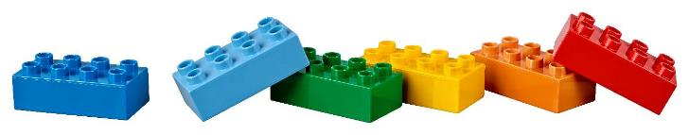
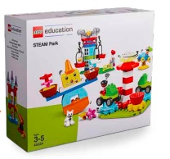
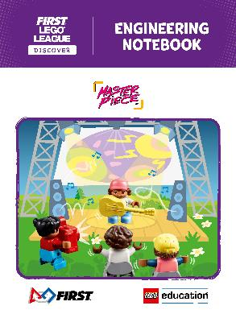
You will use…
Six Bricks
Discover Set
Engineering
Notebook
Discover Mat
STEAM Park Set
Notes:
Discover Set with Mat and Six Bricks
The Discover set consists of the Discover model, LEGO® DUPLO® figures, Six Bricks sets, mat, and building cards. The Discover model is intended to help children connect to the theme and provide a starting point for discussions and further building. The mat is used as a collaboration space to bring the models together. Each Discover set includes five sets of Six Bricks for use in the classroom. There are enough sets to give one to each child, plus one for the teacher. Each child will need one of each of the six colored bricks. The Six Bricks in this set are in addition to the Six Bricks in the Discover More set that goes home.
Engineering Notebook
You will receive a set of Engineering Notebooks, which provide a place for children to record ideas and drawings. There is one page to fill in for every other session. Provide one notebook to each child.
LEGO® Education STEAM Park Set
All teams will use the STEAM Park set to explore STEM concepts and form the basis of their team model. This set will be used throughout sessions, as well as at the celebration.
There is also a STEAM Park Teacher Guide that contains lesson plans as well as other ideas and inspiration.
STEAM Park Teacher Guide PDFs – https://education.lego.com/en-us/product-resources/steam-park/teacher-resources/teacher-guide-pdfs
We suggest pre-teaching the following sessions from the teacher guide if the class or students are new to STEAM Park:
1. Functional Elements
2. Welcome to STEAM Park
3. Gears

Slide 6

MASTERPIECESM
Visit the
FIRST® LEGO® League
YouTube Channel
to watch the
MASTERPIECESM Season Launch Video
Notes:
Watch the MASTERPIECESM Season Launch Video - https://www.youtube.com/c/FIRSTLEGOLeagueofficial

Slide 7


LEGO, the LEGO logo, DUPLO and the DUPLO logo are trademarks of the LEGO Group. ©2023 The LEGO Group. All rights reserved. FIRST®, the FIRST ® logo, and FIRST® in SHOWSM are trademarks of For Inspiration and Recognition of Science and Technology (FIRST). LEGO® is a registered trademark of the LEGO Group. FIRST ® LEGO® League and MASTERPIECESM are jointly held trademarks of FIRST and the LEGO Group. ©2023 FIRST and the LEGO Group. All rights reserved.

