Slide 1

DISCLAIMER
This presentation is designed for event referee training only. It should not be used as a reference for field setup or scoring at events.
Referees must review all official sources of information, including the Robot Game Rulebook, Robot Game Missions Video, Field Setup Video, and Challenge Updates.
Highlighted content should be updated by the Head Referee with event-specific information.

Slide 2


Slide 3



Referee Training

Slide 4
About the Season
This season, FIRST teams and supporters will take inspiration from the natural world and from one another.
Using STEM, teamwork, and creativity, participants will explore how innovation can support biodiversity, strengthen communities, and help build a healthier, more connected planet. Together, we can learn from nature and design a thriving future for our shared home.

Slide 5
Referee Training Agenda
Referee Role & Core Values
Referee Toolkit
Match Overview
Game Missions
Challenge Updates
Reminders

Slide 6
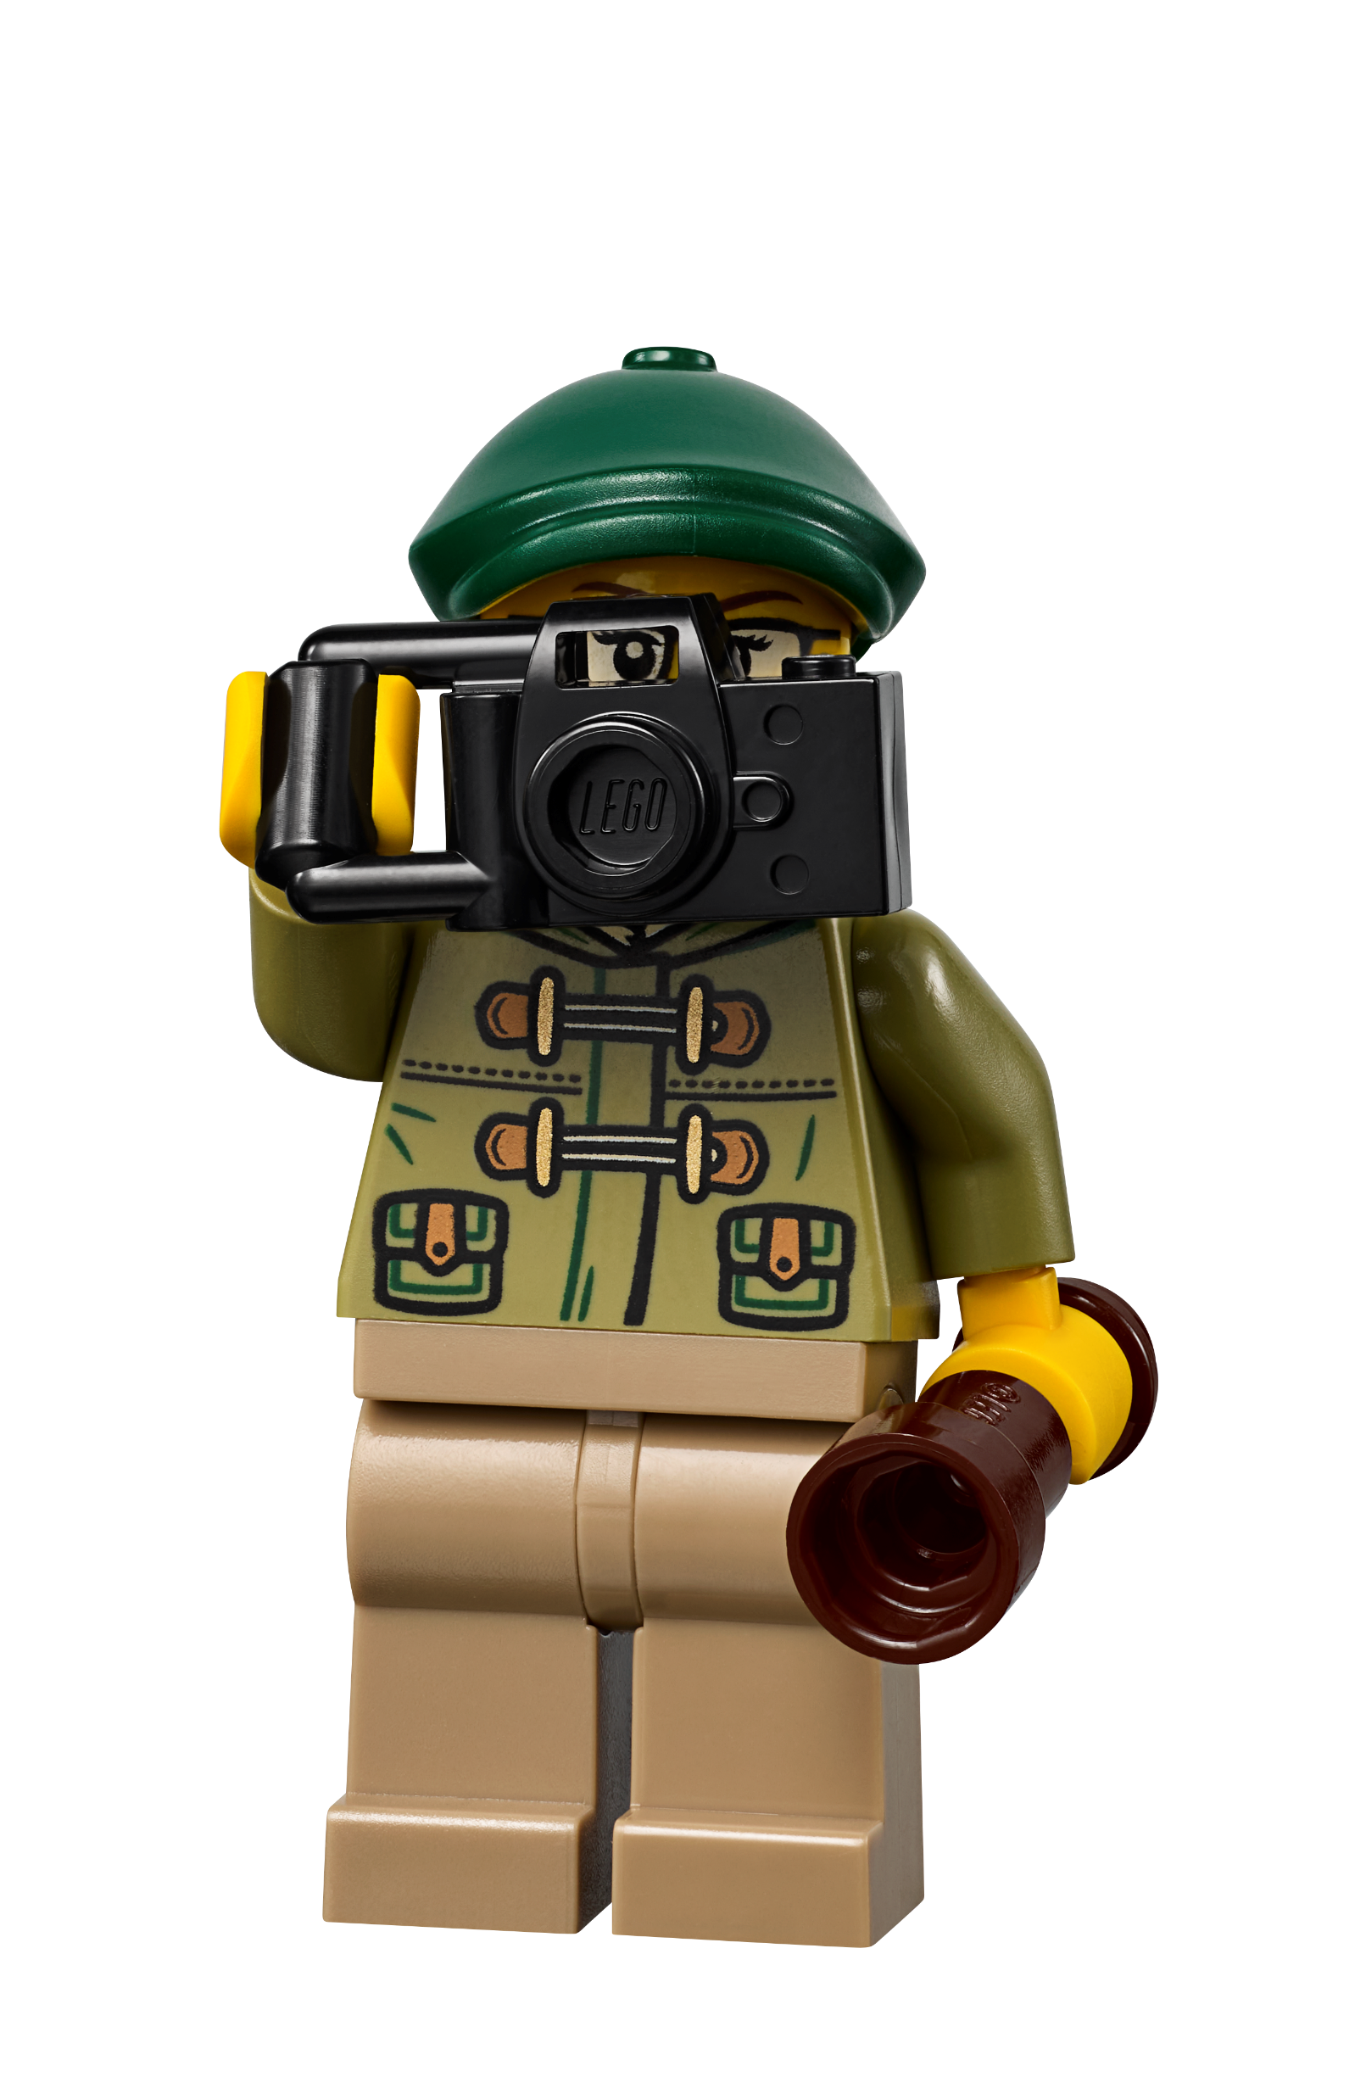
The Referee Role
Regulate the action and fairness of the robot game
Score matches together with the team
Be a kind, encouraging role model
Demonstrate Gracious Professionalism® and FIRST® Core Values in everything you do
Be familiar with referee toolkit

Slide 7






FIRST® Core Values

Slide 8

The Referee Toolkit
At the table, you will need:
Robot Game Rulebook
Challenge Updates
Scoresheet (paper or digital)
Field Setup Video (or printed reference guide)
Measuring device for equipment inspection (ruler or clipboard)

Slide 9
Match Overview
Team Arrives
Equipment Inspection
Match Setup
Play Match
Scoring
Team Leaves
Reset Table
  2.5-minute match timer starts with a countdown​

Slide 10
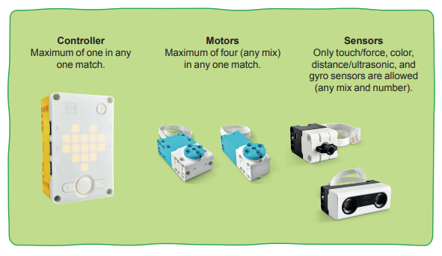
Before the Match – Equipment Inspection
Equipment: All items that teams bring to the match, including the robot, attachments, and any other materials specified in the rules.
Only LEGO parts allowed
Check equipment and quantities during pre-match inspection
All equipment must fit in both launch areas and under a height limit of 12-inches
Additional or duplicate mission models are not allowed
Extra storage not allowed (carts, bins, etc.)
See Glossary; Rules – Before the Match for a complete list of allowed equipment

Slide 11
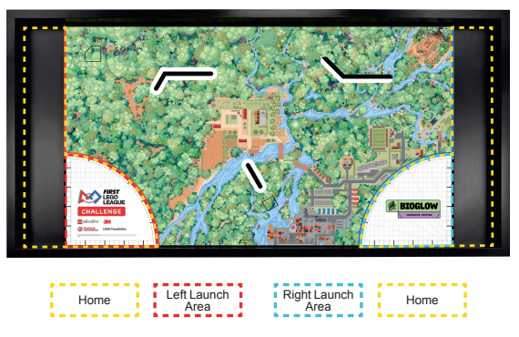
Before the Match – Setup
After inspection, teams should distribute equipment and ask final questions, then get in position for the match with no more than two technicians at each side of the table.
Referee should stand in the middle, at the bottom of the table.
See Glossary; Rules – Before the Match for more details

Slide 12
During the Match – Inside Home
Technicians may use their hands to handle the robot, equipment, and mission models when these items are completely within their respective home area.
When launching, make sure technicians are not keeping anything from moving and that the robot and anything it is about to move fit completely inside the launch area.
  Launch: The act of activating the robot from rest when completely within its designated launch area to cause it to move autonomously.
See Glossary; Rules – During the Match for a complete list of rules that apply

Slide 13
During the Match – Outside Home
If technicians interrupt the robot, it must be relaunched.
If the team interrupts the robot, ask yourself:
  Where was the robot when interrupted: partly outside, or fully outside home?
  Was it touching a mission model?
  Had it obtained something after launch?
  What should happen to the robot and/or items it is in contact with? (See Rule #15)
If an object is dropped by the robot, ask yourself:
  Where did the item come to rest: partly outside, or fully outside home?
  What should happen to that item? (See Rule #17)
Teams may not interrupt their robot in such a way that they earn points from it.
See Rules – During the Match for a complete list of rules that apply

Slide 14
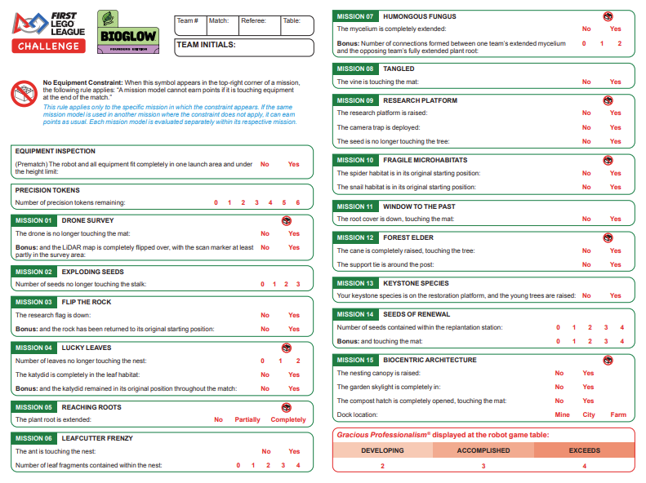
After the Match – Scoring
Complete the scoresheet together with the team and have team members sign off on the scoresheet before they leave
For scoring, all mission requirements must be visible at the end of the match unless a method was required in the mission (Robot Game Rulebook blue text)
If you need help with scoring a mission, call your head referee
When in doubt, give benefit of the doubt
See Rules – After the Match for more details

Slide 15
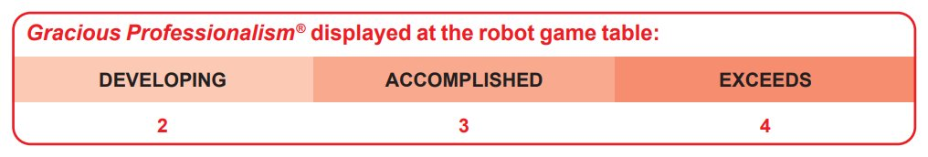
Gracious Professionalism® at the Robot Game
Make sure to fill out the team’s Gracious Professionalism® score for each match – these contribute to the team’s Core Values score (25% of Champion’s score)
Teams who do not show for their match will score 0 points
Teams who show up and do not run their robot can still earn 2, 3, or 4 points depending on the Gracious Professionalism® they demonstrate

Slide 16
Robot Game Missions
Watch the Robot Game Missions Video

Slide 17
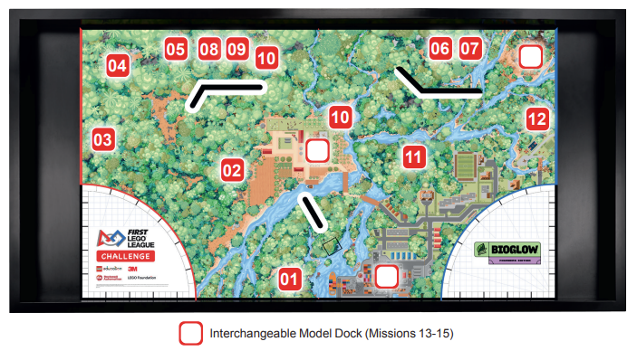
Mission Model Placement
Check that all models are in the correct setup position before the start of each match.
Mission 04 has elements that are randomized.
Teams choose which dock to place Missions 13-15 models.

Slide 18
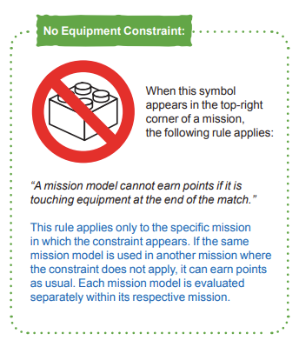
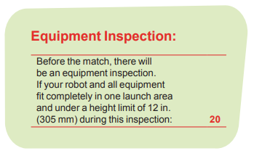

Slide 19
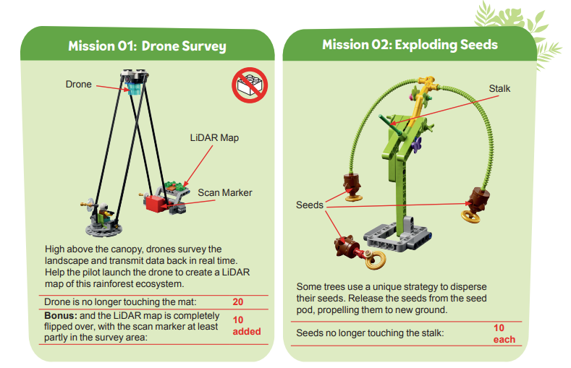

Slide 20
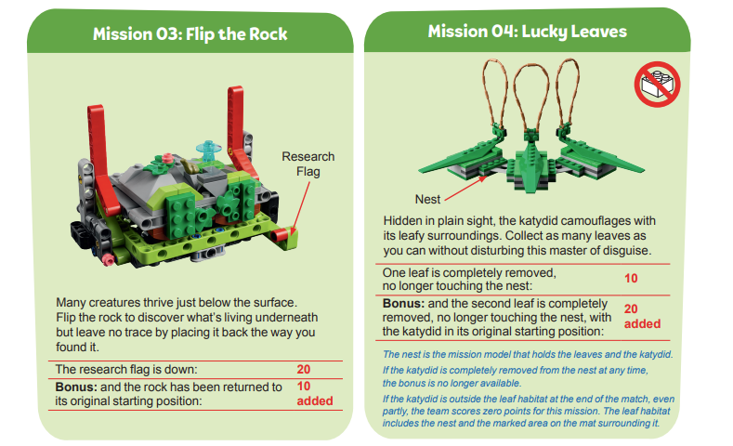

Slide 21
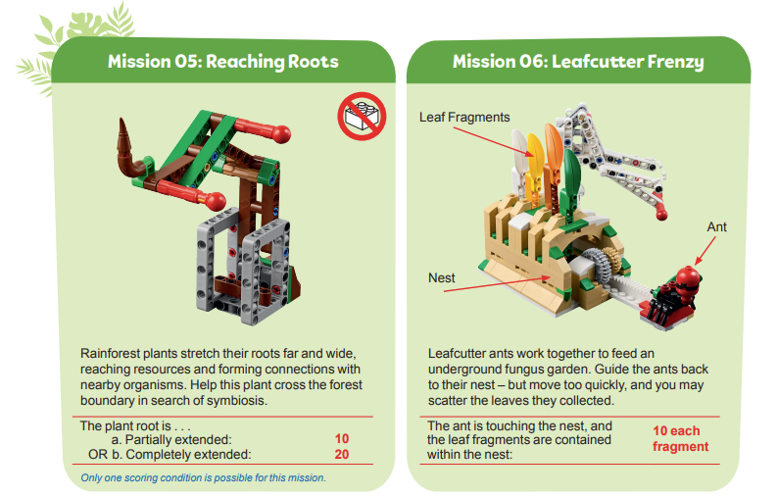

Slide 22
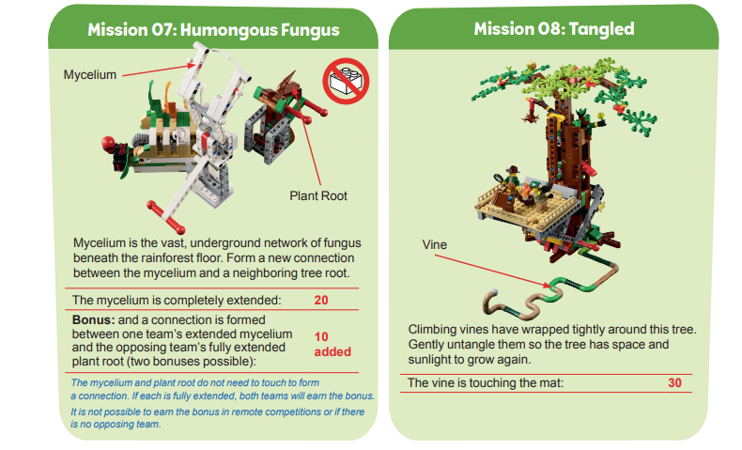

Slide 23
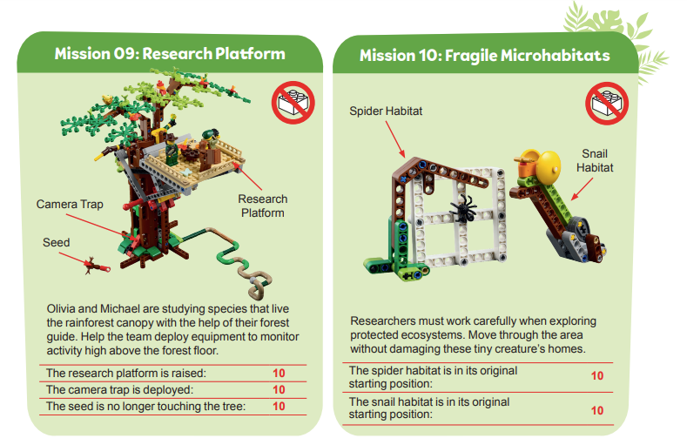

Slide 24
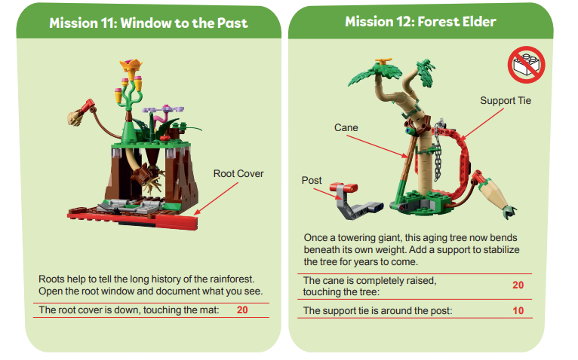

Slide 25
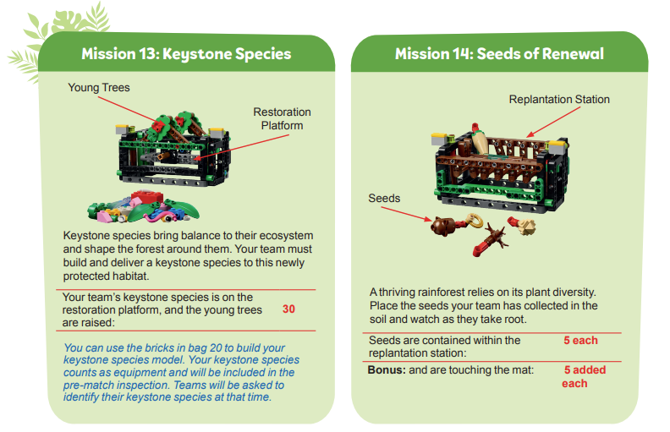
New this year!
Missions 13-15 use an interchangeable dock system
Teams choose which dock (Mine, City, or Farm) to place the model in before the match begins
The Field Setup video shows how to place these models

Slide 26
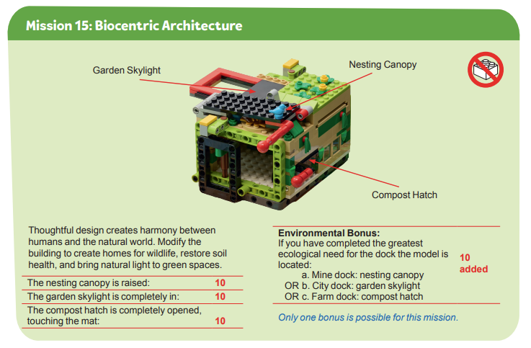
New this year!
Missions 13-15 use an interchangeable dock system
Teams choose which dock (Mine, City, or Farm) to place the model in before the match begins
The Field Setup video shows how to place these models

Slide 27
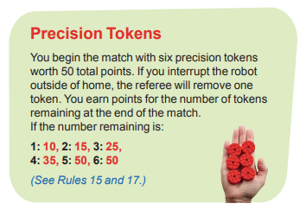
Precision Tokens
Find a convenient place to store precision tokens during the match that is visible to the team
Interruption: Any interaction by technicians with the robot or objects in contact with the robot after it has been launched (See Glossary)
See Rules – During the Match for a complete list of rules that apply during the match

Slide 28
Challenge Updates
Download and share the most recent version of the Challenge Updates document with referees at your event.

Slide 29

Challenge Updates – updated throughout the season
Challenge Updates supersede what is written in the Robot Game Rulebook or shown in official videos.
Review the most recent version of the Challenge Updates from the Season Resources page.

Slide 30
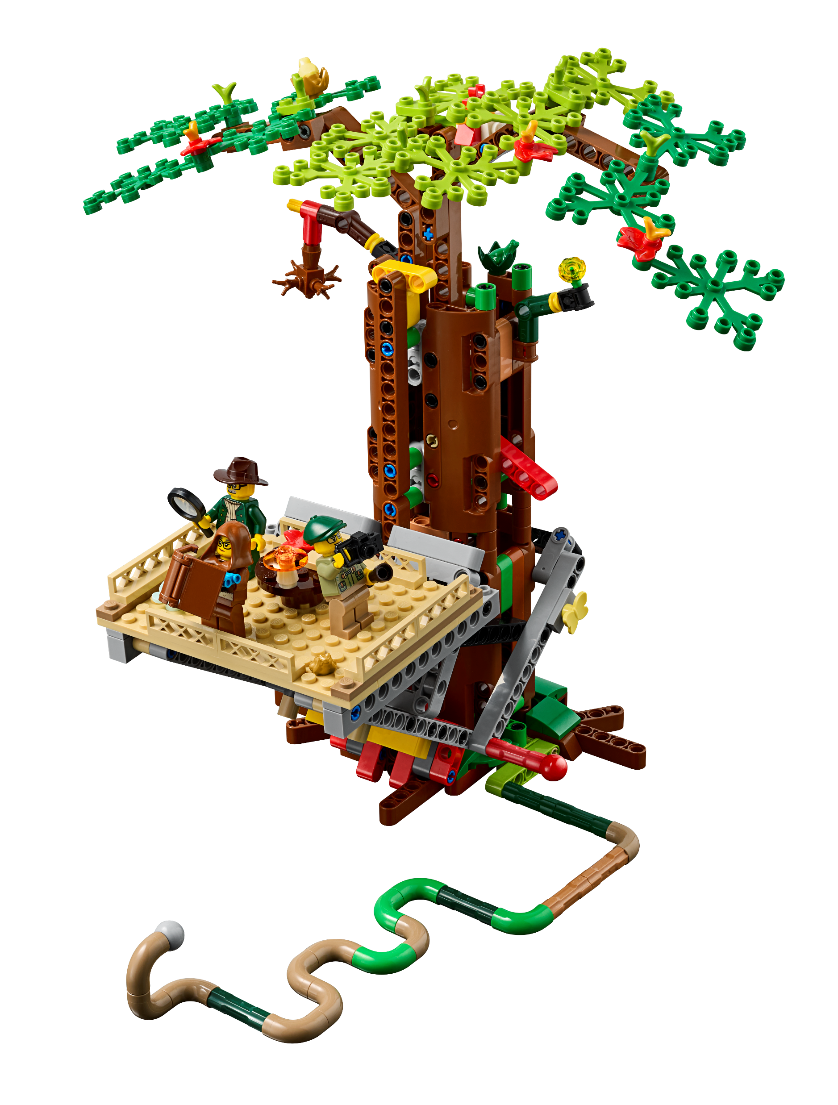
Remember:
The goal of the day is to CELEBRATE all the team has achieved, no matter the points they score
Your head referee is here to help
When in doubt, give benefit of the doubt

Slide 31
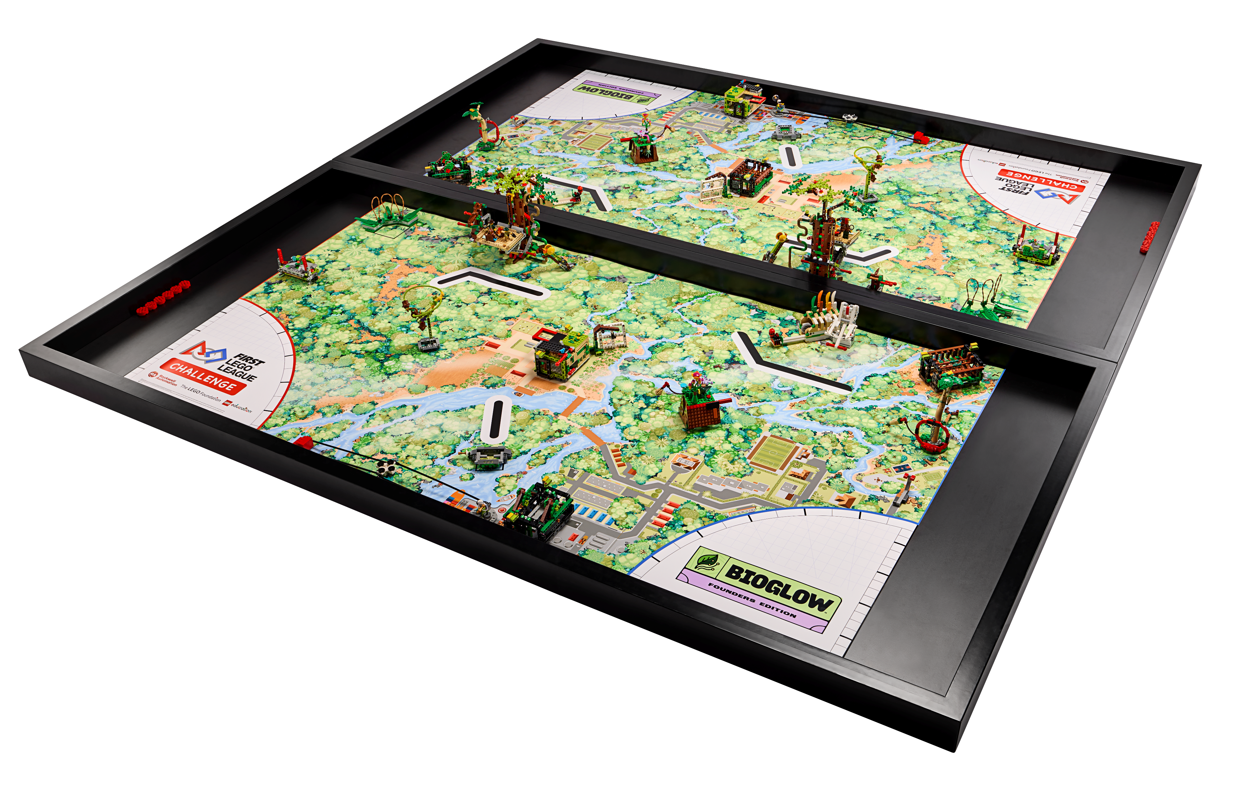
Mission or Rule Questions?
Remember, this is a high-level overview of the BIOGLOWTM Robot Game and rules.
Be sure to review the Robot Game Rulebook, official videos, and Referee Guide & Quiz for detailed guidance.

Slide 32
Event Day Information
On the following slides, you may add event-specific information such as referee table assignments, schedules and breaks, etc.
Edit or delete these slides if not used.

Slide 33
Table Assignments
Table | Referee | Field Resetter
# | Name | Names
# | Name | Names
# | Name | Names
# | Name | Names

Slide 34
Event Schedule
Add event/match schedule information here

Slide 35
Questions?

Slide 36
Thank you for being a FIRST® LEGO® League Challenge referee!

