Slide 1

DISCLAIMER
This presentation is designed for judge training and follows the format of the Judge Training Script. Judge Advisors should review the slides before presenting and update information about your event to address the needs of your volunteers.
Highlighted content should be updated by the Judge Advisor with event-specific information.

Slide 2


Slide 3



Judge Training

Slide 4
Judge Training Agenda
Season Overview
The Judge Role
Event Information
The Judging Session
Completing the Rubrics
Awards and Ceremony
Questions

Slide 5
About the Season
This season, FIRST teams and supporters will take inspiration from the natural world and from one another.
Using STEM, teamwork, and creativity, participants will explore how innovation can support biodiversity, strengthen communities, and help build a healthier, more connected planet. Together, we can learn from nature and design a thriving future for our shared home.

Slide 6
The Judge Role
Friendly and welcoming to all teams
Positive and reassuring throughout the judging session
Listen actively and ask questions after the team’s presentation
Familiar with contents of judging toolkit
Complete rubrics with feedback from all judges in your pod
Give positive and constructive feedback verbally and on the rubric

Slide 7



Challenge Materials
Guidebooks provide the challenge for the season
Teams also receive:
  Rubrics​
  Session Flowchart​
  Awards List​
  "Preparing for Your Event" video

Slide 8
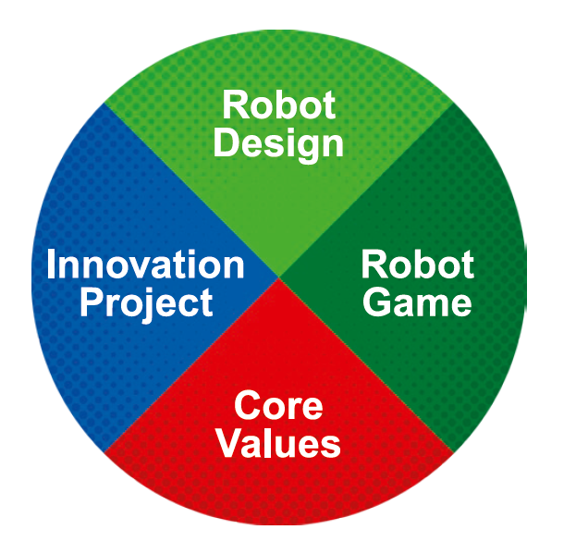
Team Expectations at the Event
3 official Robot Game matches
30-minute judging session to present their Innovation Project and their Robot Design
Core Values should be evident in everything the team does
Each area is weighted 25% of a team's Champion's Score

Slide 9
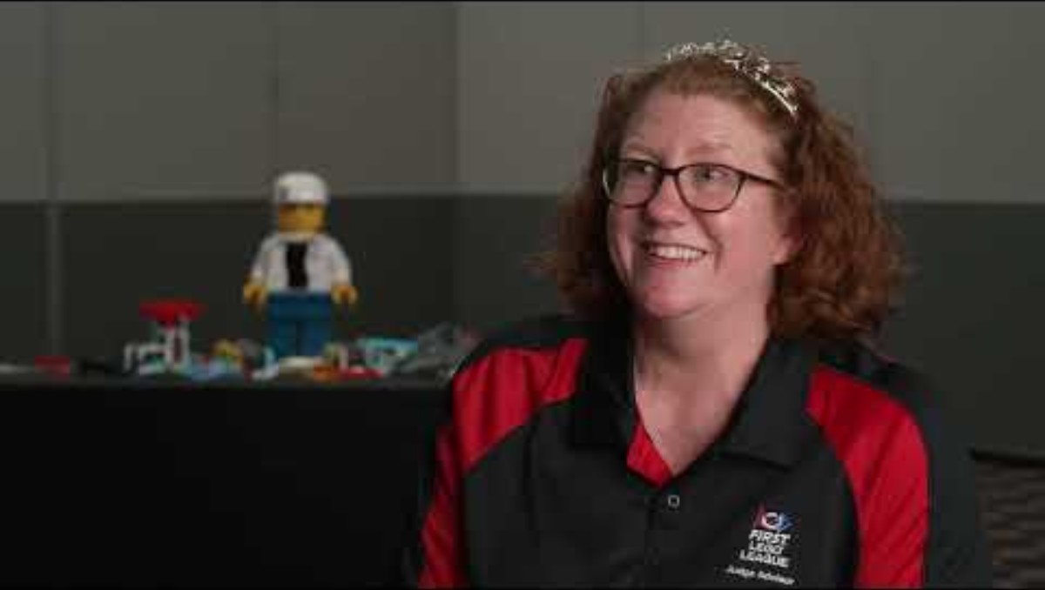
Spotlight on Judging
Spotlight on Judging (3:14) - https://www.youtube.com/watch?v=m3AwgIMWA9s

Slide 10






FIRST® Core Values

Slide 11
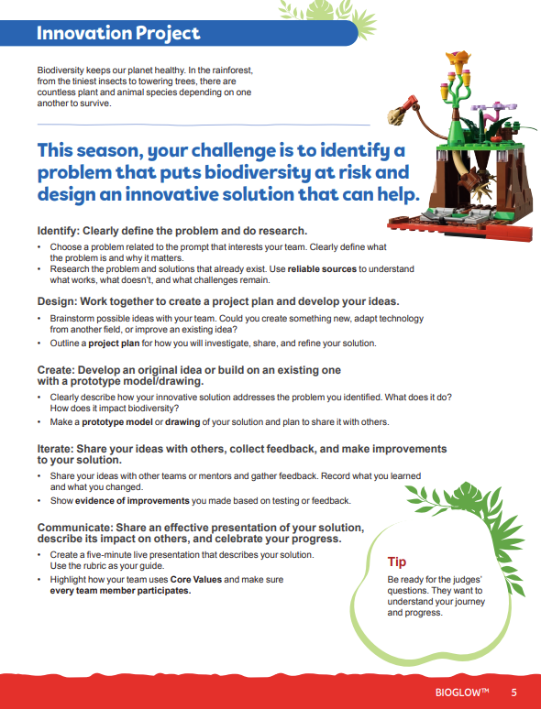
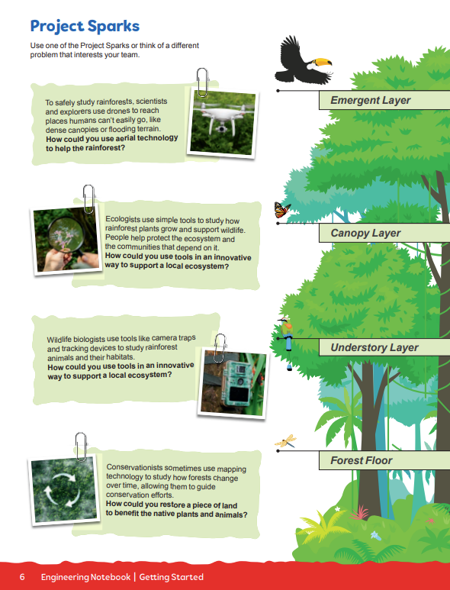
Innovation Project
…identify a problem that puts biodiversity at risk and design an innovative solution that can help.
More information on pages 5-6 of the Engineering Notebook.

Slide 12
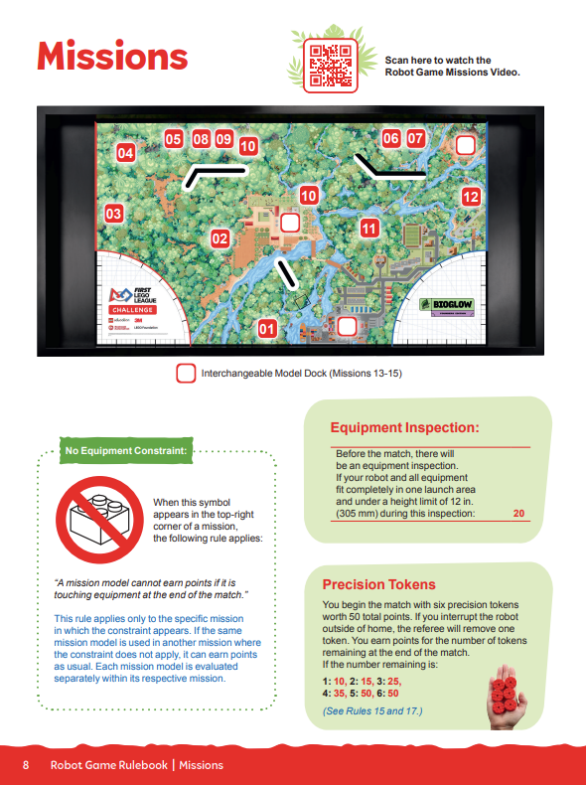
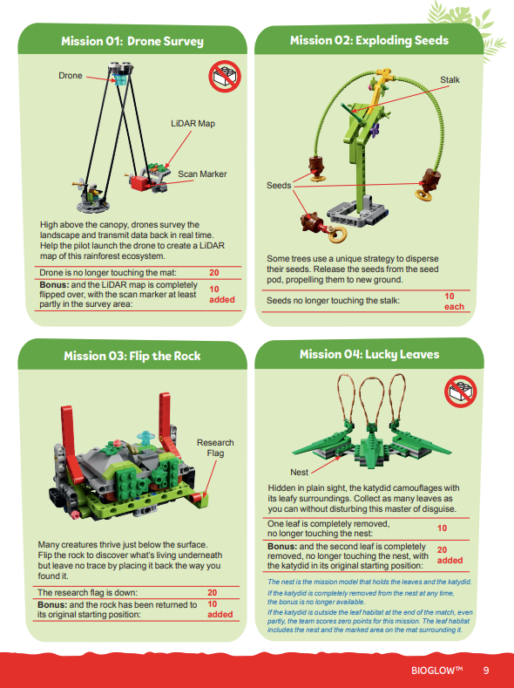
Robot Design
…build and code a robot to complete missions during a 2.5-minute match.
More information on pages 8-13 of the Robot Game Rulebook.

Slide 13
Event Day Information
On the following slides, you may add event-specific information such as judging pod/room assignments, schedules and breaks, etc.
Edit or delete these slides if not used.

Slide 14
Judging Pod Assignments
Pod | Lead Judge | Judges
# | Name | Names
# | Name | Names
# | Name | Names
# | Name | Names

Slide 15
Event Schedule
Add event/judging schedule information here

Slide 16
Judging Session & Materials

Slide 17
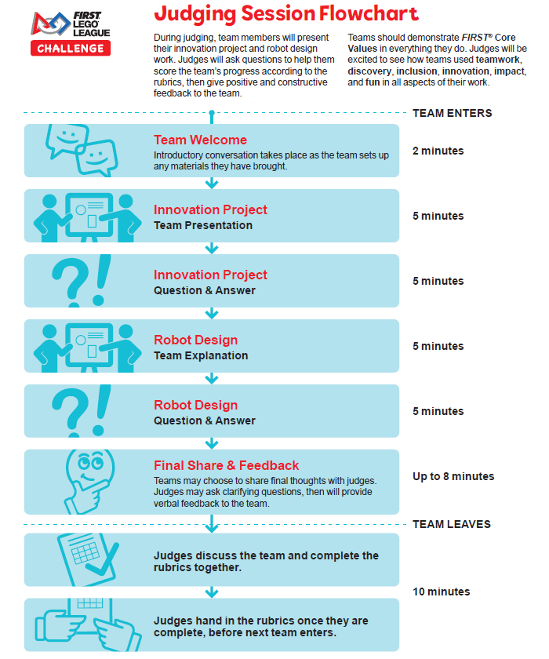
The Judging Session
Follows the flowchart that has been shared with teams
Each pod has a lead judge
Gently remind teams to wrap up if they go over time
Work together to complete rubrics
Use the Judging Session Script and Questions document to guide your conversations

Slide 18
Rubrics
Review all rubric criteria prior to judging teams
Score teams against rubric criteria, not against other teams
  Check only one score per row, no half scores
Complete one set of rubrics (3 pages) per team and return to Judge Advisor
  Rubrics may be paper or digital
Completed rubrics are returned to coaches following the event
You may want to take notes on each team in case you are asked to provide context during the award allocation process

Slide 19
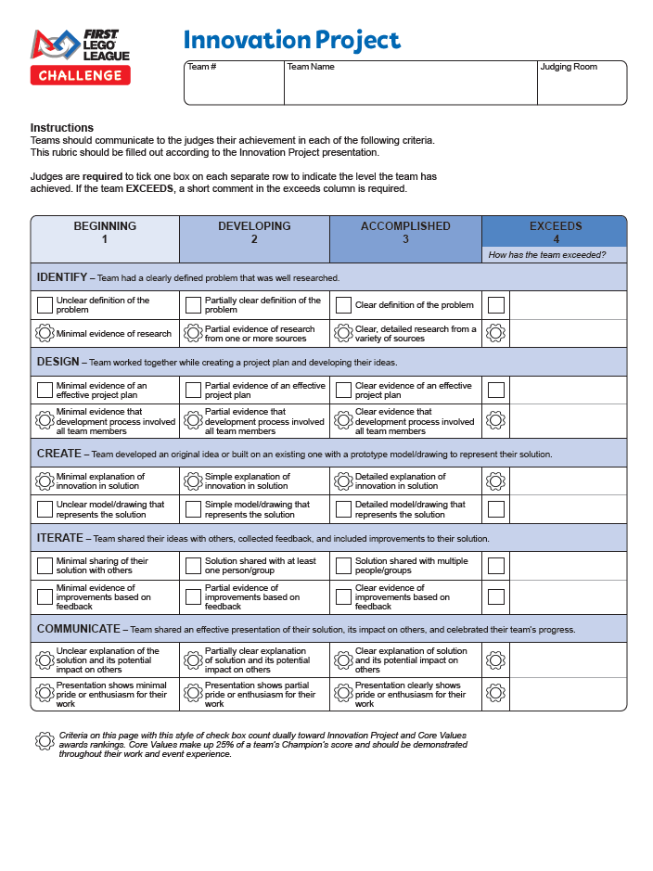
Innovation Project Rubric
Evaluate the process, not the product
Only consider what is shared during the judging session when scoring
Criteria must be fully met (a strong 2 is not necessarily a 3)
Criteria with gear-shaped icons count dually toward Core Values

Slide 20
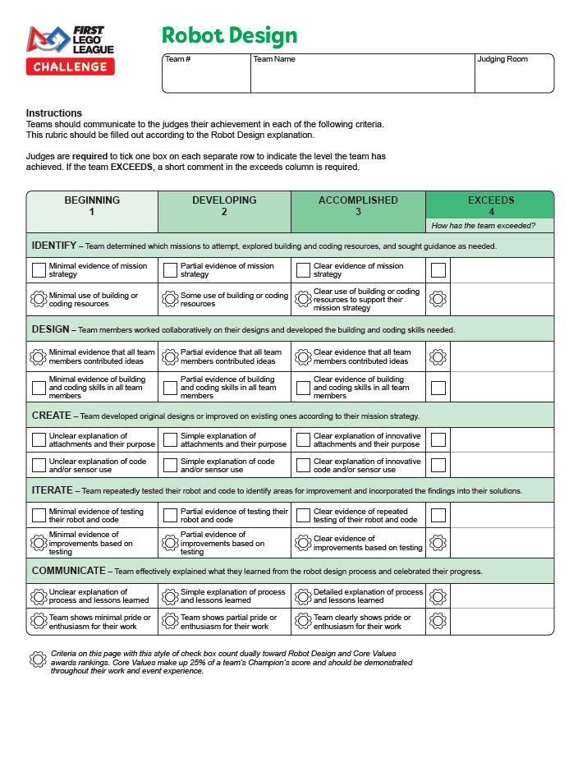
Robot Design Rubric
Watch the Robot Game Missions video
  Judges do not need to be experts in the robot game, but teams will discuss which missions they attempt
Only consider what is shared during the judging session when scoring
Criteria must be fully met (a strong 2 is not necessarily a 3)
Criteria with gear-shaped icons count dually toward Core Values

Slide 21
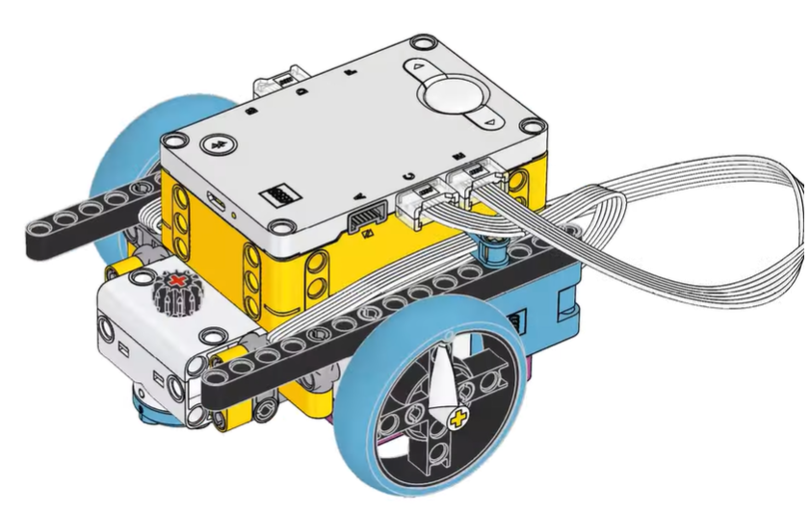
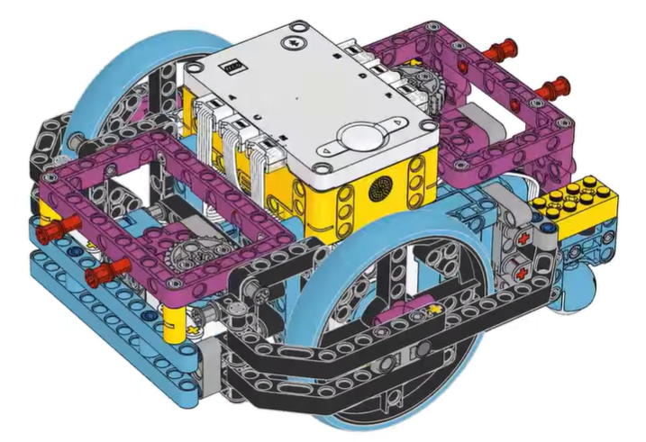
Robot Design Examples
Images: simple driving base and advanced driving base provided to teams in the LEGO Education SPIKE App

Slide 22
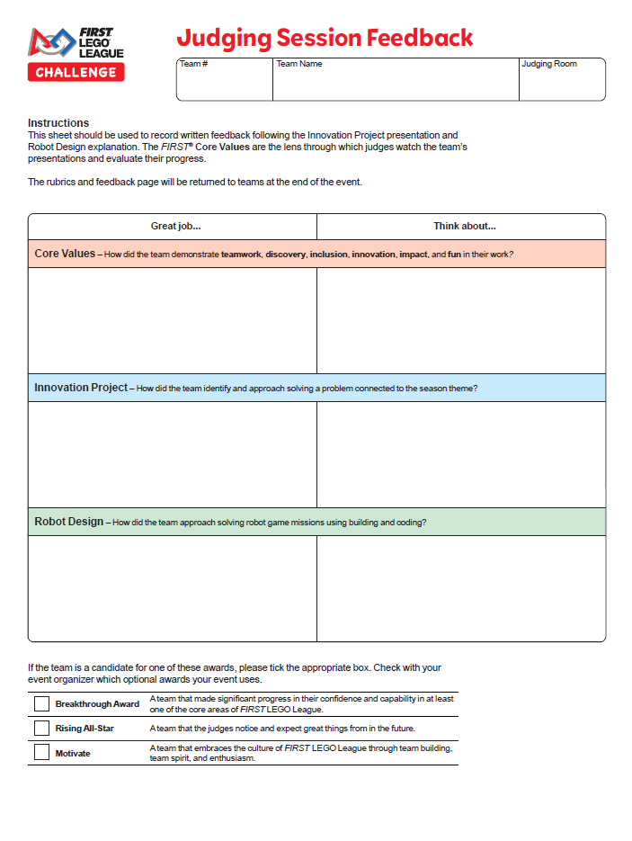
Team Feedback
Provide verbal feedback at the end of the session and written feedback on the sheet
Remember, the goal is to CELEBRATE what teams achieve and recommend actionable next steps
Feedback starters are provided in the Judging Session Script
Tick the appropriate boxes if teams should be considered for additional awards

Slide 23
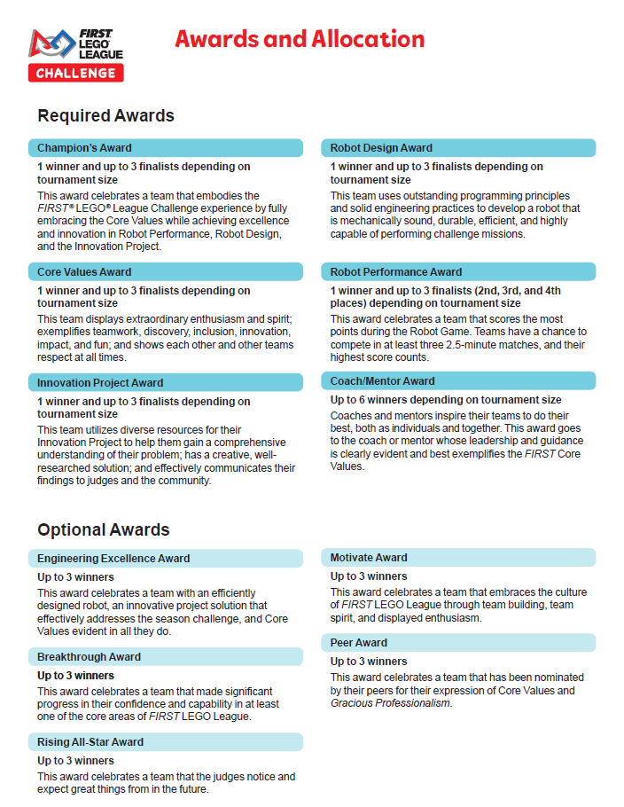
Awards & Allocation
Submitted rubric scores are used to calculate area ranks, which are used to assign awards
Judge Advisor leads the allocation process with judge input
Keep notes on each team you judge to refer to during the allocation process
List which optional or local awards, if any, will be given

Slide 24
Closing Ceremony
Add information here about the closing ceremony time, judge roles, etc.
Judges are encouraged to attend to celebrate teams and hand out awards

Slide 25
Questions?

Slide 26
Thank you for being a FIRST® LEGO® League Challenge judge!

