Slide 1


SESSION 9
I can work with my team to code our robot and test our mission strategy.
I can work with my team to iterate and improve our innovation project solution based on testing and feedback.
Students will continue running their robot on the mat and improving their code while also iterating on their innovation project solution. ​

Slide 2


Discussion
What did we do last session?
Notes:
Discuss with students the progress made on their innovation project solution and missions in the previous session. ​​

Slide 3
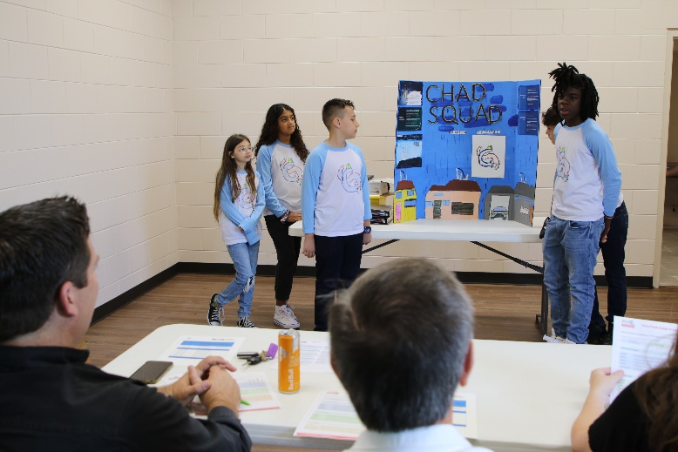

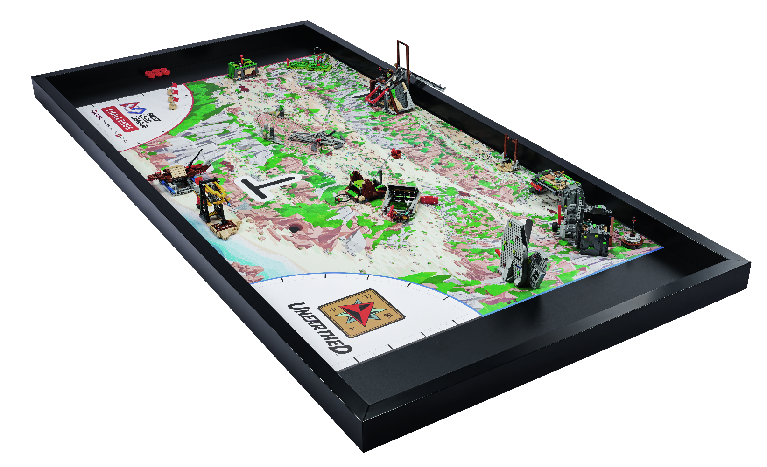
Key Vocabulary
judge: a person appointed to decide in an event
field: playing area defined by walls, including the mat, mission models, and home areas
Notes:
Session specific vocab

Slide 4

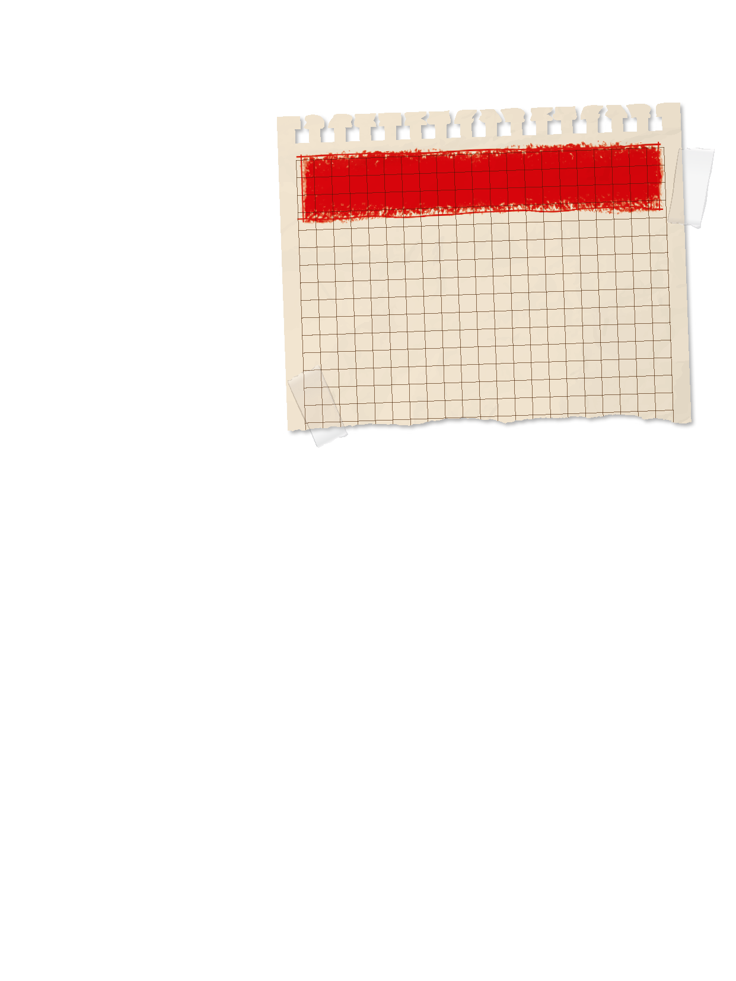
Introduction
What are some ways your team has been innovative and creative when solving problems?
Innovation: We use creativity and persistence to solve problems.
Write these on page 22 of your Engineering Notebook.
Notes:
Introduction:
Think about innovation and your team. Talk about examples of how your team has been creative and solved problems.
Session Tips:
Examples recorded here could be used for the innovation project presentation or robot design explanation.

Slide 5

Tasks
Does your mission strategy cover all the missions you wanted to try?
Try to add in one more mission if you can fit it in the 2 minute and 30 seconds of match time.
Continue iterating an improving your robot design, and document your changes.
Notes:
Tasks ​
Think about your robot mission strategy on the mat and the missions you will solve.
Continue to create a solution for each mission as time allows.
Iterate and improve your robot design and innovation project solutions. Be sure to document what happens in each step.
Session Tips​
The team should have a clear strategy for which programs to run and in what order during the robot game.
The team can also have a backup of their programs on external drive like a USB stick or an online storage website.
The Share tasks are important to keep the whole team updated on how the project and the robot are developing.
Core Values are evaluated throughout the judging session while teams present on their innovation project and robot design. Review the judging rubrics with the team.

Slide 6

Reflect
How will your team demonstrate Core Values at the event?
How will your team explain what is innovative about your solution to the judges?

Slide 7
Reflect
What features on your robot show your building skills?
What changes have you made to your innovation project and robot design based on feedback and testing?

Slide 8




Share
Share the robot skills practiced, and project on your solution in this session.
Notes:
Share ​
Discuss the reflection questions.
Get together at the mat. Share the robot skills you practiced in this session and the work completed on the innovation project.
Clean up your space​

Slide 9

Clean Up

Slide 10


LEGO, the LEGO logo, and the SPIKE logo are trademarks of the/sont des marques de commerce du/son marcas registradas de LEGO Group. ©2025 The LEGO Group. All rights reserved/Tous droits réservés/Todos los derechos reservados. FIRST®, the FIRST® logo, and FIRST® AGE™ are trademarks of For Inspiration and Recognition of Science and Technology (FIRST). LEGO® is a registered trademark of the LEGO Group. FIRST® LEGO® League and UNEARTHED™ are jointly held trademarks of FIRST and the LEGO Group. ©2025 FIRST and the LEGO Group. All rights reserved.

