Slide 1


SESSION 7
I can work with my team to continue developing their innovation project solution and create a model or prototype.
I can work with my team to design and iterate on their robot to complete additional robot game missions.
Students will continue developing their innovation project solutions by creating a prototype and iterate ono their robot build and code. ​

Slide 2


Discussion
What did we do last session?
Notes:
Discuss with students the pseudocode and mission strategy in the previous session. ​​

Slide 3
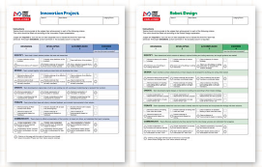

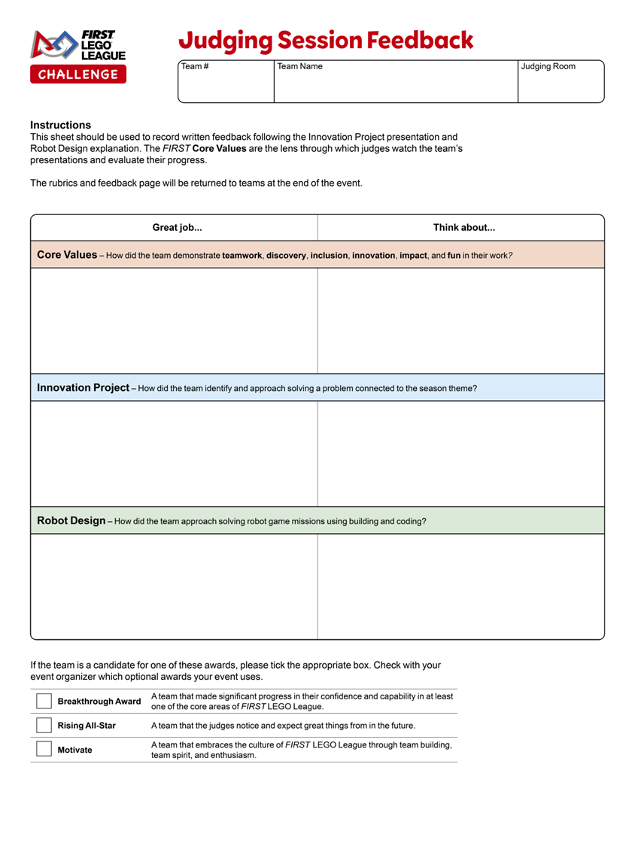
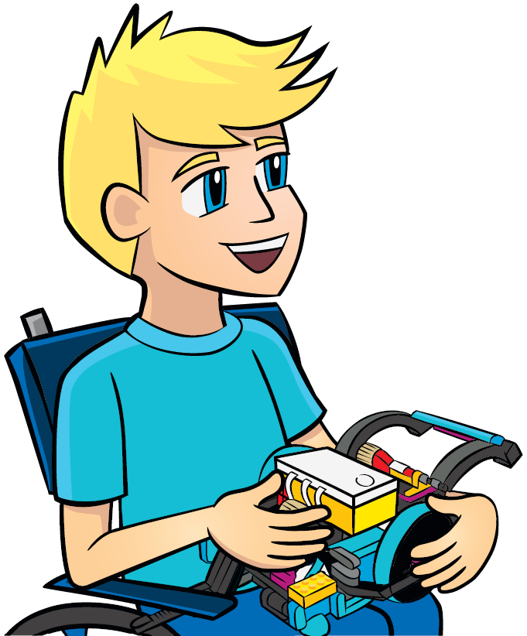
Key Vocabulary
rubric: a guide listing criteria for judging at event
feedback: the giving or sending of information
improve: to make or become better
Notes:
Session specific vocab

Slide 4

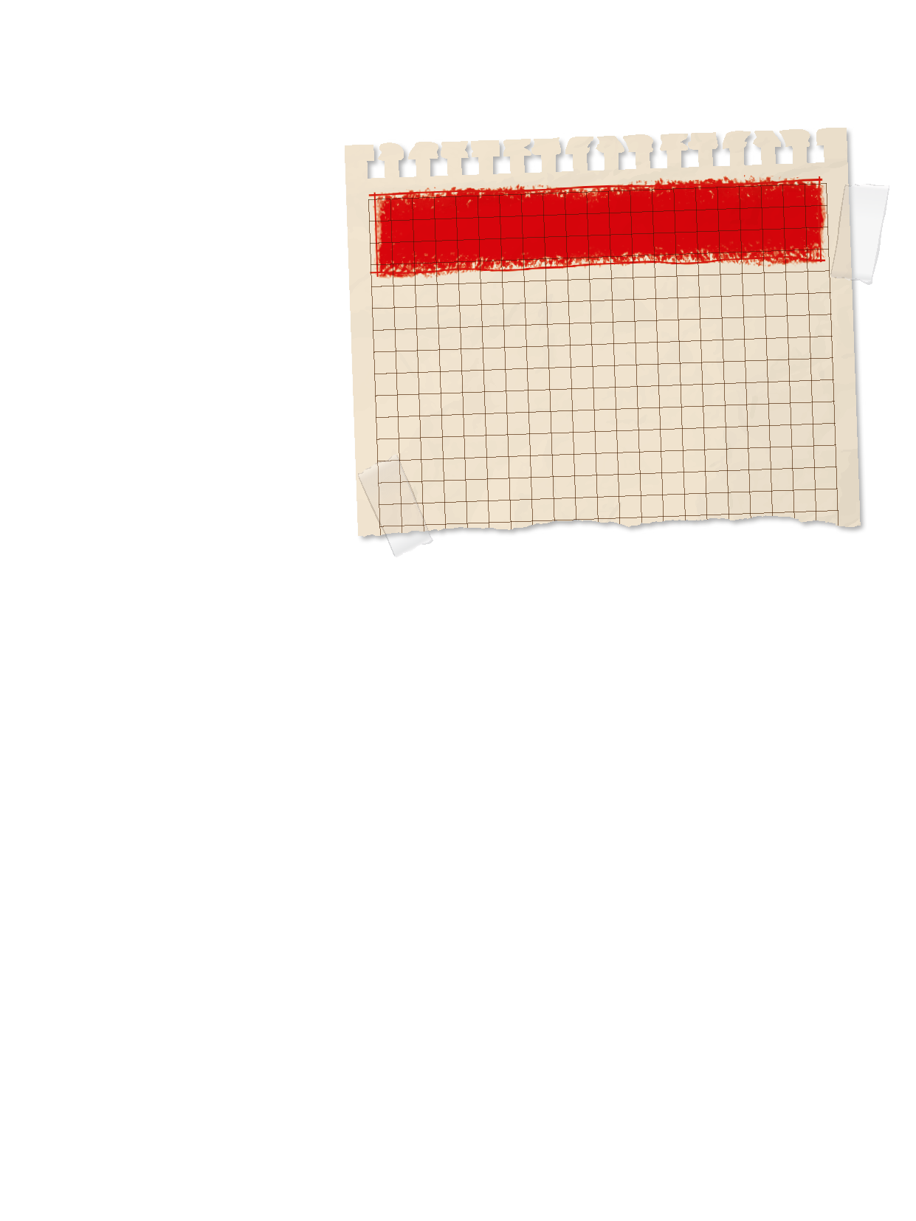
Introduction
Gracious Professionalism: We show high-quality work, emphasize the value of others, and respect individuals and the community.
Think about Gracious Professionalism®.
How has your team demonstrated this throughout the season so far?
Notes:
Introduction:
Think about Gracious Professionalism®. Talk about ways your team demonstrates this in everything you do.
Session Tips:
Look for opportunities for the team to justify and research their innovation project ideas.

Slide 5

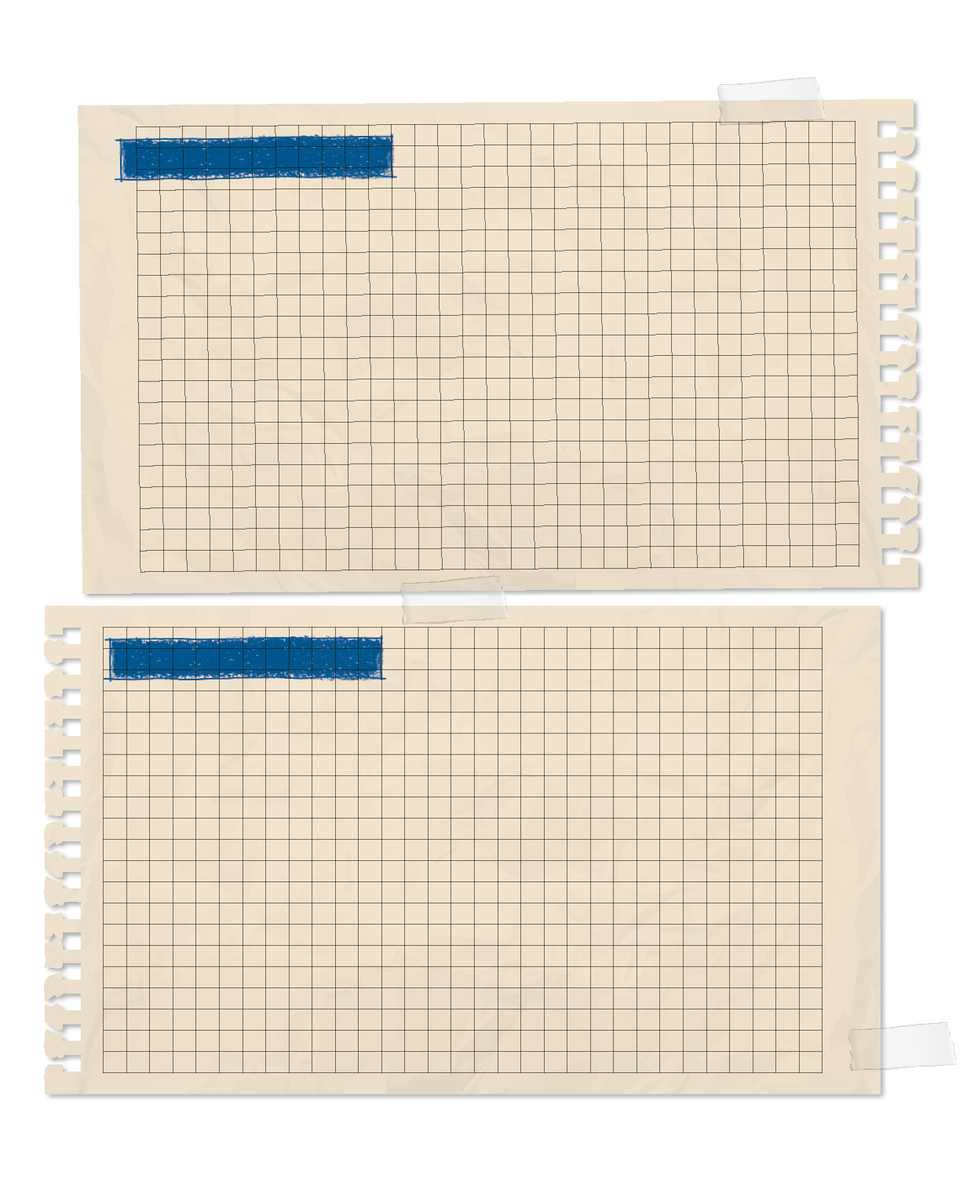
Tasks
Continue to develop your solution.
PROCESS
Describe the process you followed to develop your innovative solution.
Draw your solution and explain how it solves the problem.
Consider creating a prototype model.
Document the process for developing your solution on the Innovation Project Planning sheet, page 29 of the Engineering Notebook.
Notes:
Tasks ​
Continue to develop your innovation project solution.
Draw your solution and explain how it solves the problem.
Create a prototype model or detailed drawing of your solution. The prototype does not need to be functional, but it should help explain your solution to others.
Continue to document the process you use to develop your solution on the Innovation Project Planning sheet and throughout this Engineering Notebook.
Session Tips​
Prototypes do not need to be functional when presented to judges. The team should be able to describe in detail how it would work.
Provide a variety of materials for the team to use to make a prototype or model of their project solution.
Have the team think of people they would like to get feedback from on their solution.
Help the team schedule time to share and collect feedback on their ideas.

Slide 6

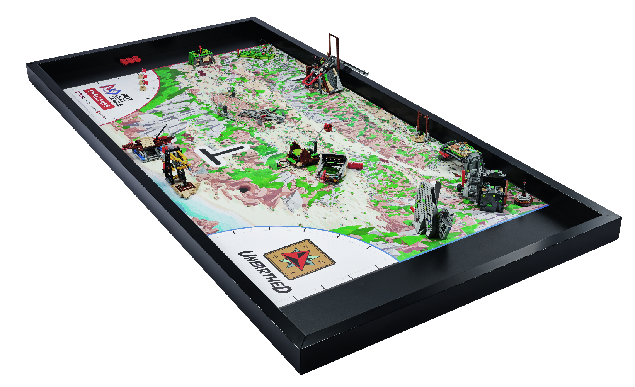
Tasks
Continue to test and improve your robot and its attachments in the robot game.
Can you combine mission solutions into one piece of programming?
Notes:
Tasks ​
Continue to test and improve your robot and its attachments to complete missions in the robot game.
Create a program for each new mission you attempt or combine mission solutions into one program.
Revisit previous lessons to develop your coding skills or work on solving the missions.
Session Tips​
Check the team knows and understands the Core Values and Gracious Professionalism®.
Different members of the team can be responsible for specific missions; each member can develop and own the robot run for those missions.
When the team has a base robot, they should do a straight drive test. If it doesn’t drive straight, troubleshoot by first looking at the robot’s center of gravity and balance.
When creating their mission strategy, the team should determine which launch area will be the robot’s starting position. Make sure there is enough room for the whole robot to fit inside the launch area.
Encourage the students to explain their program as the robot moves and make notes about what they observe during testing.

Slide 7

Reflect
Can you describe your solution in a way that is easy for others to understand?
How can you improve your drawing or prototype so it represents your solution?

Slide 8
Reflect
Who can you share your solution with for feedback?
How can you iterate and improve your robot design or your attachments?
How are you using the engineering design process to develop your mission strategy?

Slide 9




Share
Share the robot skills you practiced and the work you have completed on the innovation project.
Notes:
Share ​
Discuss the reflection questions.
Get together at the mat. Share the robot skills you practiced in this session and the work completed on the innovation project.
Clean up your space.​

Slide 10

Clean Up

Slide 11


LEGO, the LEGO logo, and the SPIKE logo are trademarks of the/sont des marques de commerce du/son marcas registradas de LEGO Group. ©2025 The LEGO Group. All rights reserved/Tous droits réservés/Todos los derechos reservados. FIRST®, the FIRST® logo, and FIRST® AGE™ are trademarks of For Inspiration and Recognition of Science and Technology (FIRST). LEGO® is a registered trademark of the LEGO Group. FIRST® LEGO® League and UNEARTHED™ are jointly held trademarks of FIRST and the LEGO Group. ©2025 FIRST and the LEGO Group. All rights reserved.

