Slide 1


SESSION 6
I can work with my team to begin developing the solution to their innovation project problem.
I can work with my team to create a mission strategy plan and write pseudocode for a mission.
Students will develop a solution to their innovation project, develop a mission strategy, and write pseudocode. ​

Slide 2


Discussion
What did we do last session?
Notes:
Discuss with students the guided mission and any others they complete as well as the research and sources they found related to their innovation project in the previous session. ​​

Slide 3


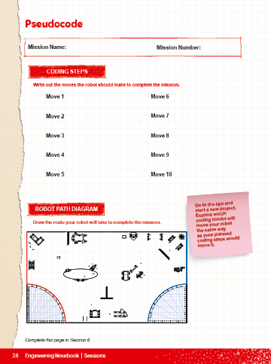
Key Vocabulary
prototype: serves as a model or inspiration for idea or solution
pseudocode: simple representation of a robot’s plan or simple diagrams instead of code
Notes:
Session specific vocab

Slide 4


Introduction
What have you learned so far and what you still want to explore?
What does our team need to spend more time on?
Complete the “Halfway There” section on page 8 of your Engineering Notebook.
Notes:
Introduction:
Talk about what your team has learned so far and what you still want to explore.
Complete the “Halfway There” section of the Team Progress sheet on page 8
Session Tips:
Provide extra paper or a shared digital file for the team to capture the process they use to create their robot and innovation project solutions.

Slide 5

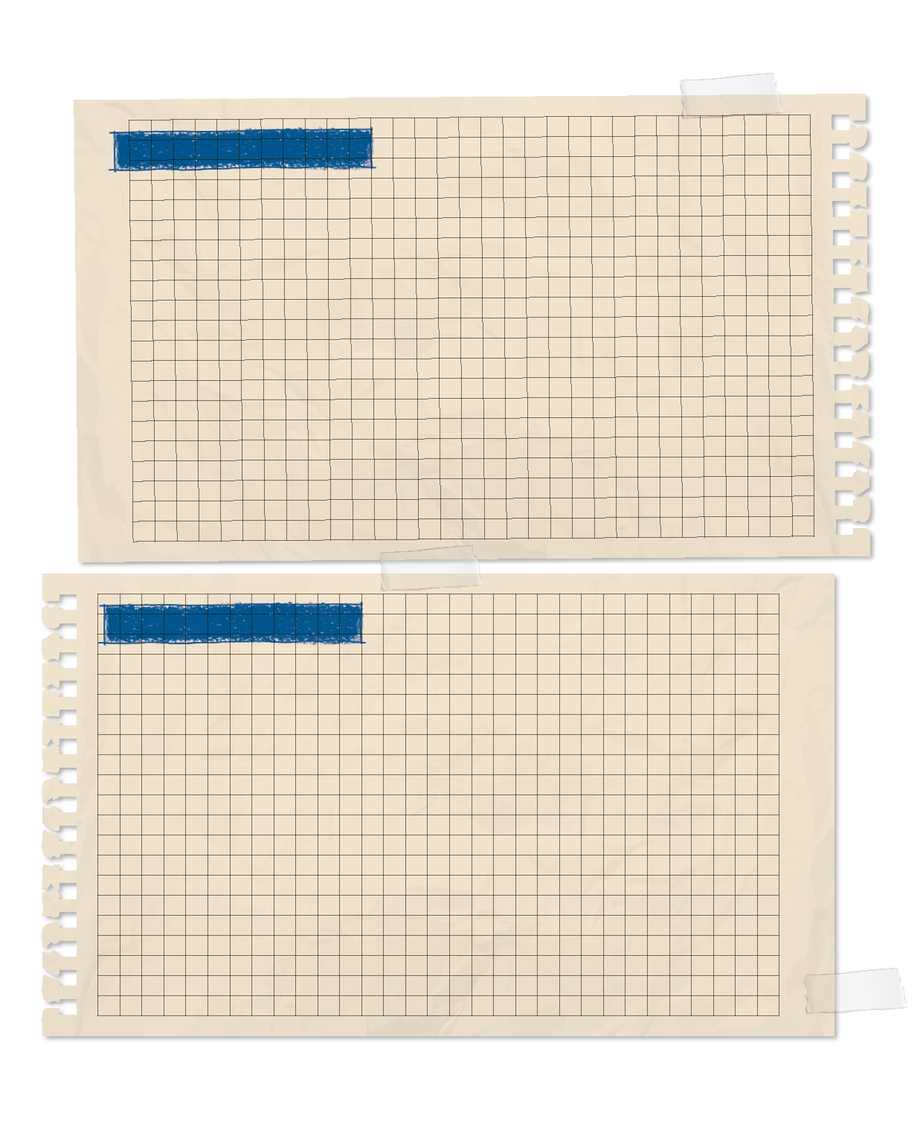
Tasks
How can you develop your solution?
PROCESS
Describe the process you followed to develop your innovative solution.
Use the planning sheet on page 29 of your Engineering Notebook.
Determine what materials you might need to create a prototype.
Notes:
Tasks ​
Make a plan for how you will develop a solution to your problem. Use the Innovation Project Planning sheet on page 29 as a tool.
Use a variety of sources and keep track of them in this Engineering Notebook.
Determine what materials might be needed to create a prototype of your solution.
Session Tips​
The team will be judged on their final robot and project solutions as well as the process they used.
Take some extra time with the team if needed to explore all the solution ideas and narrow it down to one.
The Innovation Project Planning sheet on page 29 of the Engineering Notebook can be completed over multiple sessions to help the team document their process.
The team will begin to develop their own innovation project solution.

Slide 6

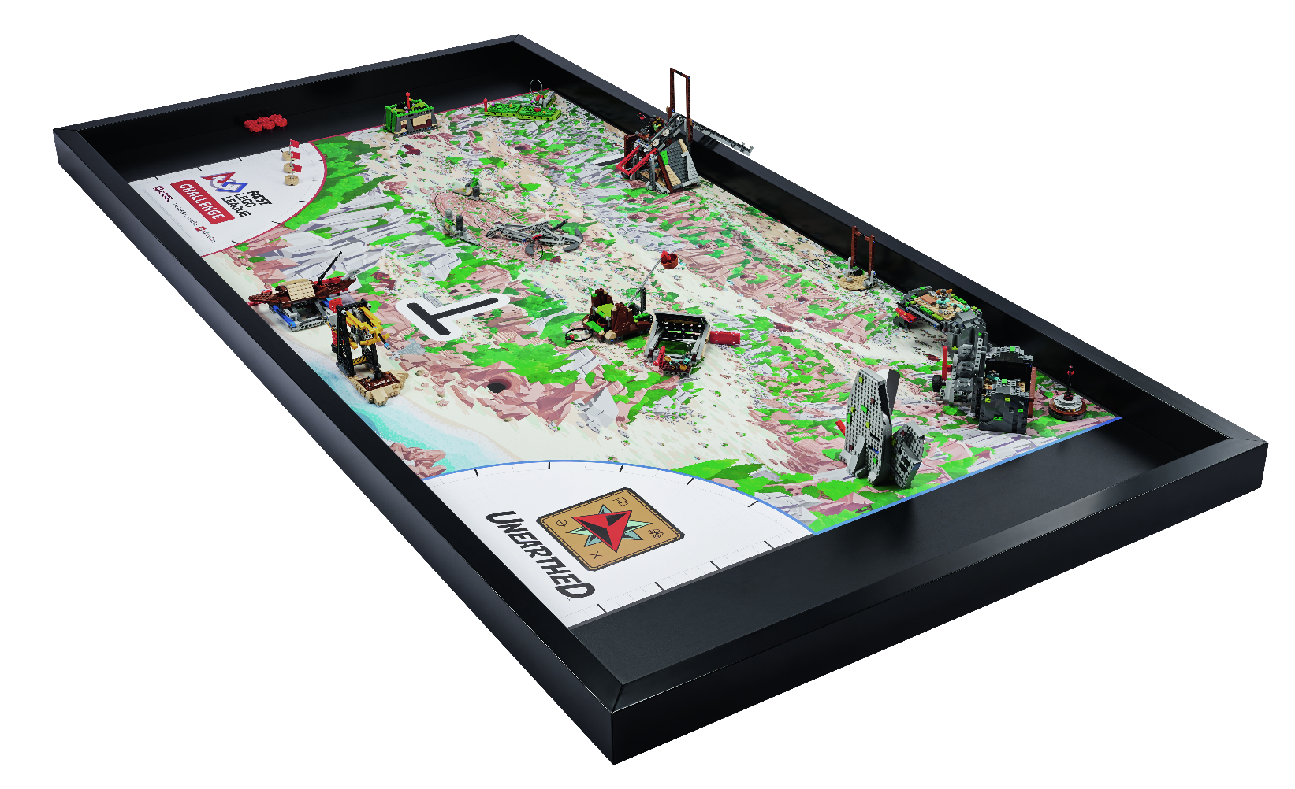

Tasks
Review the Robot Game Missions video and Robot Game Rulebook.
What missions have you completed so far?
Which missions do you still want to try?
Notes:
Tasks ​
Review the “Robot Game Missions” video and Robot Game Rulebook
Discuss which missions your team has attempted so far and which missions you want to try. Start to develop a mission strategy
Come up with a plan to test and improve your robot.
Complete the Pseudocode sheet on page 28 for a selected mission.
Upload your program ideas to your robot using the SPIKE™ app and see if they work.
Continue to practice completing missions in the robot game.
Session Tips​
The team should pause to reflect on the last few sessions. Ask the team what they feel most proud of so far. What are they excited about?
Provide sticky notes and planning cards for the team to place on the mat to map out their mission strategy.
Encourage the team to find the missions where points can be scored most easily and to do them first.
The Pseudocode sheet on page 28 of the Engineering Notebook can be photocopied. It can be used for each mission the team attempts.

Slide 7
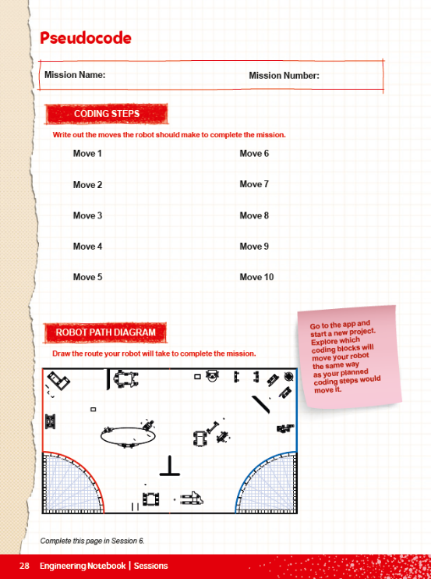
Tasks
Complete the Pseudocode sheet on page 28 of your Engineering Notebook.
Put your program ideas in the SPIKETM app, test if they work with your robot on the mat.
Notes:
Tasks ​
Review the “Robot Game Missions” video and Robot Game Rulebook
Discuss which missions your team has attempted so far and which missions you want to try. Start to develop a mission strategy
Come up with a plan to test and improve your robot.
Complete the Pseudocode sheet on page 28 for a selected mission.
Upload your program ideas to your robot using the SPIKE™ app and see if they work.
Continue to practice completing missions in the robot game.
Session Tips​
The team should pause to reflect on the last few sessions. Ask the team what they feel most proud of so far. What are they excited about?
Provide sticky notes and planning cards for the team to place on the mat to map out their mission strategy.
Encourage the team to find the missions where points can be scored most easily and to do them first.
The Pseudocode sheet on page 28 of the Engineering Notebook can be photocopied. It can be used for each mission the team attempts.

Slide 8

Reflect
How can documenting your progress with the innovation project help during your team’s judging session at the event?
What are your innovative ideas to solve the problem?

Slide 9
Reflect
How can your robot’s attachments and program support your team’s mission strategy?
How can you iterate and improve your robot design used in previous tasks?

Slide 10




Share
Share the robot skills learned in this session.
Notes:
Share ​
Discuss the reflection questions
Get together at the mat. Share the robot skills you learned in this session.
Clean up your space.
​

Slide 11

Clean Up

Slide 12


LEGO, the LEGO logo, and the SPIKE logo are trademarks of the/sont des marques de commerce du/son marcas registradas de LEGO Group. ©2025 The LEGO Group. All rights reserved/Tous droits réservés/Todos los derechos reservados. FIRST®, the FIRST® logo, and FIRST® AGE™ are trademarks of For Inspiration and Recognition of Science and Technology (FIRST). LEGO® is a registered trademark of the LEGO Group. FIRST® LEGO® League and UNEARTHED™ are jointly held trademarks of FIRST and the LEGO Group. ©2025 FIRST and the LEGO Group. All rights reserved.

