Slide 1


SESSION 5
I can work with my team to apply coding principles to the guided mission.
I can work with my team to propose a new solution to the problem or improve on an existing solution.
Students will look for resources for their innovation project and narrow down their solution. They will continue to build attachments and code their robot to complete the guided mission. ​

Slide 2


Discussion
What did we do last session?
Notes:
Discuss with students the coding of sensors learned about and the research completed on their innovation project problem statement in the previous session. ​​

Slide 3
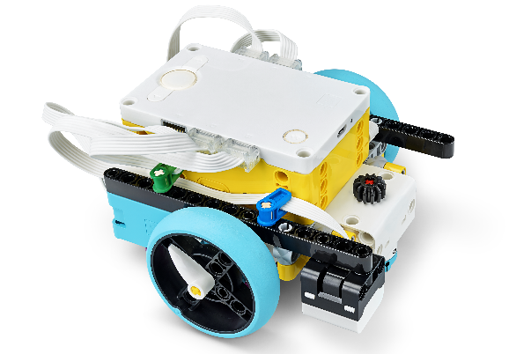

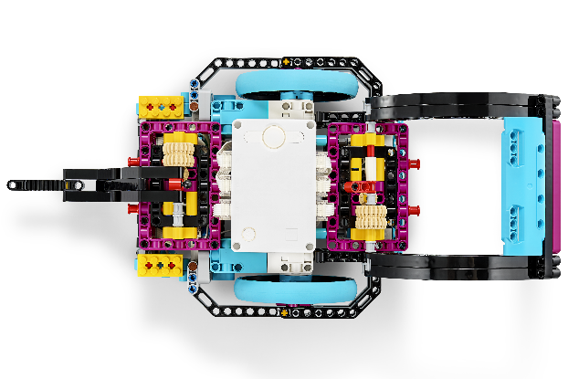

Key Vocabulary
solution: an action or process of solving a problem
attachment: the physical connection by which one thing is attached to another
engineering design process: process used to solve problems and create solutions
Notes:
Session specific vocab

Slide 4

Introduction
Think about teamwork.
Teamwork: We are stronger when we work together.
Talk about ways your team has been learning and working together.
Notes:
Introduction:
Think about teamwork and your team. Talk about ways your team has been learning and working together
Session Tips:
Team-building activities are great for teams to develop their Core Values and learn how to work together.

Slide 5



Tasks
Keep researching the problem you’ve chosen.
Will your team propose a new solution or improve an existing one?
Notes:
Tasks ​
Continue to research the problem you have chosen.
Decide whether your team will propose a new solution or improve an existing one.
Use this page to capture your research.
Select a solution to develop with your team.
Session Tips​
Teams should be able to clearly define the problem they have chosen. This will be evaluated during the judging session at the event.
Have the team reference the rubrics often.
Teams should use design thinking to create their solution to the problem.

Slide 6

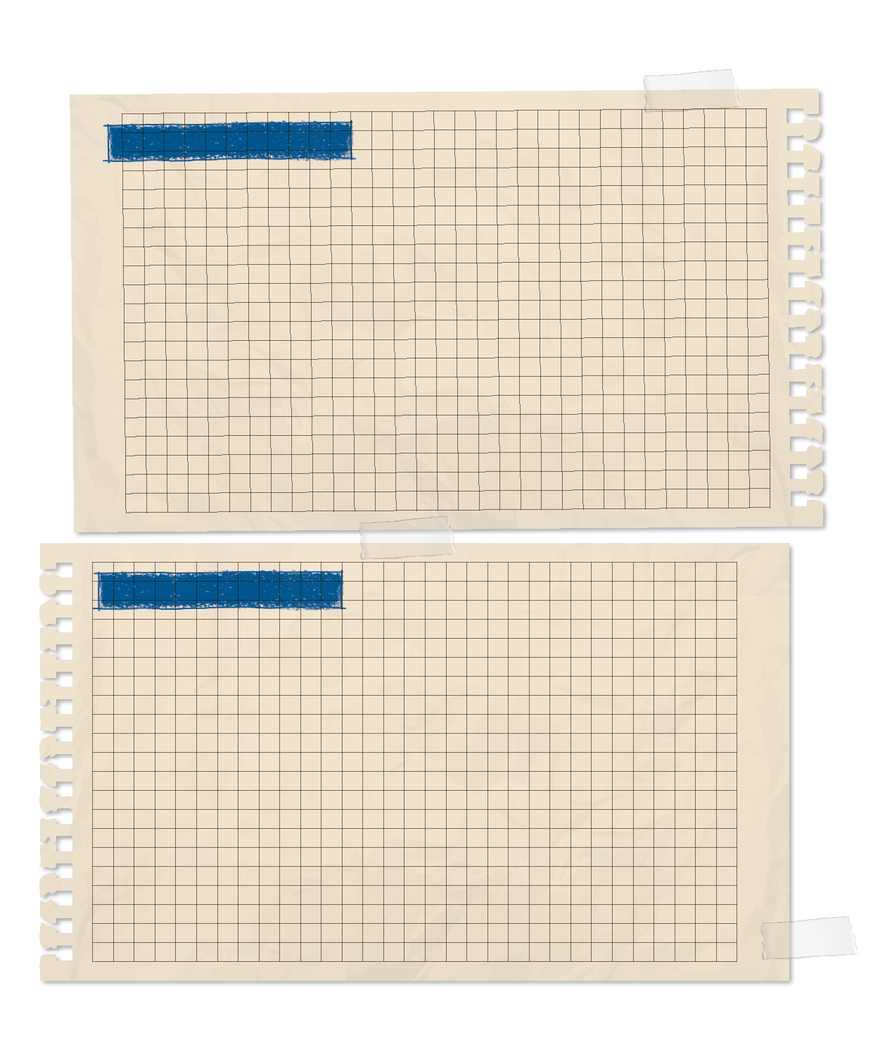
Tasks
Record your research in your Engineering Notebook.
PROCESS
Write down where you got your information, and include details such as the title, author, or website.
Select one solution to develop with your team.
Notes:
Tasks ​
Continue to research the problem you have chosen.
Decide whether your team will propose a new solution or improve an existing one.
Use this page to capture your research.
Select a solution to develop with your team
Session Tips​
Teams should be able to clearly define the problem they have chosen. This will be evaluated during the judging session at the event.
Have the team reference the rubrics often.
Teams should use design thinking to create their solution to the problem.
The team should record what they learn and note any questions that still need to be researched to develop their solution.

Slide 7


Tasks
In the SPIKETM app, complete the following lesson.
Competition Ready Unit: Guided Mission
Competition Ready Unit: Assembling an Advanced Driving Base (optional)
Notes:
Tasks ​
Open the SPIKE™ app. Find your lesson.
Competition Ready Unit: Guided Mission
Competition Ready Unit: Assembling an Advanced Driving Base (optional)
Have fun practicing the guided mission until it works consistently.
Continue to practice completing other missions in the robot game
Session Tips​
The team should be able to describe how everyone contributes to the team.
If the team is sharing one robot, they can code on individual devices and then take turns running their programs on the robot.
The provided program for the guided mission will not only solve the mission but also be helpful to use on other missions. A guided mission is provided only for SPIKE™ Prime sets.
Remind the team to test program changes in small steps instead of changing the entire program at once.
If an attachment is needed for a mission, keep it in a plastic bag labeled with the mission number.

Slide 8
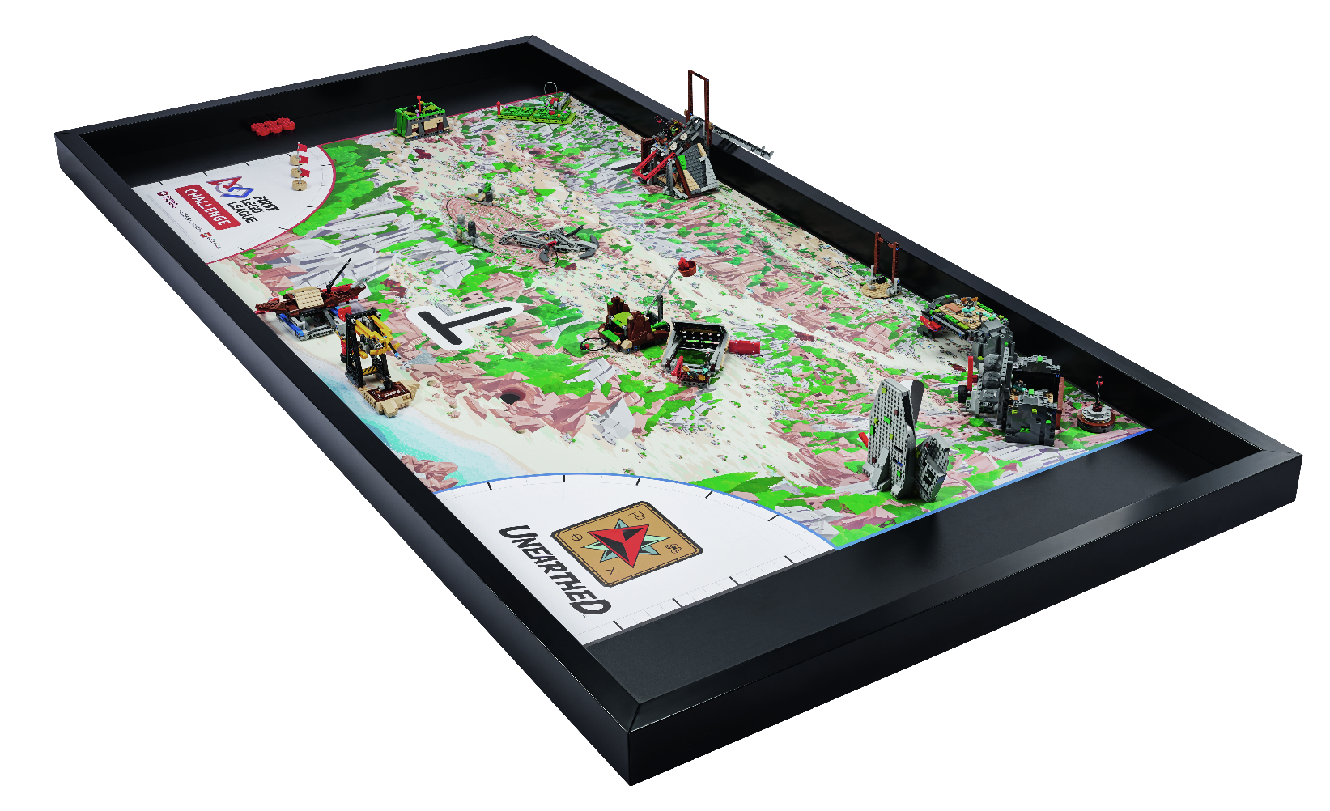
Tasks
Try to code your robot to attempt a different mission.
Remember to test program changes in small steps.
If an attachment is needed for a mission, keep it in a plastic bag labeled with the mission number.
Notes:
Tasks ​
Open the SPIKE™ app. Find your lesson.
Competition Ready Unit: Guided Mission
Competition Ready Unit: Assembling an Advanced Driving Base (optional)
Have fun practicing the guided mission until it works consistently.
Continue to practice completing other missions in the robot game
Session Tips​
The team should be able to describe how everyone contributes to the team.
If the team is sharing one robot, they can code on individual devices and then take turns running their programs on the robot.
The provided program for the guided mission will not only solve the mission but also be helpful to use on other missions. A guided mission is provided only for SPIKE™ Prime sets.
Remind the team to test program changes in small steps instead of changing the entire program at once.
If an attachment is needed for a mission, keep it in a plastic bag labeled with the mission number.

Slide 9

Reflect
Is there someone your team can talk to about the problem you selected?
What questions would you ask them?
How will your team work together to develop an innovative solution to the problem?

Slide 10
Reflect
What does the guided mission teach you about Coopertition®?
How does the engineering design process help you create a strategy for solving missions in the robot game?

Slide 11




Share
Share the robot skills learned in this session.
Notes:
Share ​
Discuss the reflection questions
Get together at the mat. Share the robot skills you learned in this session.
Clean up your space.
​

Slide 12
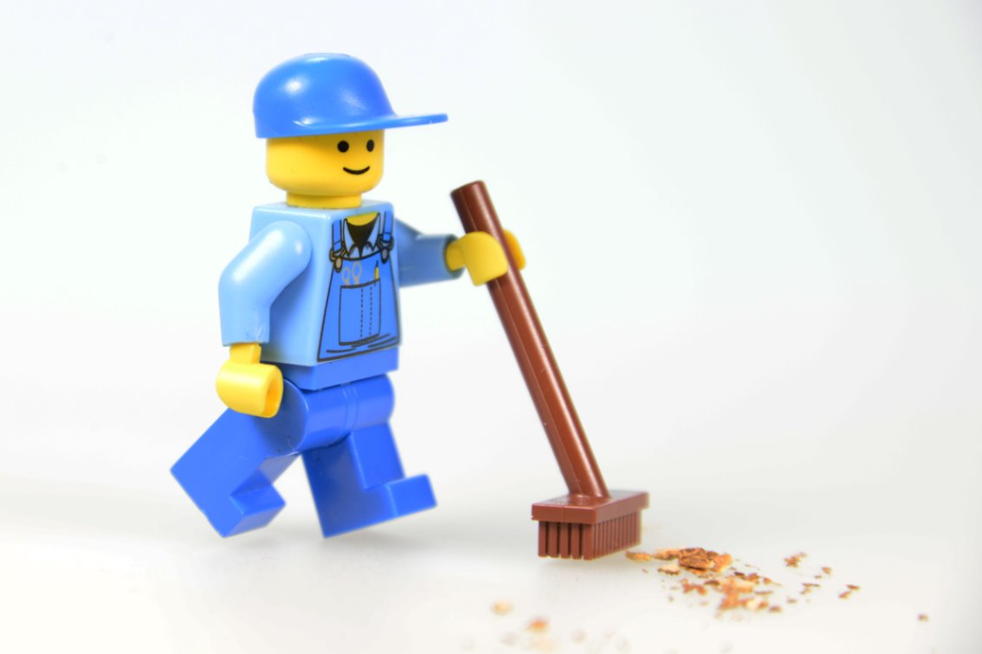
Clean Up

Slide 13


LEGO, the LEGO logo, and the SPIKE logo are trademarks of the/sont des marques de commerce du/son marcas registradas de LEGO Group. ©2025 The LEGO Group. All rights reserved/Tous droits réservés/Todos los derechos reservados. FIRST®, the FIRST® logo, and FIRST® AGE™ are trademarks of For Inspiration and Recognition of Science and Technology (FIRST). LEGO® is a registered trademark of the LEGO Group. FIRST® LEGO® League and UNEARTHED™ are jointly held trademarks of FIRST and the LEGO Group. ©2025 FIRST and the LEGO Group. All rights reserved.

