Slide 1


SESSION 2
I can work with my team to build a driving base and code it to move forward, move backward, and turn.
I can work with my team to explore and research ideas for their innovation project.
Students will begin to learn coding and building skills and think about how the mission models on the mat are associated with the Innovation Project.

Slide 2


Discussion
What did we do last session?
Notes:
Discuss with students the different mission models they built, and the Project Sparks from last session. ​​

Slide 3


Introduction
Discovery: We explore new skills and ideas.
Record how you will use discovery in your team’s journey.
Record your team goals and what you hope to learn on page 8 of your Engineering Notebook.
Notes:
Introduction:
• Think about how you will use the Core Value of discovery in your team’s journey.
• Record what your goals are and what you hope to learn on the Team Progress sheet on page 8.
Session Tips:
Teams will explore the six Core Values throughout their season.

Slide 4
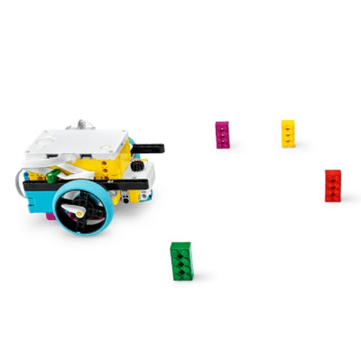


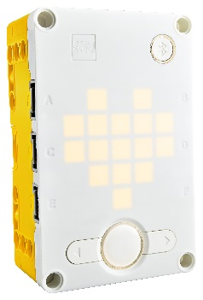
Key Vocabulary
robot: The controller and any attached equipment that is intended to remain connected
code: pre-programmed instructions
controller: unit that runs the programs for the robot
Notes:
Session specific vocab

Slide 5


Tasks
In the SPIKETM app, complete the following lessons.
Tutorial Activities 1-6 (optional)
Competition Ready Unit Training Camp 1: Driving Around
Notes:
Tasks ​
Open the SPIKE App/ Click the Start button.
Find your Lesson.
Tutorial Activities (1-6 (optional)
Competition Ready Unit Training Camp 1: Driving Around
Use the skills you learned to navigate your robot to one of the mission models
Determine what coding and building skills you can apply in the robot game. Use the notes section to record your ideas.
As you navigate around the mat, talk with your team about any innovation project ideas sparked by the mission models.
​
Session Tips​
The Tutorial Activities are optional but recommended if your team has minimal coding and building experience.
After a program is downloaded onto the controller, it cannot be transferred back to be opened and edited.

Slide 6
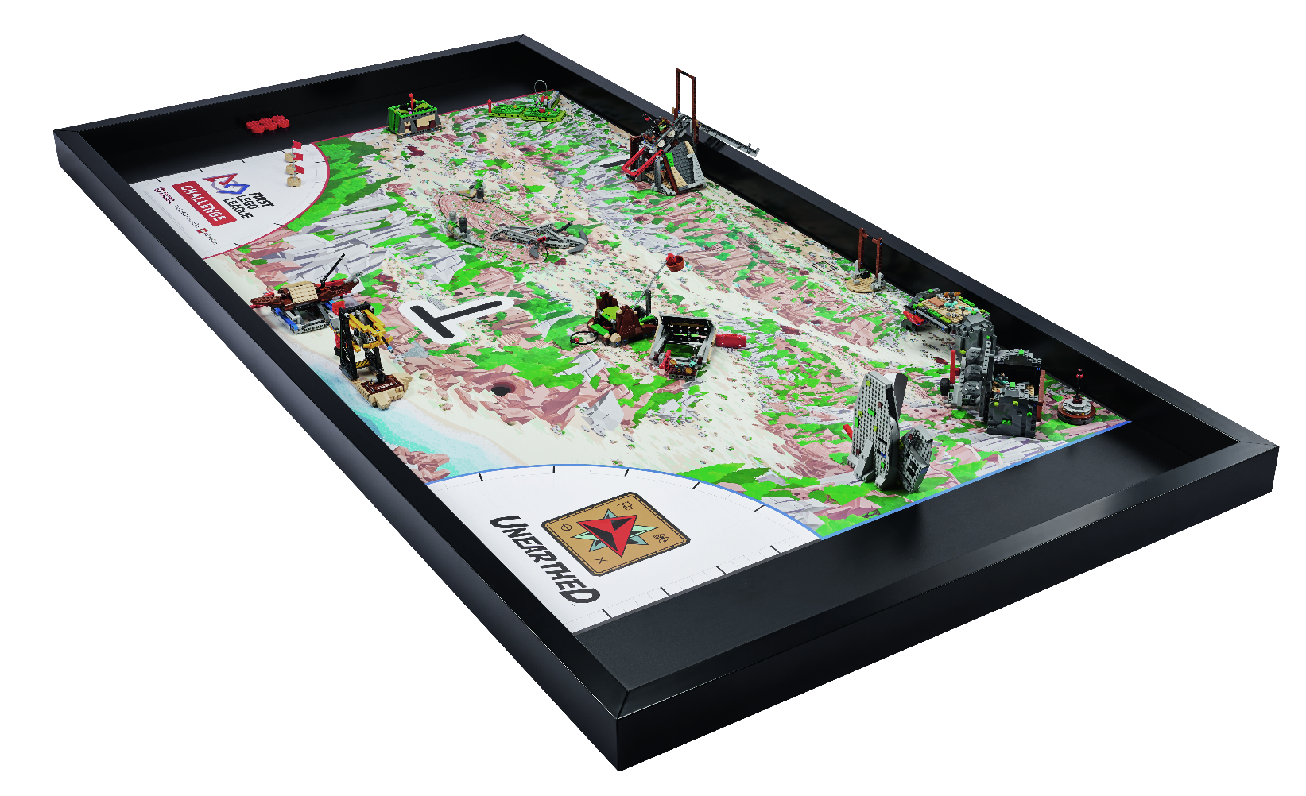
Tasks
Navigate your robot to one of the mission models.
Take notes about what coding and building skills you have learned and can use on in the robot game.
Notes:
Tasks ​
Open the SPIKE App/ Click the Start button.
Find your Lesson.
Tutorial Activities (1-6 (optional)
Competition Ready Unit Training Camp 1: Driving Around
Use the skills you learned to navigate your robot to one of the mission models
Determine what coding and building skills you can apply in the robot game. Use the notes section to record your ideas.
As you navigate around the mat, talk with your team about any innovation project ideas sparked by the mission models.
​
Session Tips​
The Tutorial Activities are optional but recommended if your team has minimal coding and building experience.
After a program is downloaded onto the controller, it cannot be transferred back to be opened and edited.

Slide 7

Tasks
Talk with your team about any innovation project ideas sparked by the mission models.
Notes:
Tasks ​
Open the SPIKE App/ Click the Start button.
Find your Lesson.
Tutorial Activities (1-6 (optional)
Competition Ready Unit Training Camp 1: Driving Around
Use the skills you learned to navigate your robot to one of the mission models
Determine what coding and building skills you can apply in the robot game. Use the notes section to record your ideas.
As you navigate around the mat, talk with your team about any innovation project ideas sparked by the mission models.
​
Session Tips​
The Tutorial Activities are optional but recommended if your team has minimal coding and building experience.
After a program is downloaded onto the controller, it cannot be transferred back to be opened and edited.

Slide 8

Reflect
How can aiming your robot at a model help your team in the robot game?
How did you use the engineering design process in this session?
What Project Sparks interest your team?
Does your team want to explore a different problem?
Notes:
Session Tips:
The team should reference the innovation project page and begin identifying problems. The team will need to have their problem statement finalized by Session 3.

Slide 9




Share
Share the robot skills learned in this session.
Notes:
Share ​
Discuss the reflection questions
Get together at the mat. Share the robot skills you learned in this session.
Clean up your space.
​
Session Tips​
Have the team practice their new skills by trying to drive the robot to a model and return to home..

Slide 10

Clean Up

Slide 11


LEGO, the LEGO logo, and the SPIKE logo are trademarks of the/sont des marques de commerce du/son marcas registradas de LEGO Group. ©2025 The LEGO Group. All rights reserved/Tous droits réservés/Todos los derechos reservados. FIRST®, the FIRST® logo, and FIRST® AGE™ are trademarks of For Inspiration and Recognition of Science and Technology (FIRST). LEGO® is a registered trademark of the LEGO Group. FIRST® LEGO® League and UNEARTHED™ are jointly held trademarks of FIRST and the LEGO Group. ©2025 FIRST and the LEGO Group. All rights reserved.

