Slide 1


SESSION 12
I can work with my team to practice our presentation for our innovation project and robot solutions.
I can work with my team to run practice robot game matches.
Students will practice their presentations and practice robot game matches to prepare for their event. ​

Slide 2


Discussion
What did we do last session?
Notes:
Discuss with students the progress made on their presentations for robot design and innovation project in the previous session. ​​

Slide 3

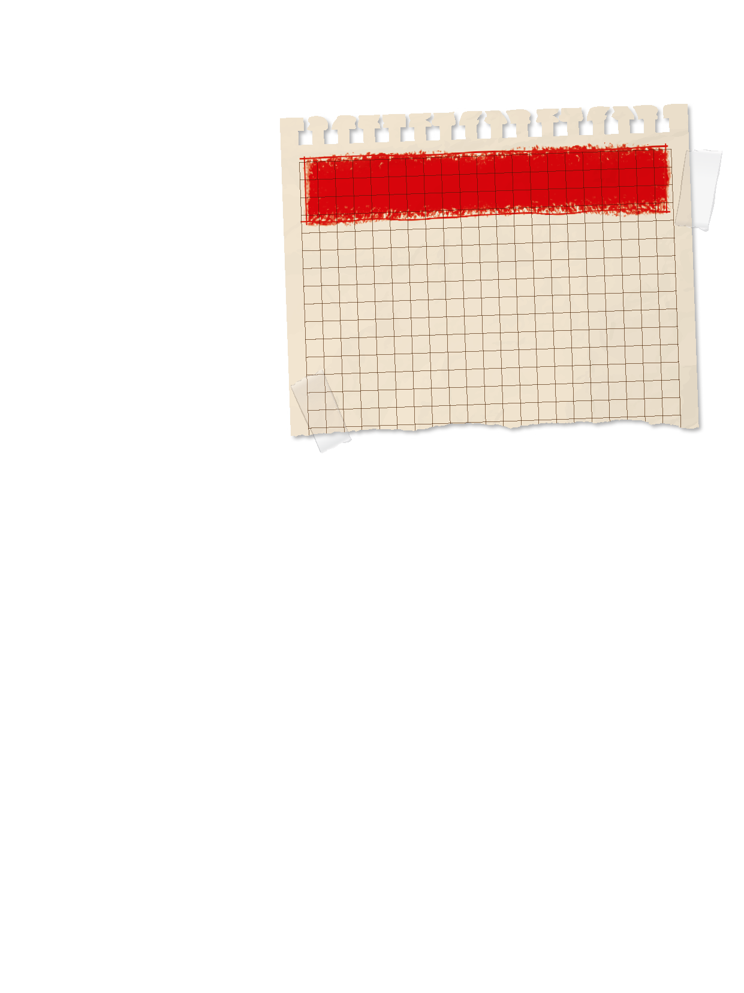
Introduction
Fun: We enjoy and celebrate what we do!
What are some examples of how you had fun this season?
Look back at your team’s goals on page 8 of the Engineering Notebook.
Did you achieve them?
Notes:
Introduction:
Reflect on how your team has had fun while exploring the season theme. Talk about examples of how your team has had fun throughout this experience.
Look at your team’s goals listed on page 8. Did you achieve them?
Session Tips:
Try to split the time in this session equally between rehearsing the presentation and practicing the matches.
Encourage the team to practice their presentation before the event. They can practice by sharing their solutions with others. The judging session flowchart tells you how much time is allowed for the presentation.

Slide 4


Tasks
Rehearse your full presentation for your innovation project and robot design.
Get feedback from your coach, a mentor, or another team.
Notes:
Tasks ​
Rehearse your full presentation communicating your innovation project and robot design work.
Collect feedback on your presentation from your coach, a mentor, or another team.
Practice multiple 2.5-minute robot game matches and calculate the points you score.
Review page 26, Prepare for Your Event, and page 27, Rubrics & Scoresheets.
Session Tips​
Have the team run their 2.5-minute robot matches. Make sure they practice running their programs in the right order.
The team should have a contingency plan for if things don’t go as planned during the robot game.
They could identify other missions to run. Remind the team about the Core Values and how they will show them throughout the event, including at every robot game match.

Slide 5


Tasks
Practice multiple 2 minute 30 second robot game matches.
Use the scoresheets on page 27 to calculate the points you score.
Notes:
Tasks ​
Rehearse your full presentation communicating your innovation project and robot design work.
Collect feedback on your presentation from your coach, a mentor, or another team.
Practice multiple 2.5-minute robot game matches and calculate the points you score.
Review page 26, Prepare for Your Event, and page 27, Rubrics & Scoresheets.
Session Tips​
Have the team run their 2.5-minute robot matches. Make sure they practice running their programs in the right order.
The team should have a contingency plan for if things don’t go as planned during the robot game.
They could identify other missions to run. Remind the team about the Core Values and how they will show them throughout the event, including at every robot game match.

Slide 6
Reflect
What is your plan for having your team’s robot attachments ready for the robot game?
What has your team accomplished?

Slide 7




Share
Practice presenting your project and robot design presentations.
Notes:
Share ​
Discuss the reflection questions.
Review the judging rubrics and robot game scoresheet.
Practice presenting your project and robot design explanation.
Clean up your space​

Slide 8
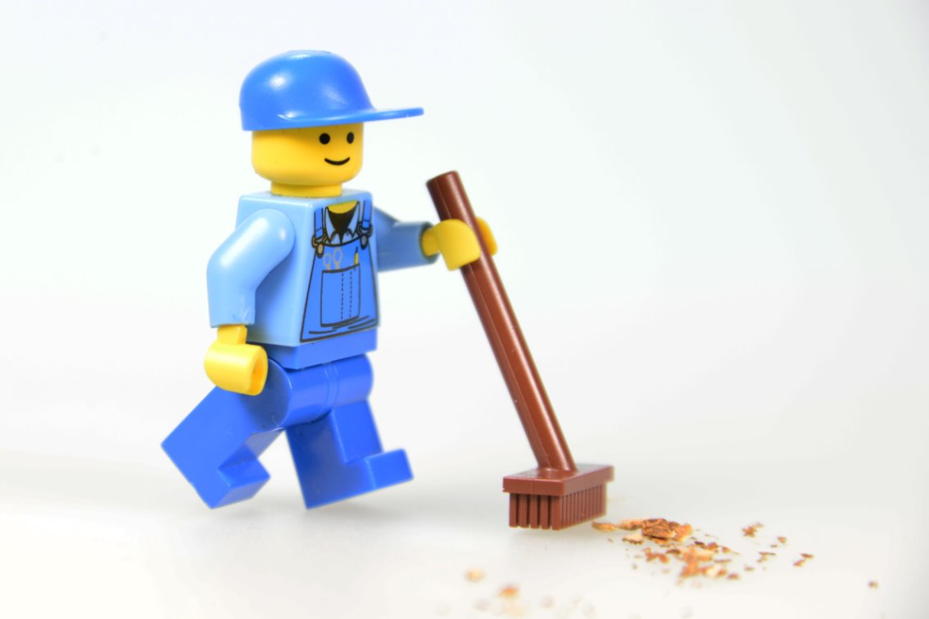
Clean Up

Slide 9


LEGO, the LEGO logo, and the SPIKE logo are trademarks of the/sont des marques de commerce du/son marcas registradas de LEGO Group. ©2025 The LEGO Group. All rights reserved/Tous droits réservés/Todos los derechos reservados. FIRST®, the FIRST® logo, and FIRST® AGE™ are trademarks of For Inspiration and Recognition of Science and Technology (FIRST). LEGO® is a registered trademark of the LEGO Group. FIRST® LEGO® League and UNEARTHED™ are jointly held trademarks of FIRST and the LEGO Group. ©2025 FIRST and the LEGO Group. All rights reserved.

