Slide 1


SESSION 11
I can work with my team to finalize our innovation project presentation.
I can work with my team to finalize our robot game and prepare our robot design explanation.
Students will finalize their innovation project presentation and outline their robot design presentation. ​

Slide 2


Discussion
What did we do last session?
Notes:
Discuss with students the progress made on their innovation project solution and missions in the previous session. ​​

Slide 3

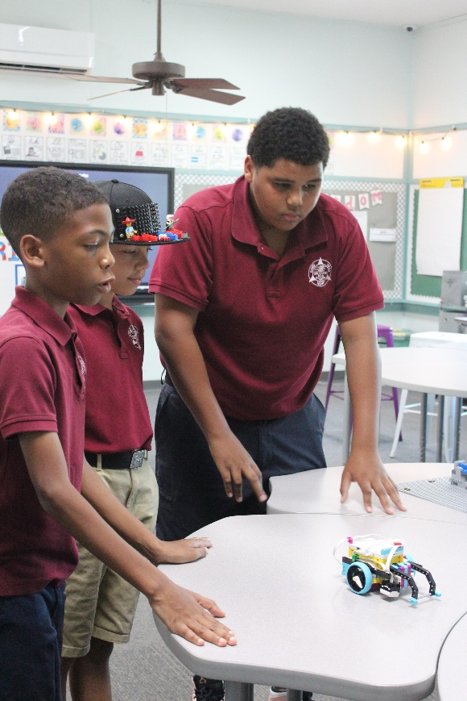
Key Vocabulary
explanation: a statement that makes something clear
robot design: process used to build and code robot
Notes:
Session specific vocab

Slide 4

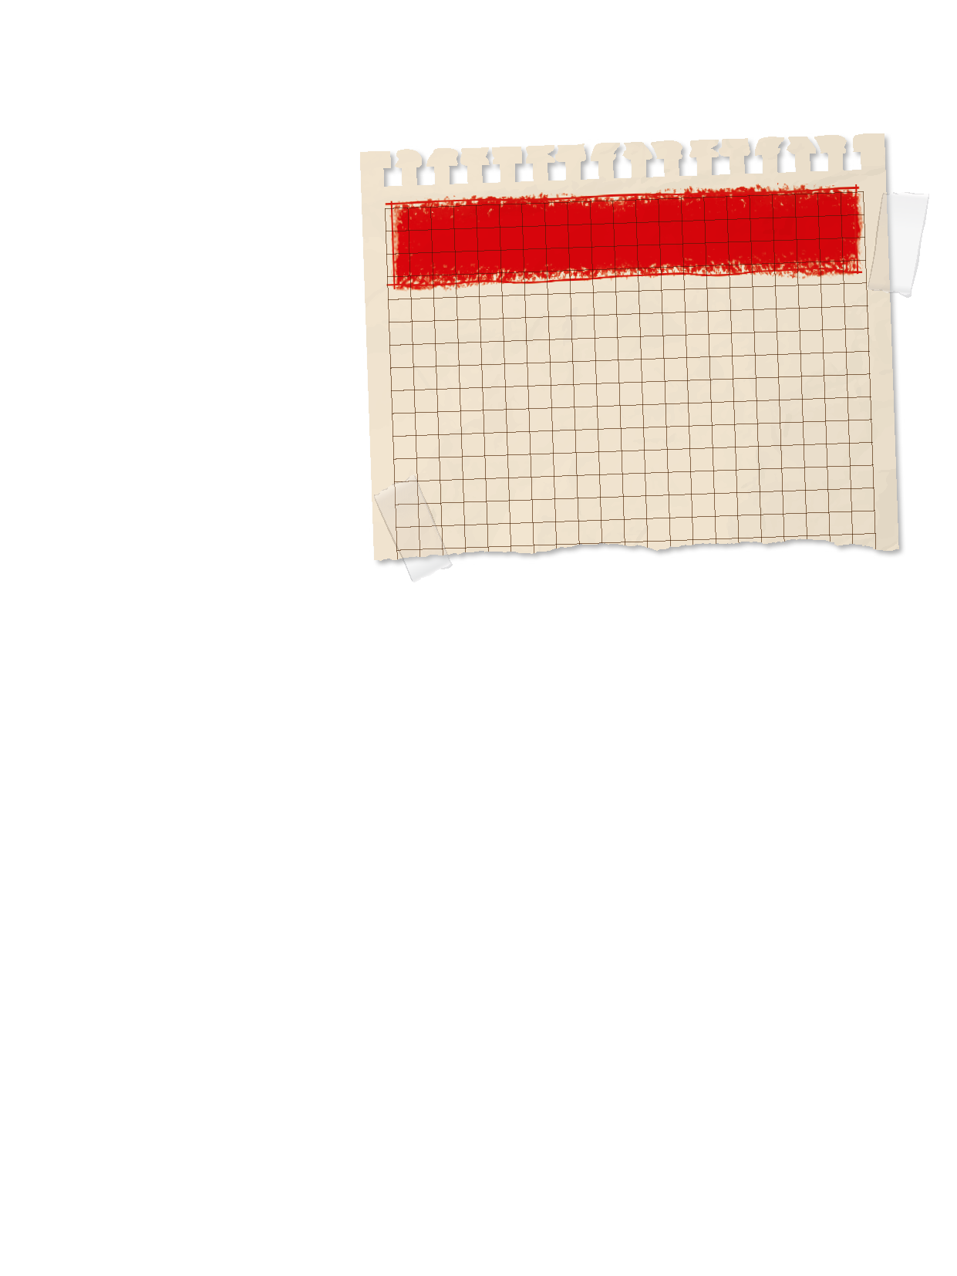
Introduction
Inclusion: We respect each other and embrace our differences.
What are some ways your team has inclusive?
Complete the “Event Time” section on page 8 of your Engineering Notebook.
Notes:
Introduction:
Think about inclusion and your team. Talk about examples of how your team makes sure everyone is respected and their voices are heard.
Complete the “Event Time” section of the Team Progress sheet on page 8
Session Tips:
Provide the team with the robot design rubric.

Slide 5


Tasks
Continue working on and practicing your innovation project presentation.
Does everyone have a part in the presentation.
Notes:
Tasks ​
Continue working on your innovation project presentation.
Plan and write out your robot design explanation. Refer to the robot design rubric for what to cover.
Make sure to share how each member of the team contributed to the project and robot design.
Practice your full explanation.
Session Tips​
Have the team reflect on their progress and complete the final section of the Team Progress sheet on page 8 of the Engineering Notebook.
It’s important for the team to practice communicating their innovation project and robot design solutions.
Every team member should participate in the presentation at the judging session. If the team needs any accommodations, contact the organizer of the event.
As part of their mission strategy, the team should know who will run the robot during the matches.

Slide 6
Tasks
Using the robot design rubric, plan your presentation.​
Write a script to help remember key points.​
​
Make sure to explain how everyone contributed to the robot design.
Notes:
Tasks ​
Continue working on your innovation project presentation.
Plan and write out your robot design explanation. Refer to the robot design rubric for what to cover.
Make sure to share how each member of the team contributed to the project and robot design.
Practice your full explanation.
Session Tips​
Have the team reflect on their progress and complete the final section of the Team Progress sheet on page 8 of the Engineering Notebook.
It’s important for the team to practice communicating their innovation project and robot design solutions.
Every team member should participate in the presentation at the judging session. If the team needs any accommodations, contact the organizer of the event.
As part of their mission strategy, the team should know who will run the robot during the matches.

Slide 7
Reflect
What will you do if a mission does not work during a match?
How are everyone’s contributions recognized in the presentation?
How has FIRST ® LEGO ® League made a difference for you?

Slide 8




Share
Practice your project presentation and collect feedback.
Notes:
Share ​
Discuss the reflection questions.
Practice your project presentation and collect feedback.
Clean up your space.
​

Slide 9

Clean Up

Slide 10


LEGO, the LEGO logo, and the SPIKE logo are trademarks of the/sont des marques de commerce du/son marcas registradas de LEGO Group. ©2025 The LEGO Group. All rights reserved/Tous droits réservés/Todos los derechos reservados. FIRST®, the FIRST® logo, and FIRST® AGE™ are trademarks of For Inspiration and Recognition of Science and Technology (FIRST). LEGO® is a registered trademark of the LEGO Group. FIRST® LEGO® League and UNEARTHED™ are jointly held trademarks of FIRST and the LEGO Group. ©2025 FIRST and the LEGO Group. All rights reserved.

