Slide 1
DISCLAIMER
This presentation is designed for event referee training only. It should not be used as a reference for field setup or scoring at events.
Referees must review all official sources of information for the UNEARTHEDTM robot game, including the Robot Game Rulebook, Robot Game Missions Video, Field Setup Video, and Challenge Updates.
Highlighted content should be updated by the Head Referee.

Slide 2
Notes:
PLEASE NOTE THE FOLLOWING USAGE REQUIREMENTS FOR THE FIRST® FORWARDSM presented by Qualcomm template.
Presentations using this deck must include the FIRST FORWARD cover slide (Slide 1) to ensure recognition of our presenting sponsor, Qualcomm.
Do not modify the template or overlap any of the built-in graphics.
This template uses the Roboto font family, which can be downloaded for free at fonts.google.com/specimen/Roboto

Slide 3


Referee Training

Slide 4
Agenda
Referee Role & Core Values
Referee Toolkit
Match Overview
UNEARTHED Missions
Challenge Updates
Reminders

Slide 5
The Referee Role
Regulate the action and fairness of the robot game
Score matches together with the team
Be a kind, encouraging role model
Demonstrate Gracious Professionalism® and FIRST Core Values in everything you do

Slide 6






FIRST® Core Values

Slide 7

The Referee Toolkit
At the table, you will need:
Robot Game Rulebook
Challenge Updates
Scoresheet (paper or digital)
Field Setup Video (or printed reference guide)
Measuring device for equipment inspection

Slide 8
Match Overview
Team Arrives
Equipment Inspection
Match Setup
Play Match
Scoring
Team Leaves
Reset Table

Slide 9
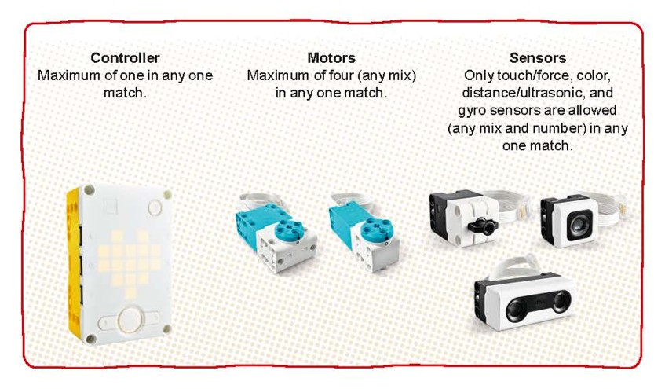
Before the Match – Equipment & Inspection
Equipment: All items that teams bring to the match, including the robot, attachments, and any other materials specified in the rules.
Only LEGO parts allowed
Check equipment and quantities during pre-match inspection
All equipment must fit in both launch areas and under a height limit of 12-inches
Additional or duplicate mission models are not allowed
Extra storage not allowed (carts, bins, etc.)
See Glossary; Rules – Before the Match for a complete list of allowed equipment

Slide 10
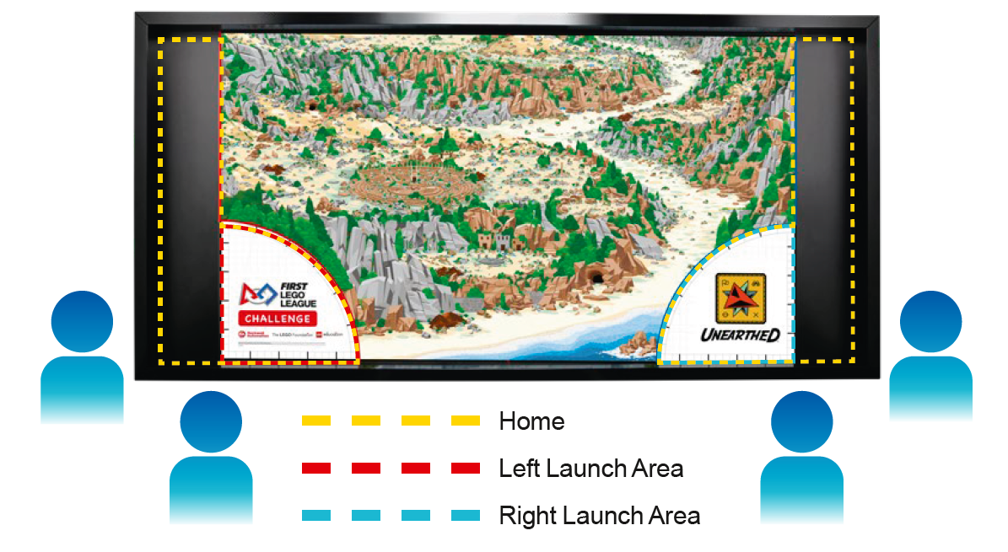
Before the Match – Setup
After inspection, teams should distribute equipment and ask final questions, then get in position for the match with no more than two technicians at each side of the table.
Referee should stand in the middle, at the bottom of the table.
See Glossary; Rules – Before the Match for more details

Slide 11
During the Match – Inside Home
Technicians may use their hands to handle the robot, equipment, and mission models when these items are completely within their respective home area.
When launching, make sure technicians are not keep anything from moving and that the robot and anything it is about to move fits completely inside the launch area.
Launch: The act of activating the robot from rest when completely within its designated launch area to cause it to move autonomously.
See Glossary; Rules – During the Match for a complete list of rules that apply

Slide 12
During the Match – Outside Home
If technicians interrupt the robot, it must be relaunched.
If the team interrupts the robot, ask yourself:
Where was the robot when interrupted: partly outside, or fully outside home?
Was it touching a mission model?
Had it obtained something after launch?
What should happen to the robot and/or items it is in contact with? (See Rule #15)
If an object is dropped by the robot, ask yourself:
Where did the item come to rest: partly outside, or fully outside home?
What should happen to that item? (See Rule #17)
Teams may not interrupt their robot in such a way that they earn points from it.
See Rules – During the Match for a complete list of rules that apply

Slide 13
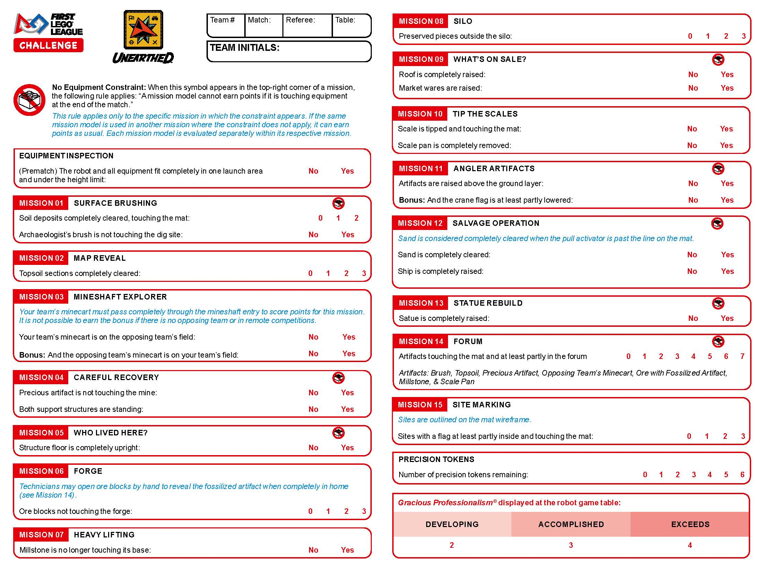
After the Match – Scoring
Complete the scoresheet together with the team and have team members sign off on the scoresheet before they leave
For scoring, all mission requirements must be visible at the end of the match unless a method was required in the mission (noted in blue text)
If you need help with scoring a mission, call your head referee
When in doubt, give benefit of the doubt
See Rules – After the Match for more details

Slide 14
Gracious Professionalism® at the Robot Game
Make sure to fill out the team’s Gracious Professionalism® score for each match – these contribute to the team’s Core Values score (25% of Champion’s score)
Teams who do not show for their match will score 0 points
Teams who show up and do not run their robot can still earn 2, 3, or 4 points depending on the Gracious Professionalism® they demonstrate

Slide 15
Robot Game Missions
UNEARTHED Robot Game Missions Video

Slide 16
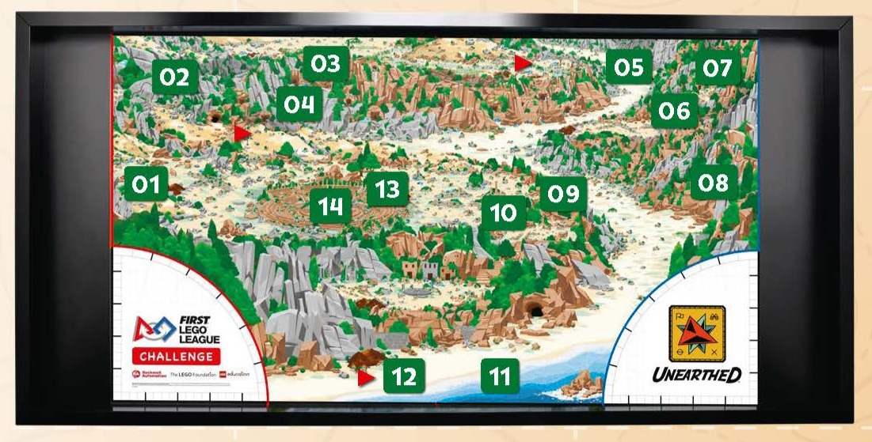
Mission Model Placement
Check that all models are in the correct setup position before the start of each match.
Missions 6 & 8 have elements that are randomized.
Mission 15 targets

Slide 17
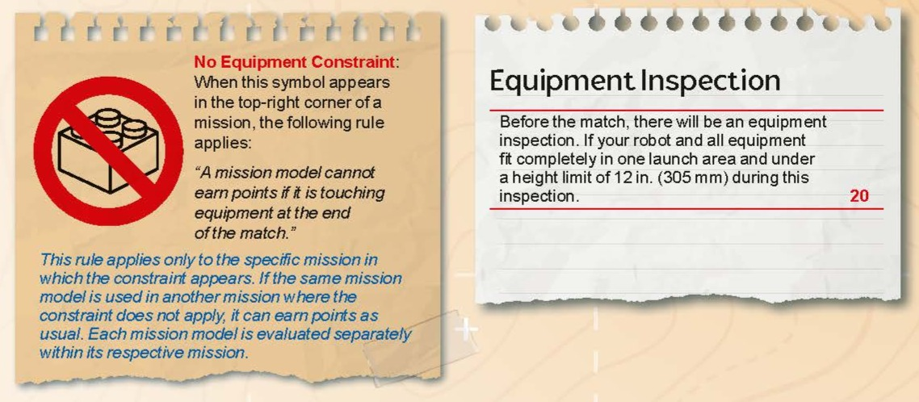

Slide 18
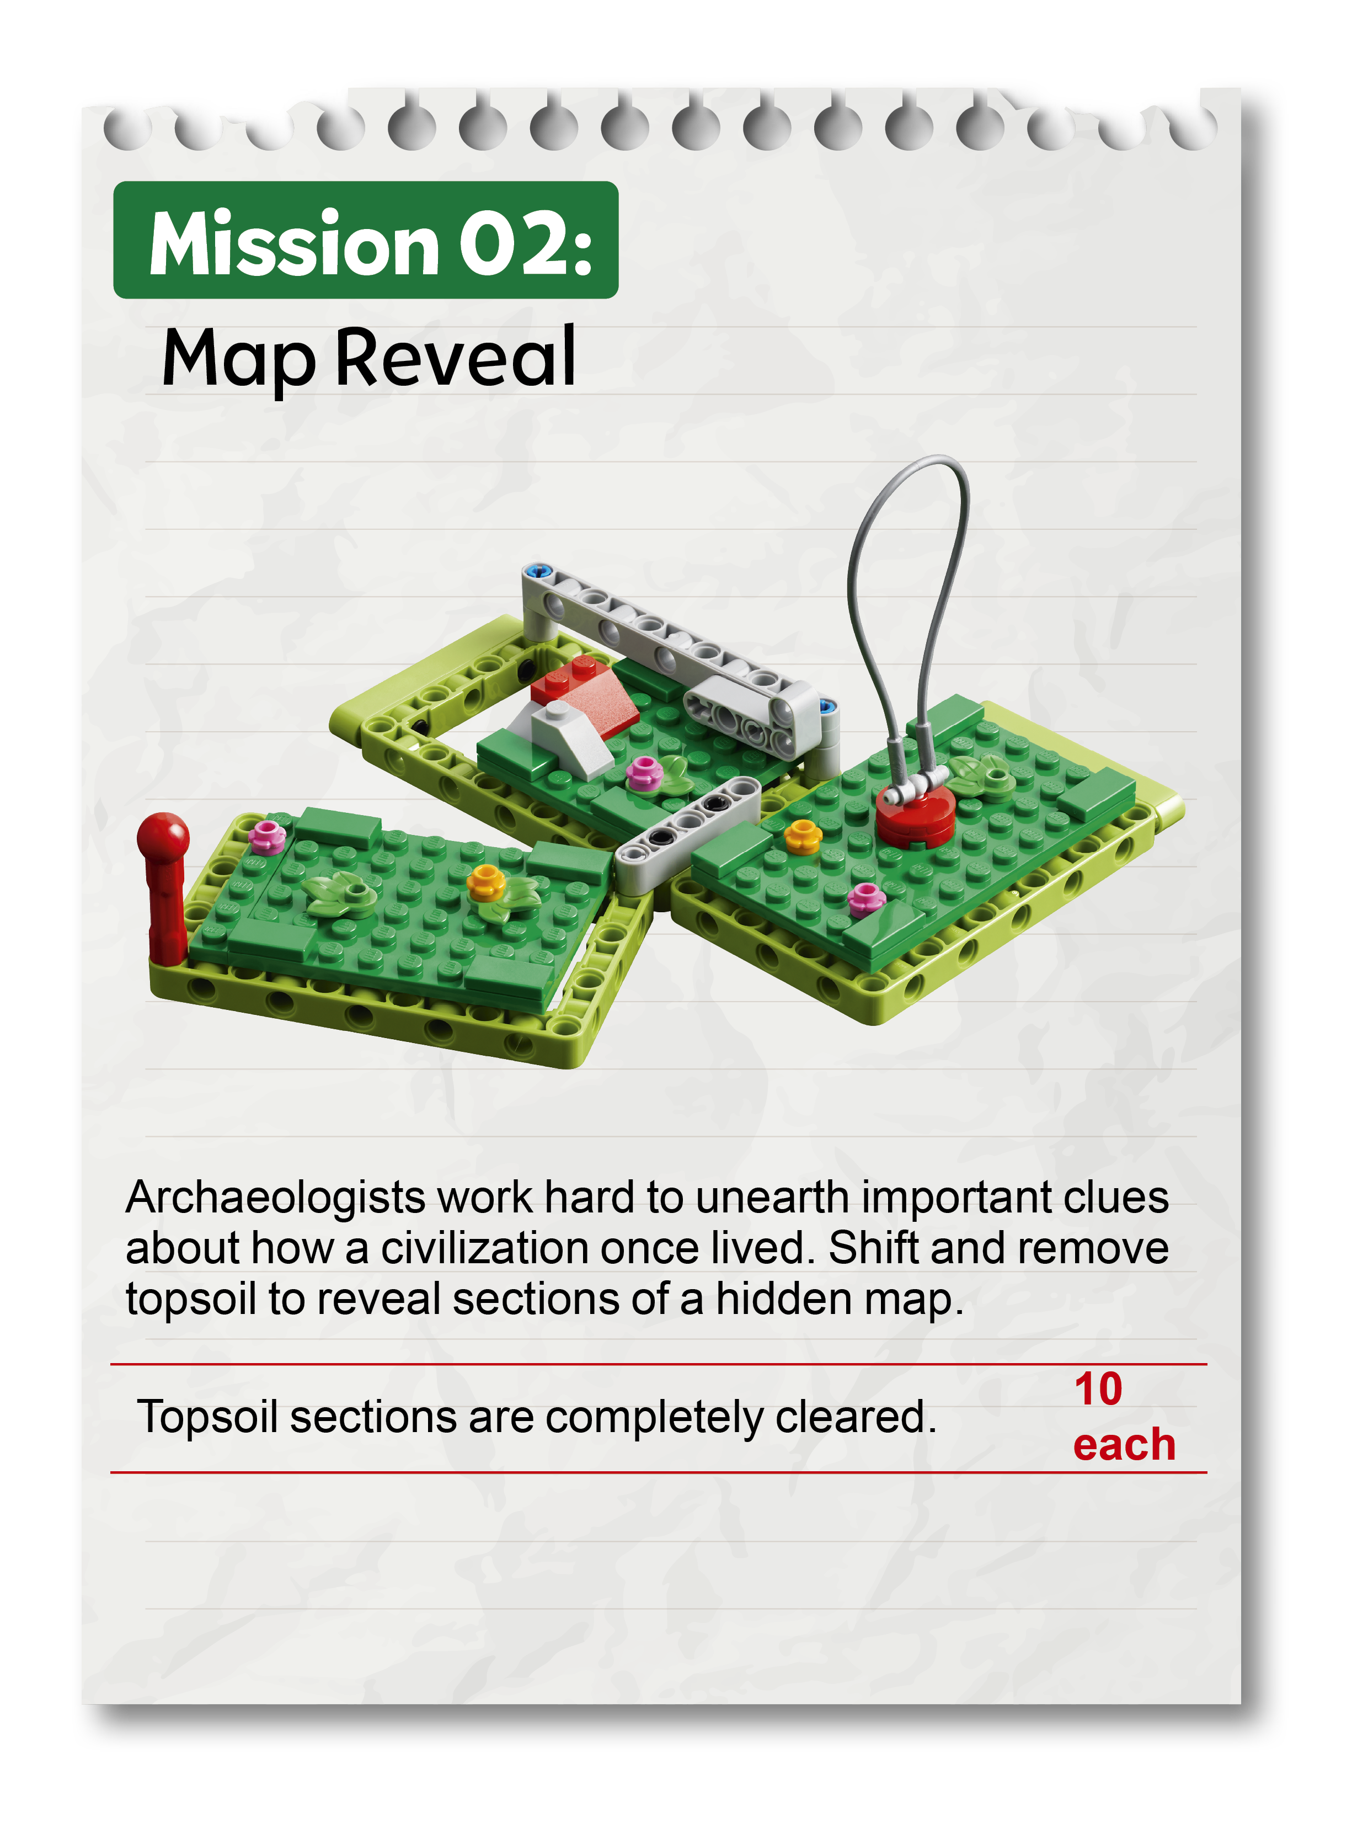
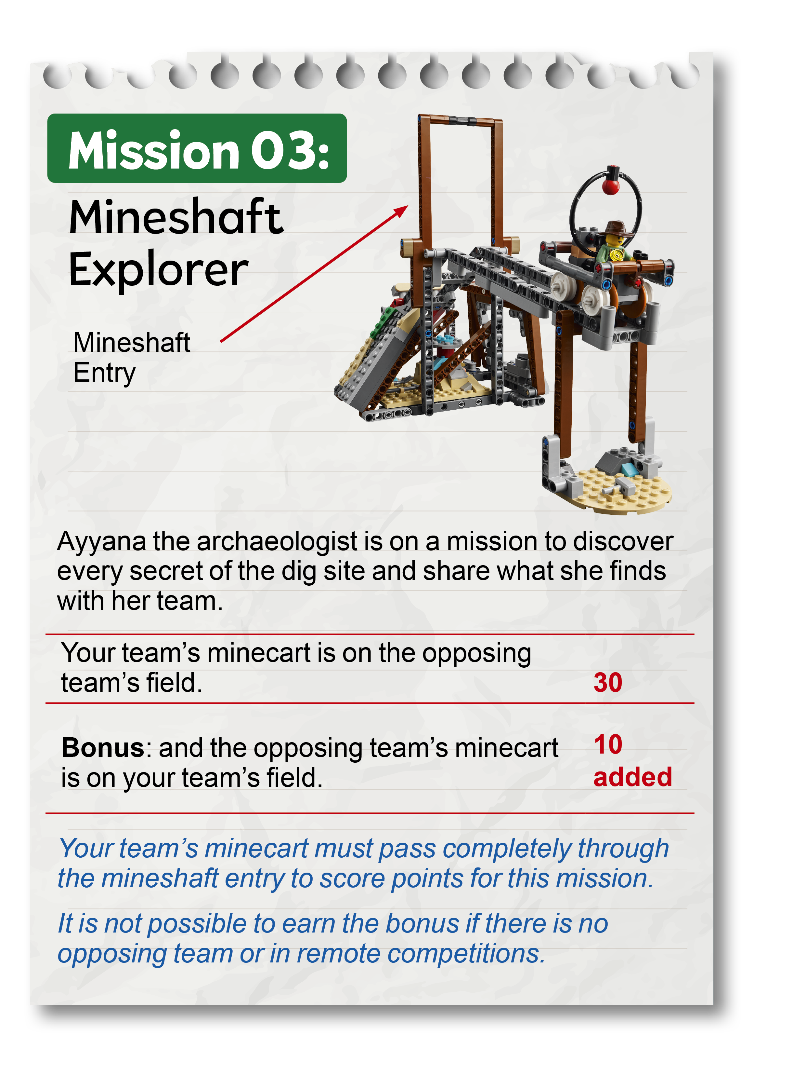
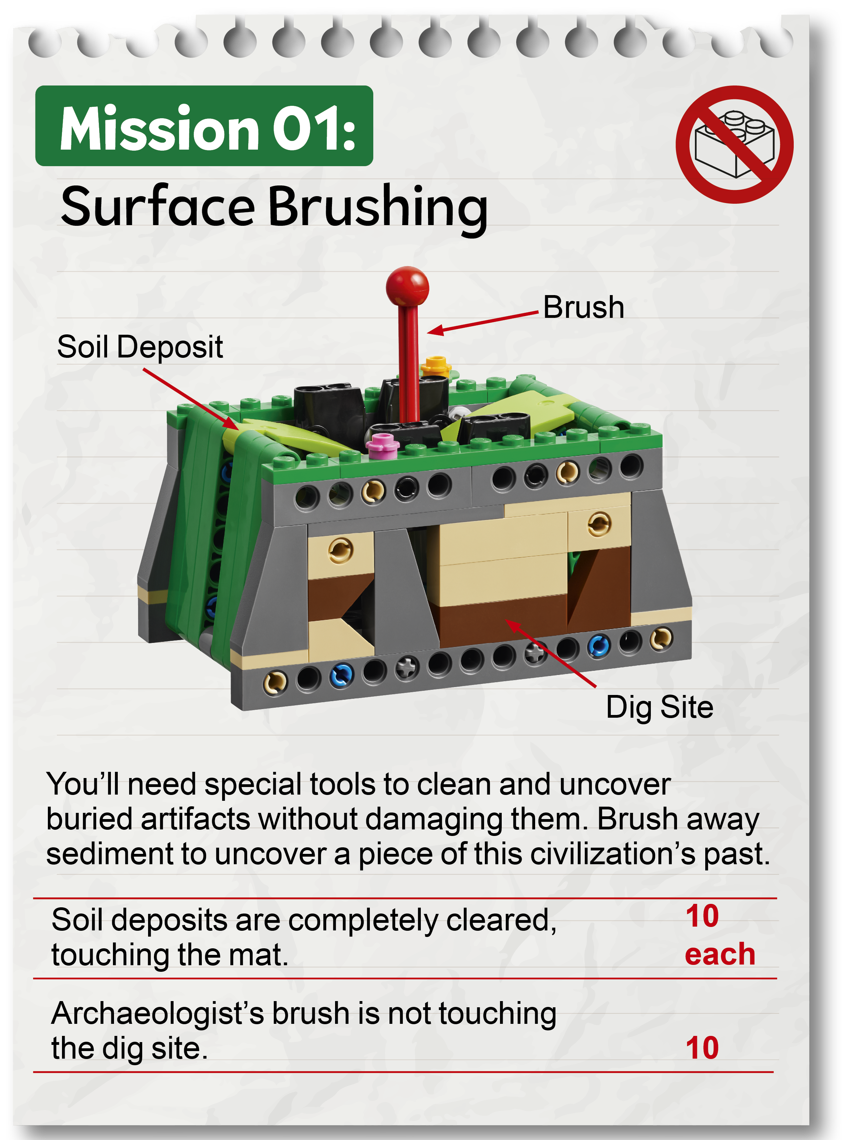

Slide 19
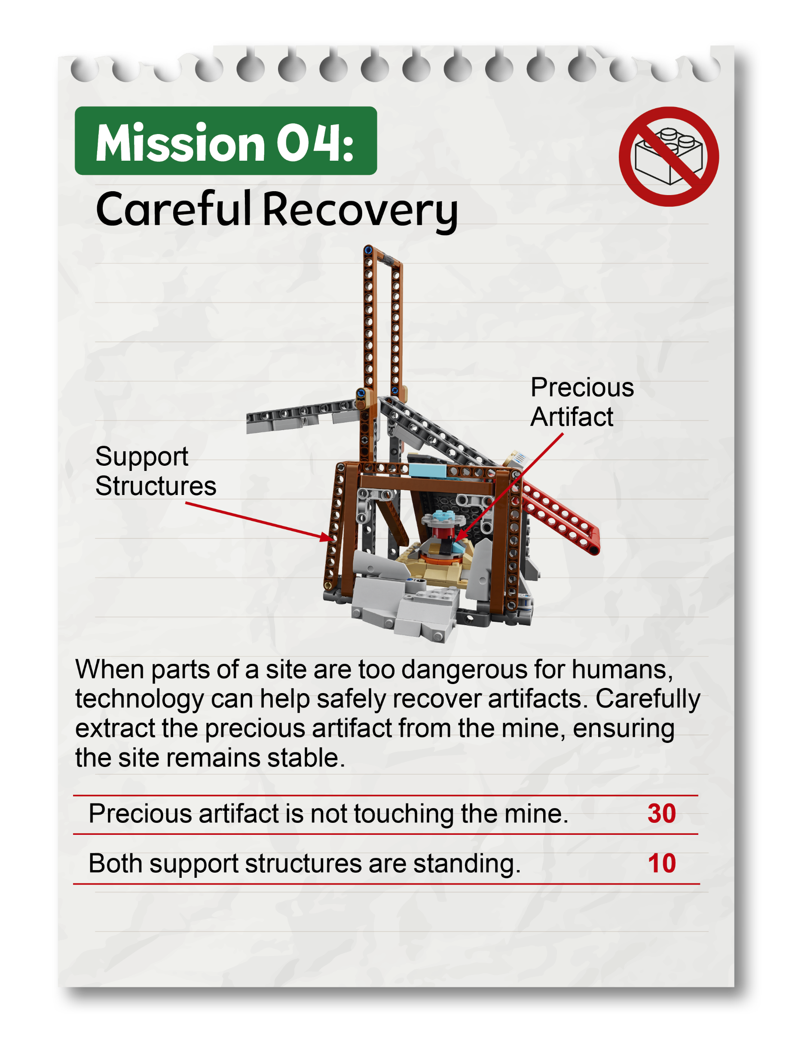
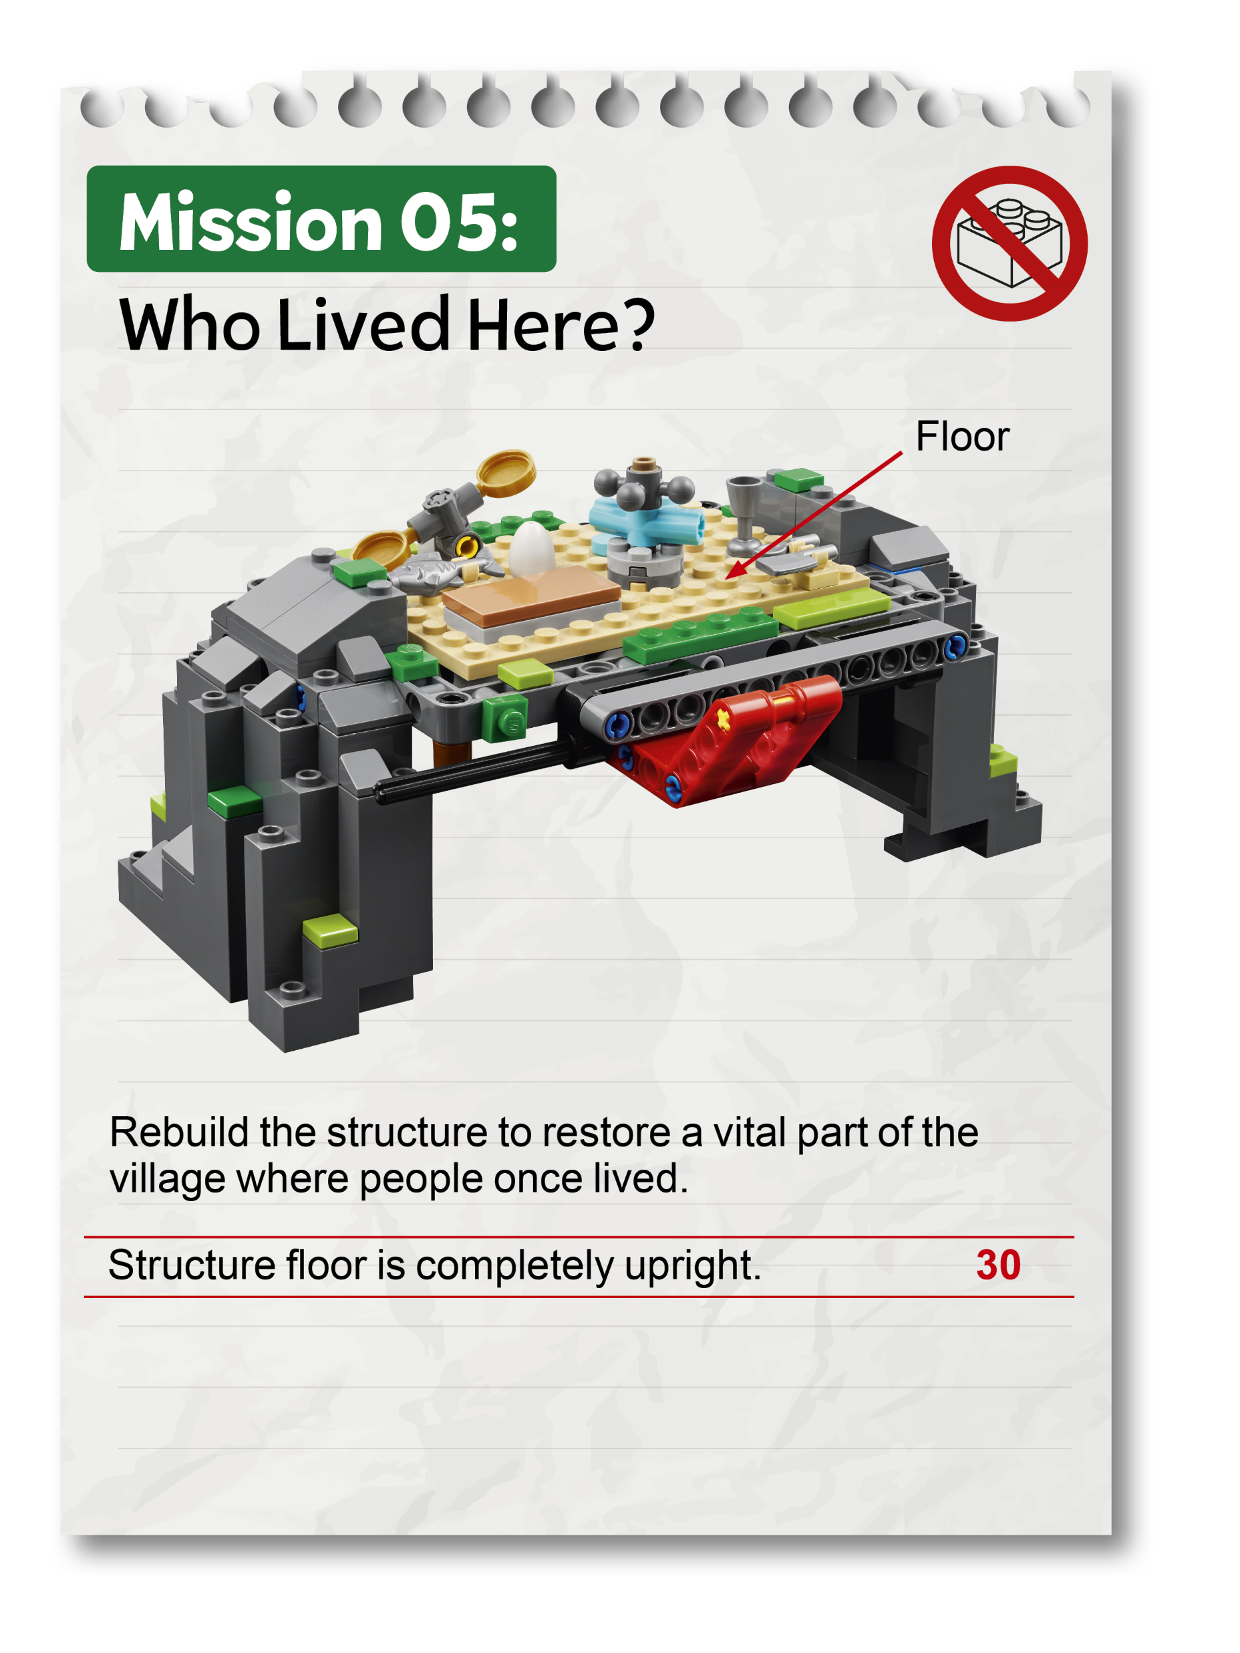
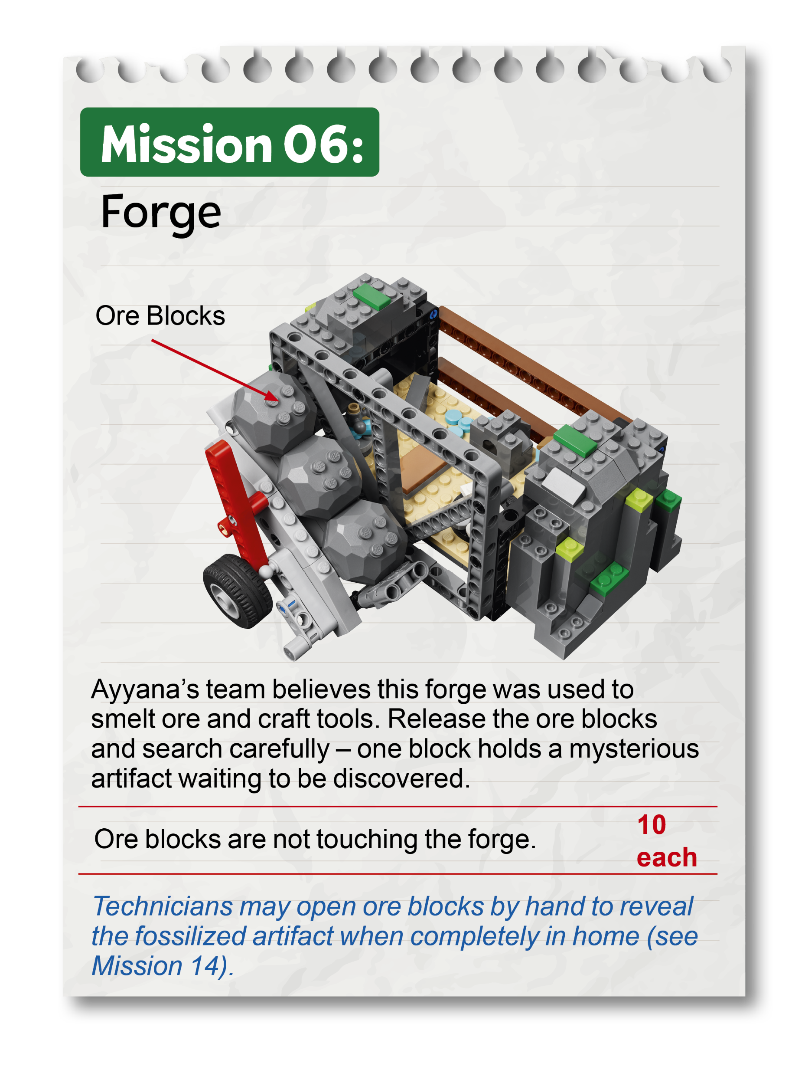

Slide 20
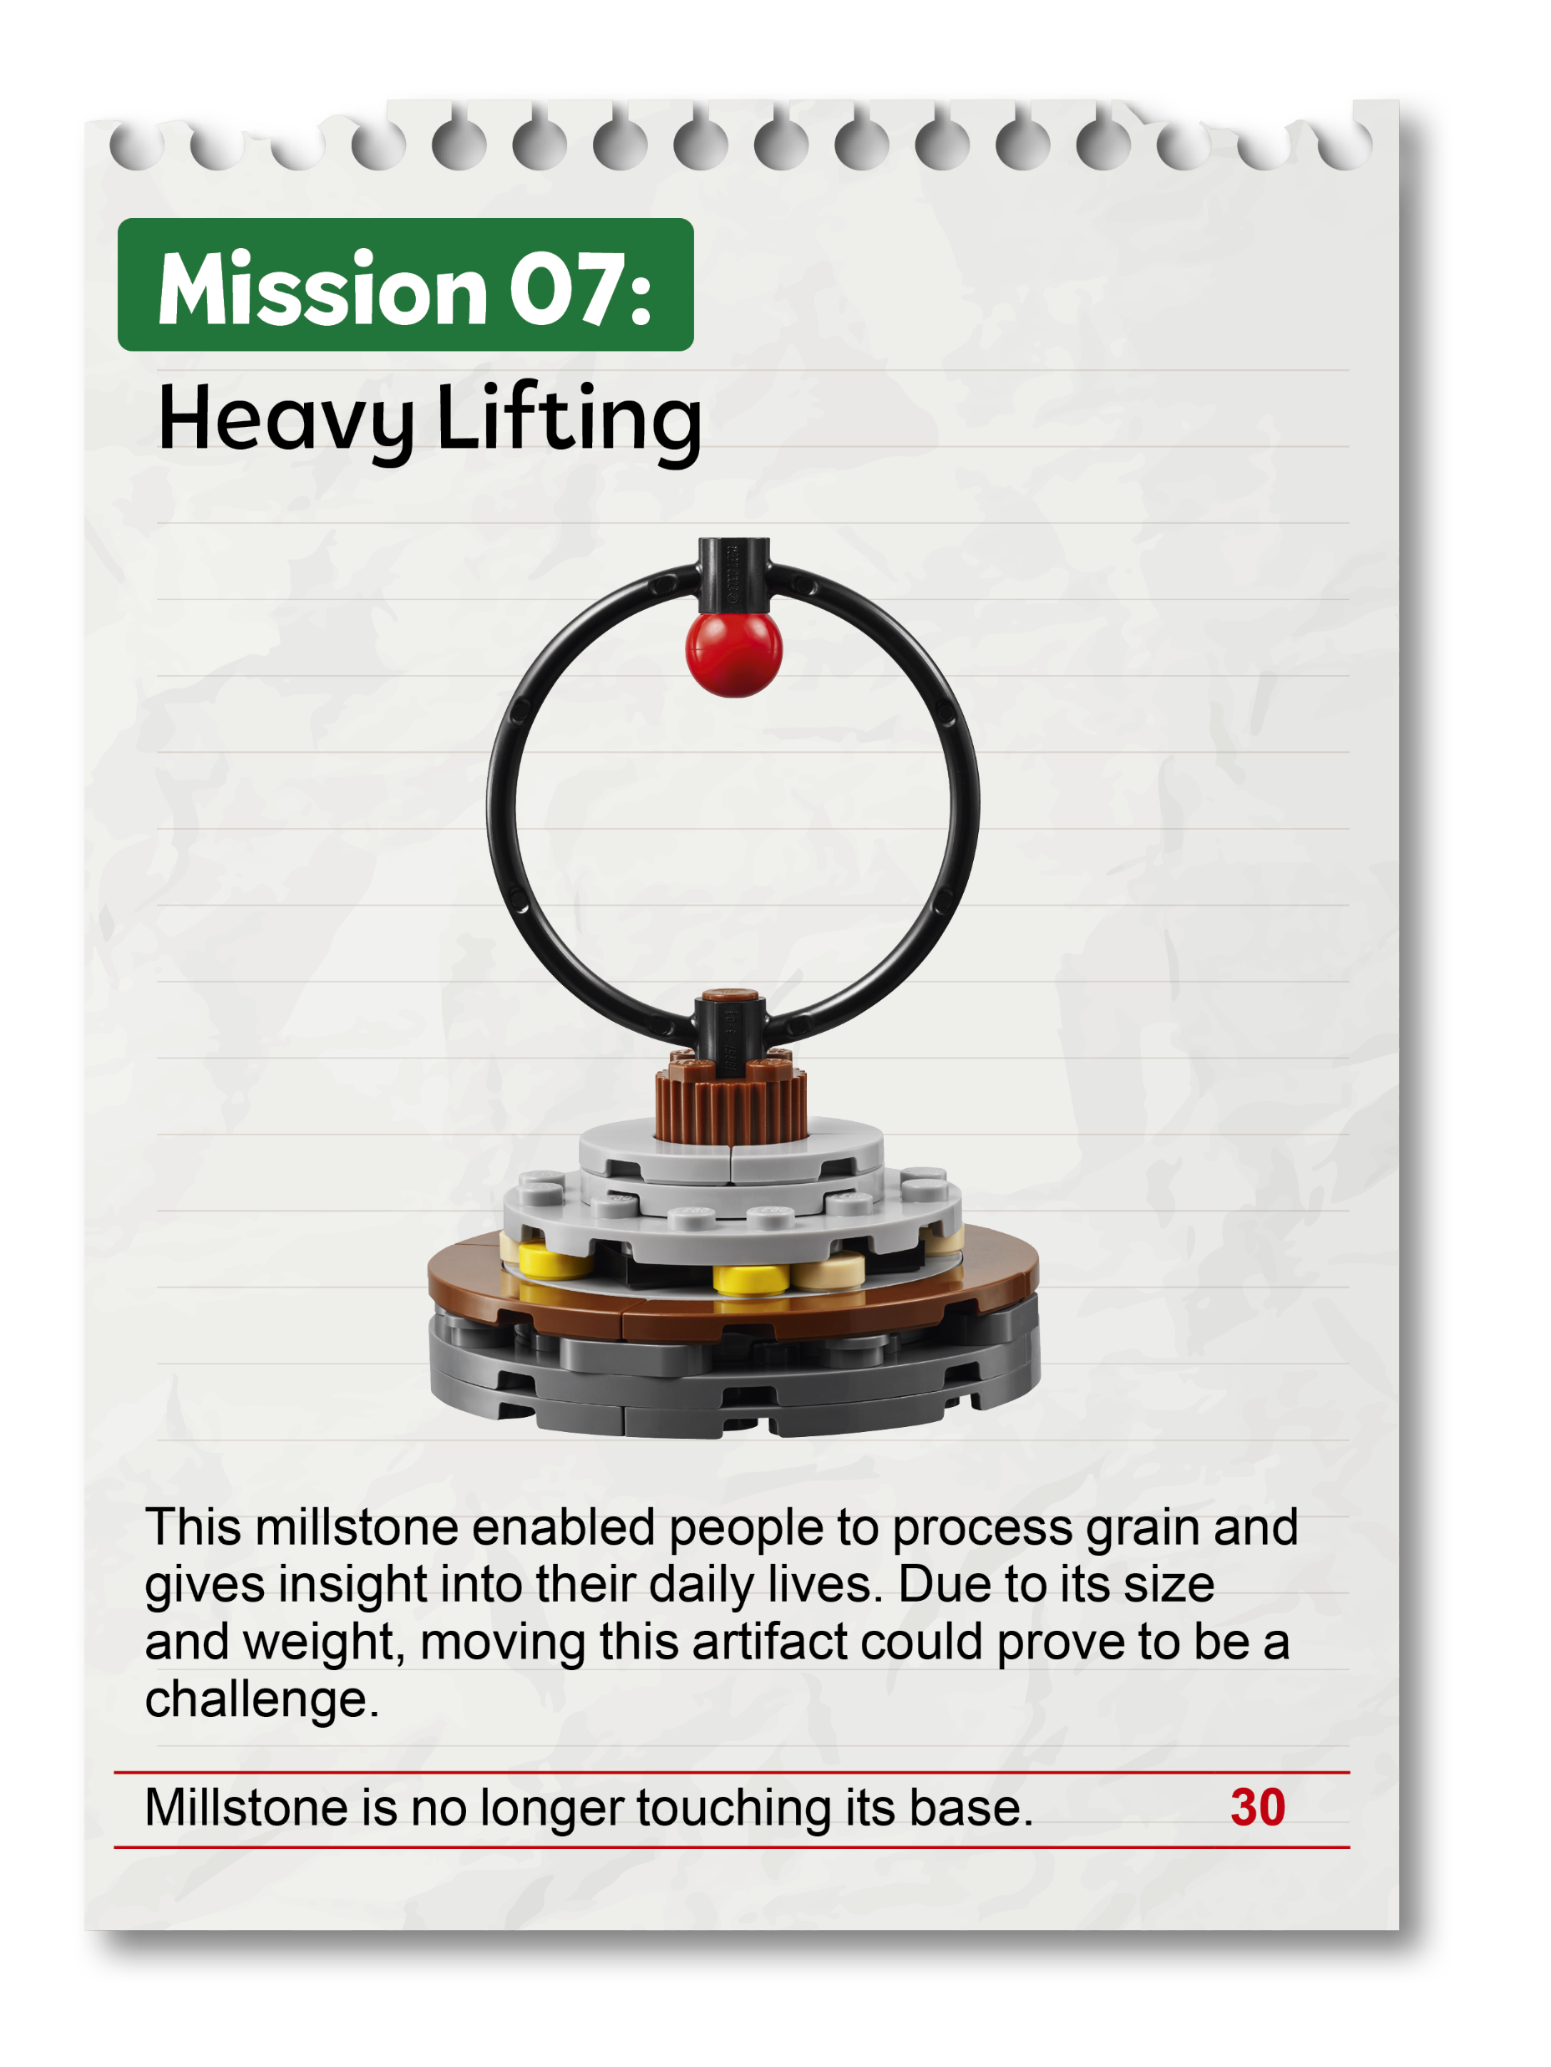
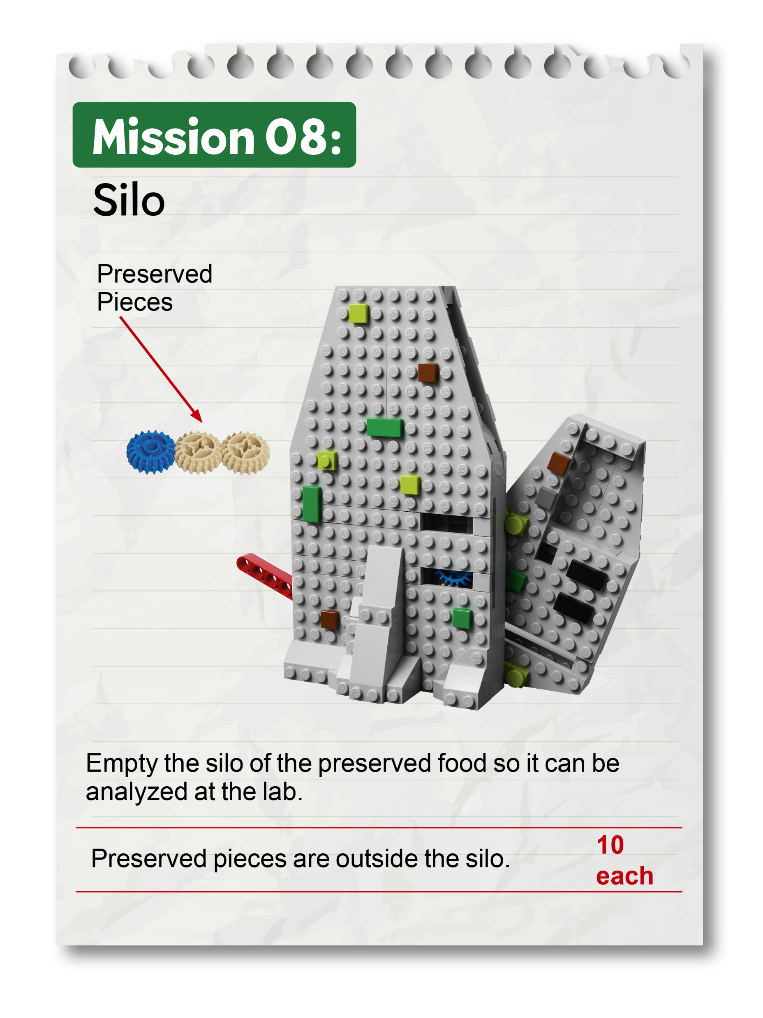
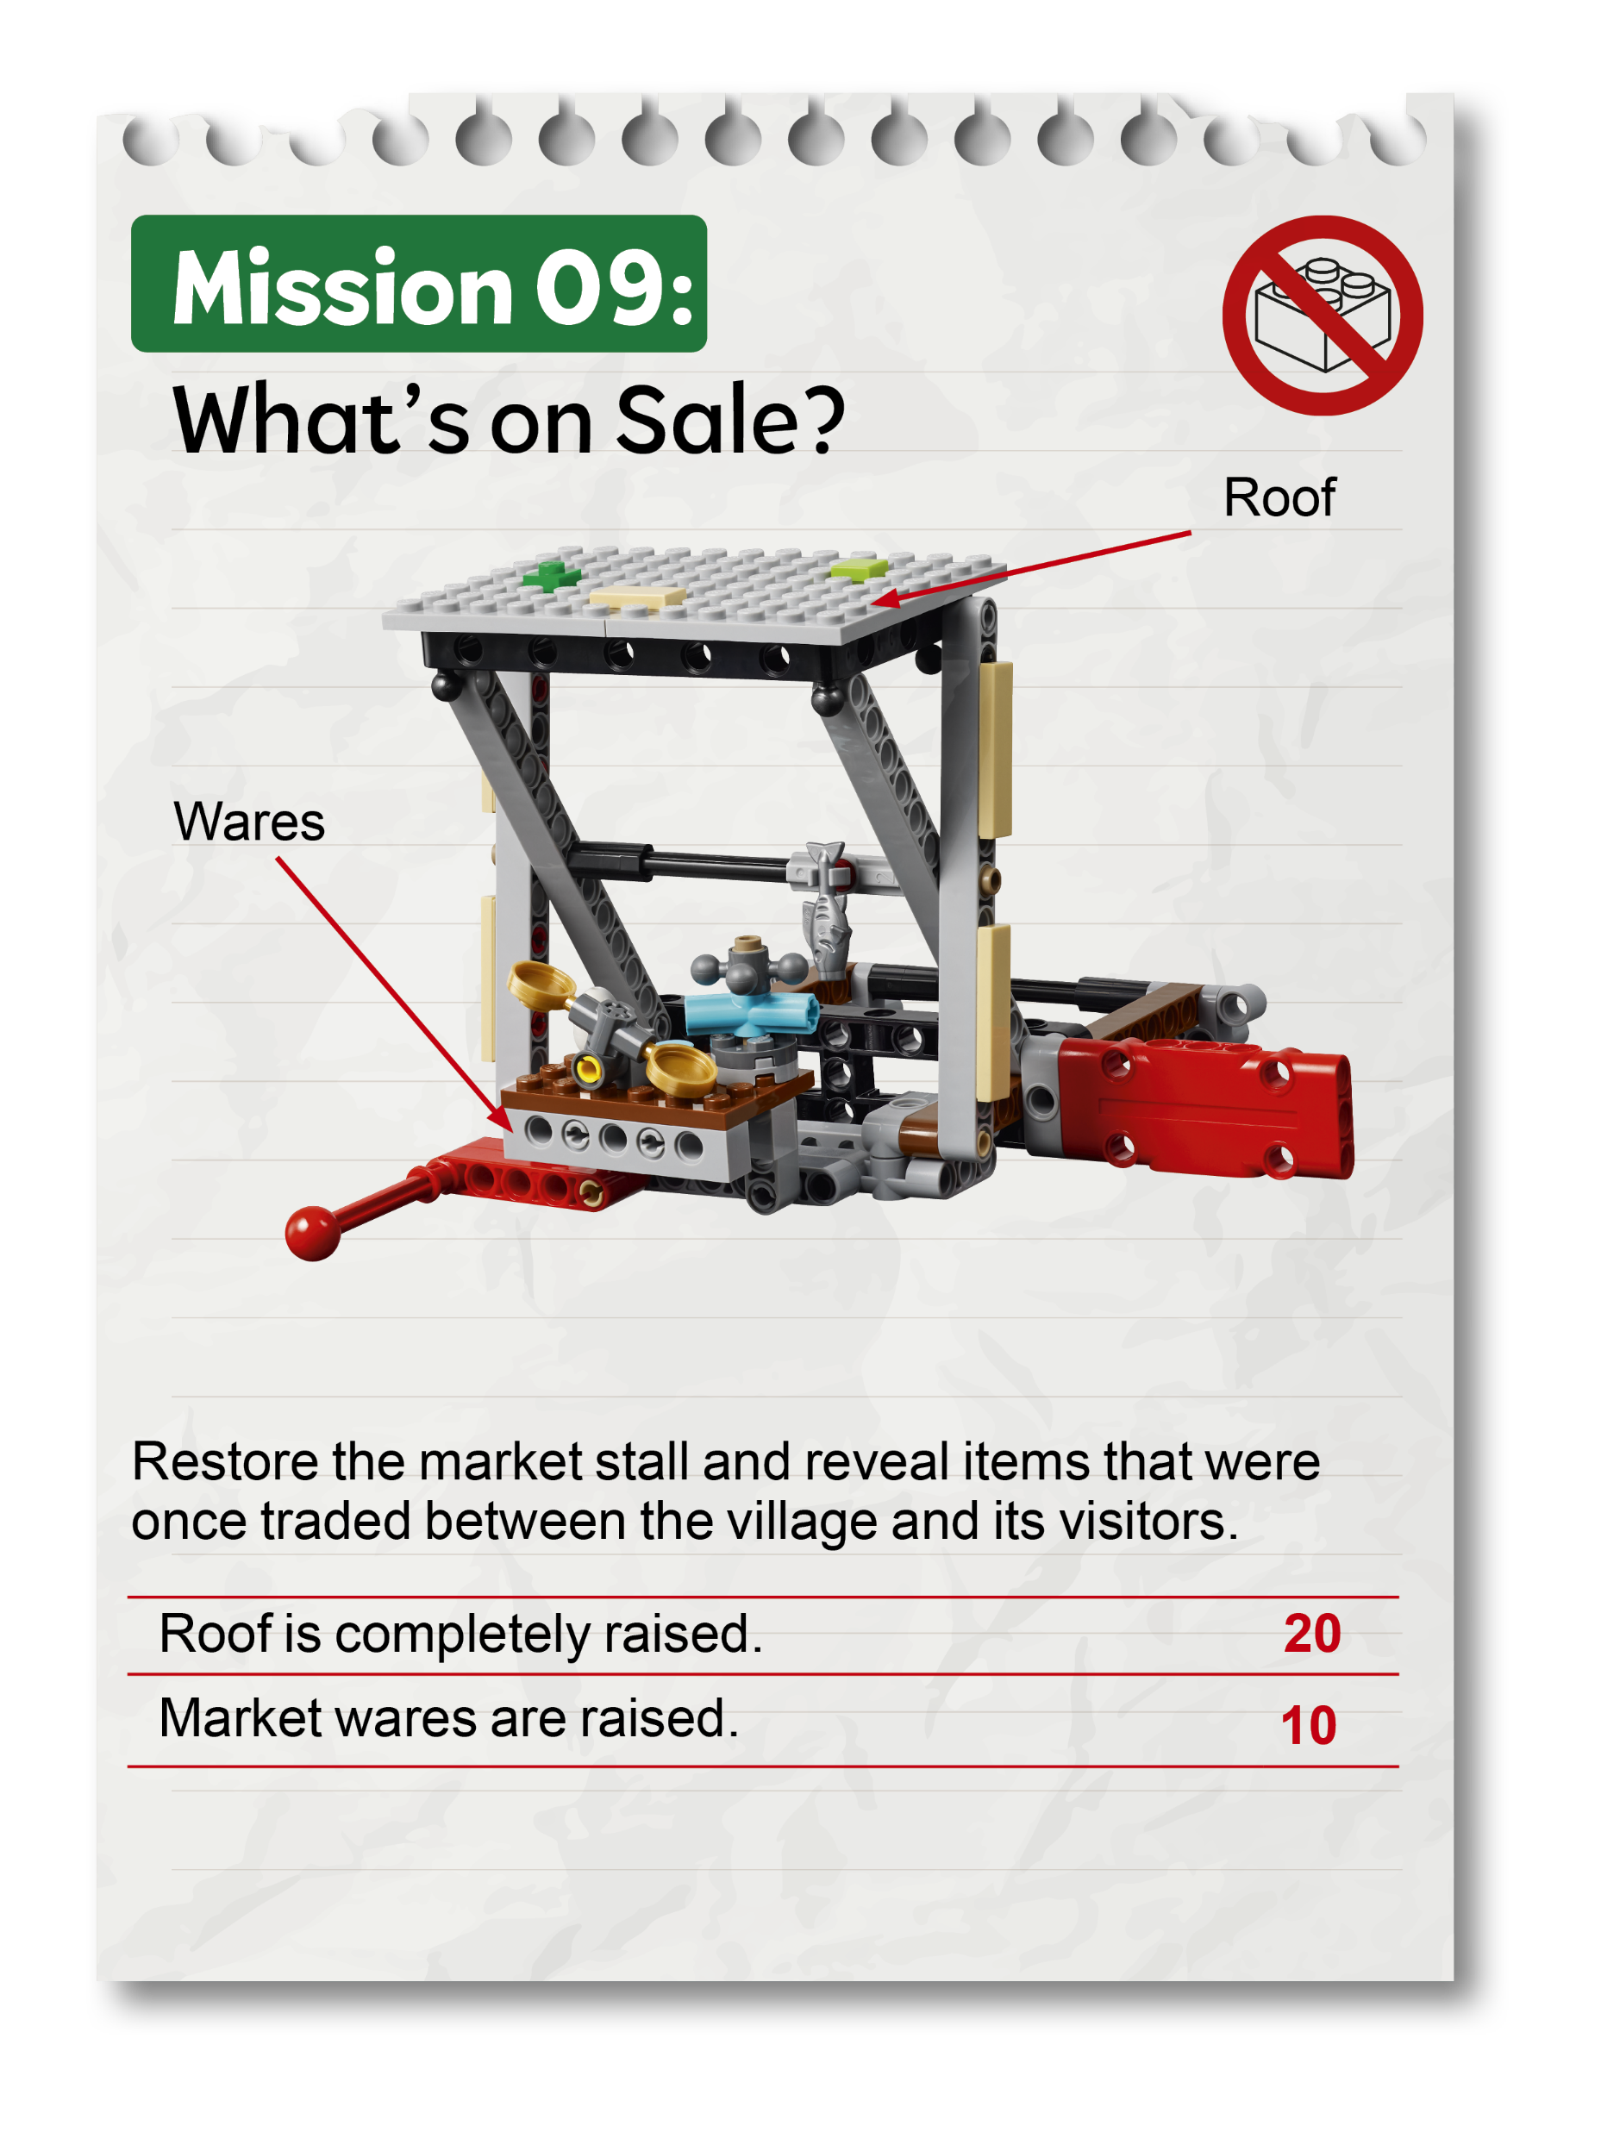

Slide 21
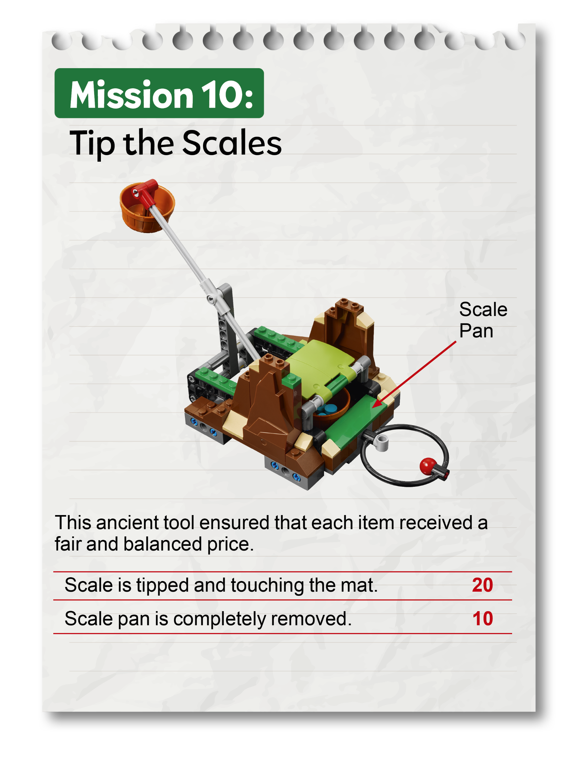
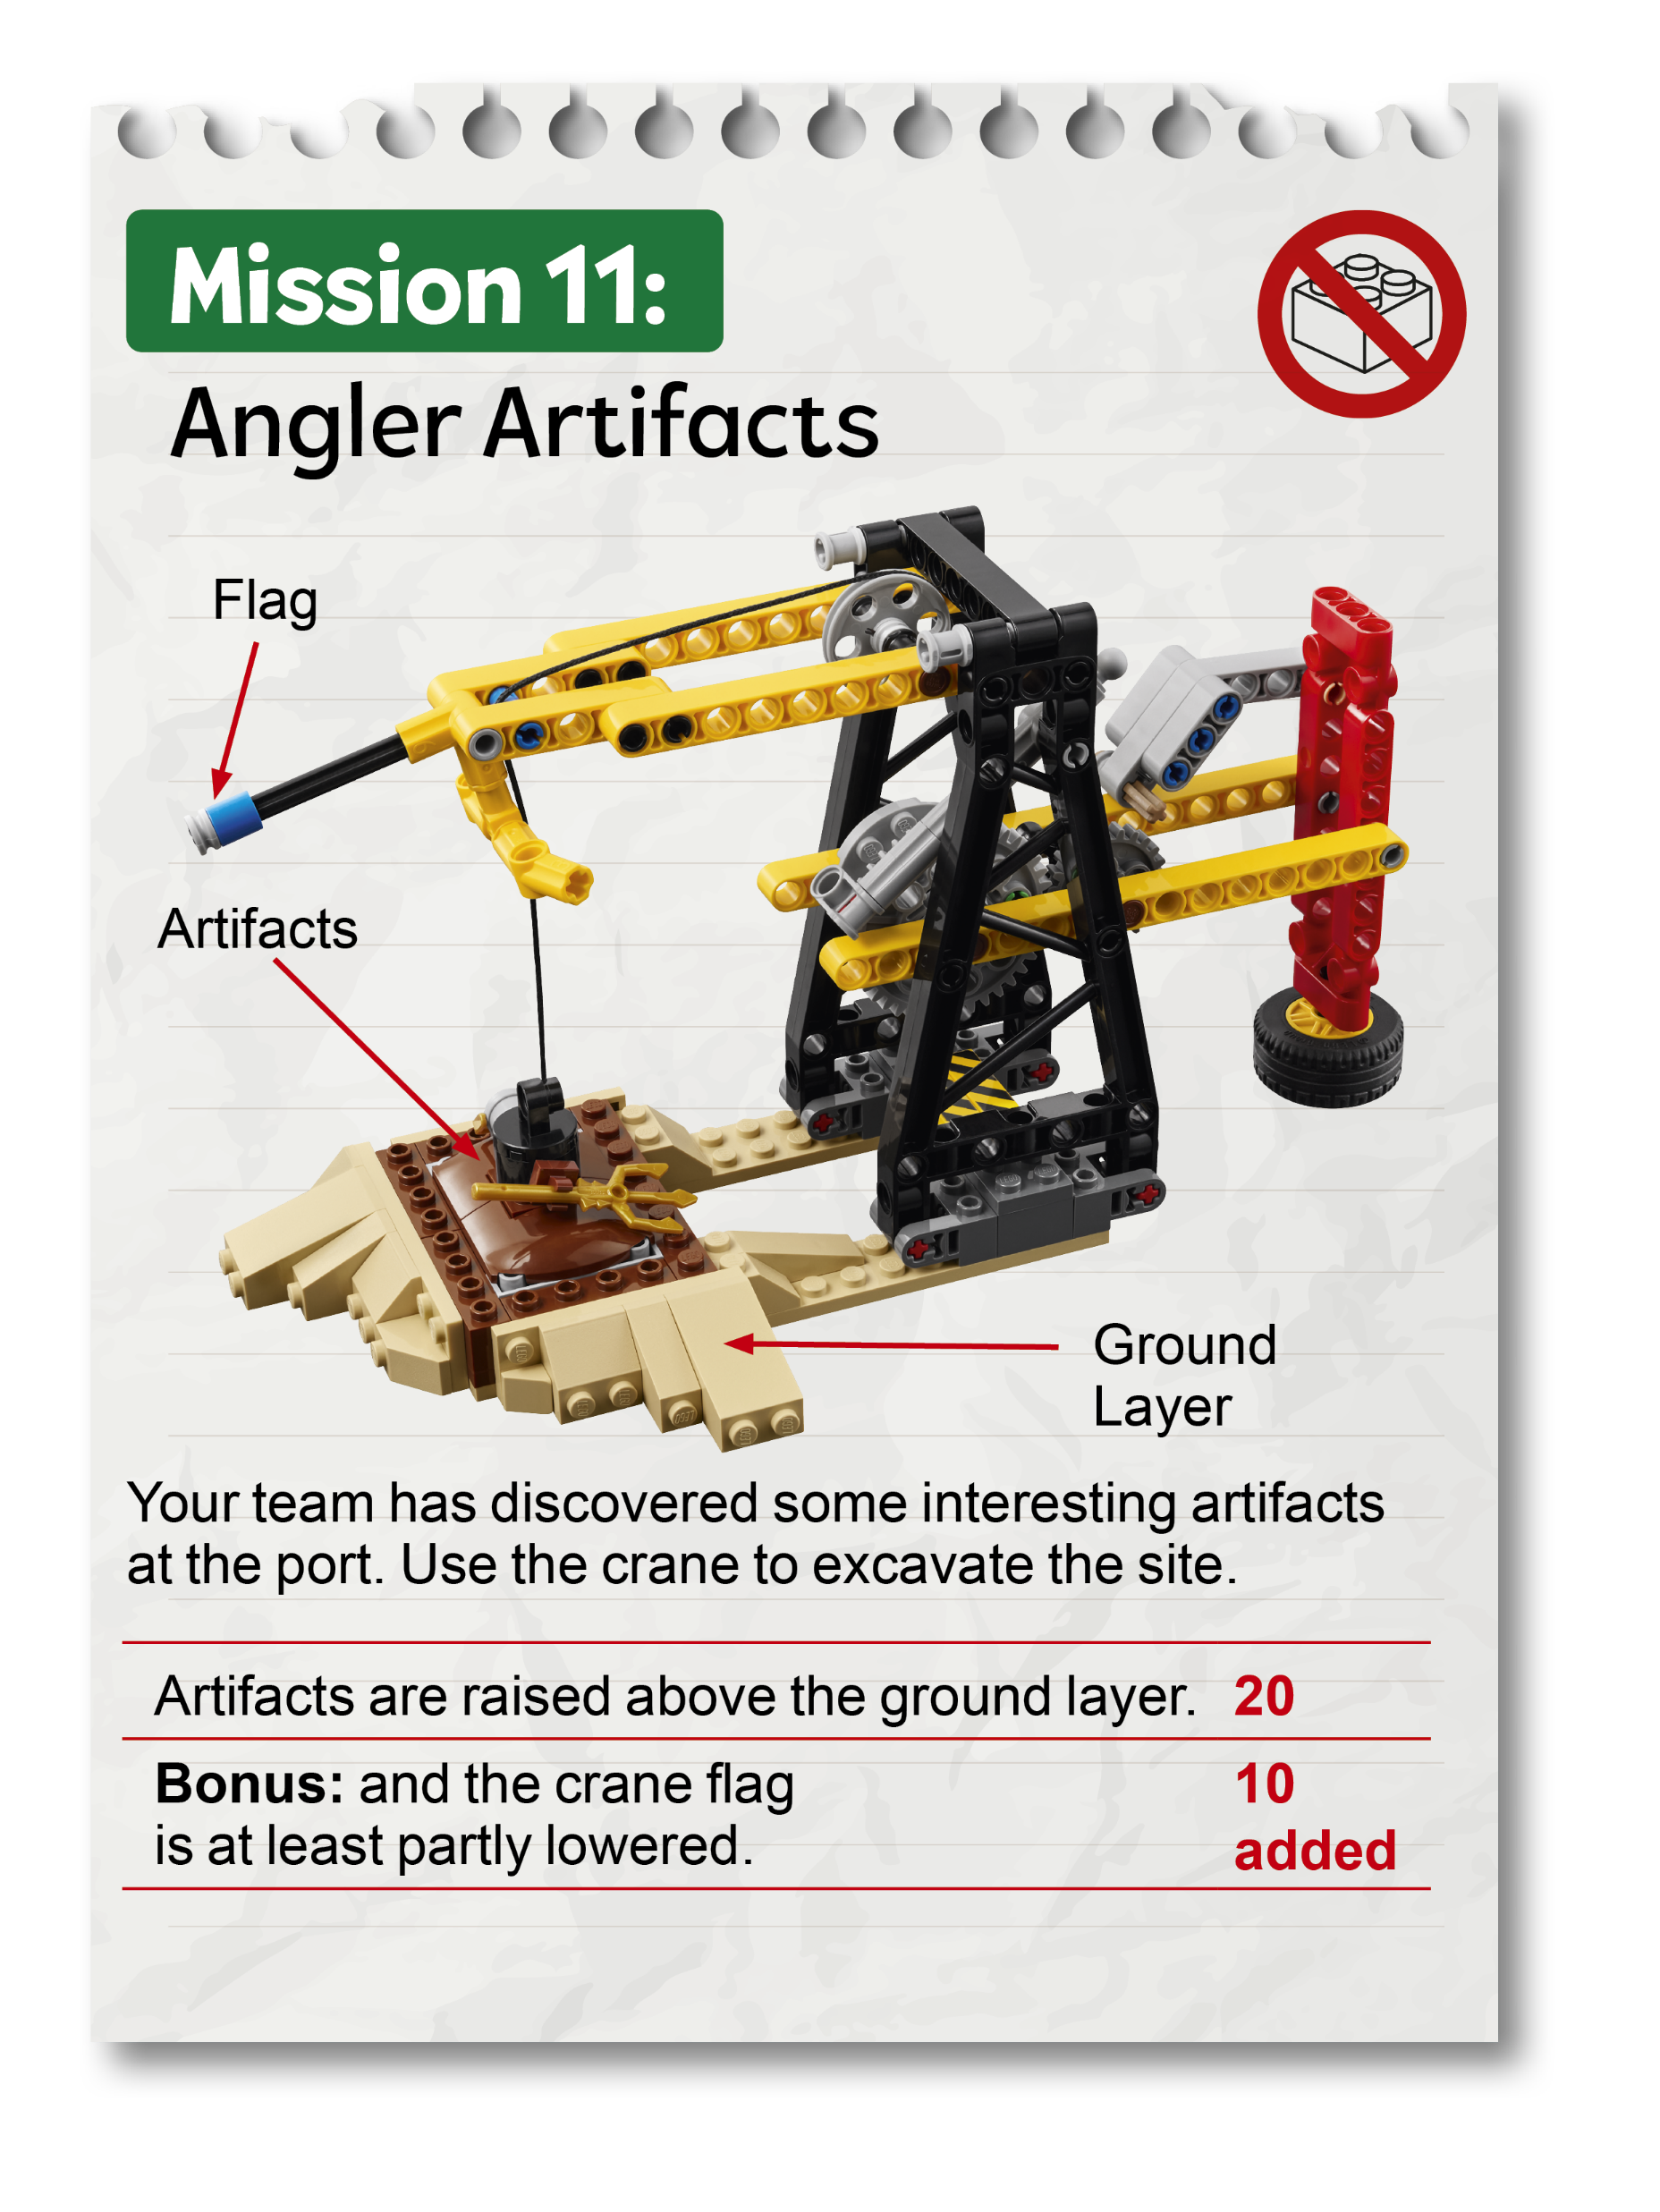
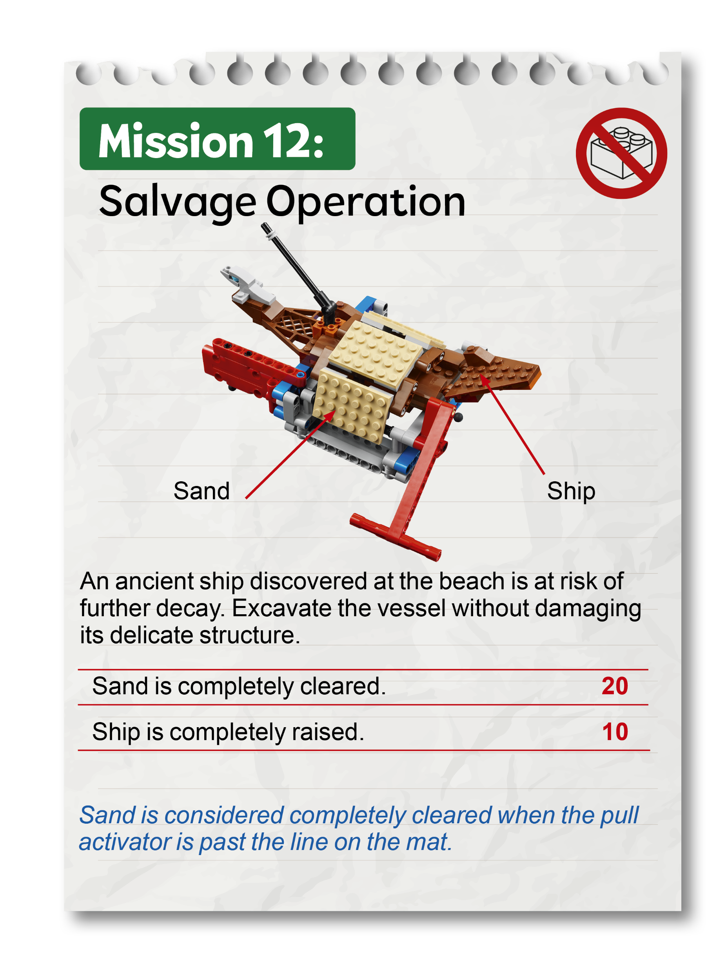

Slide 22
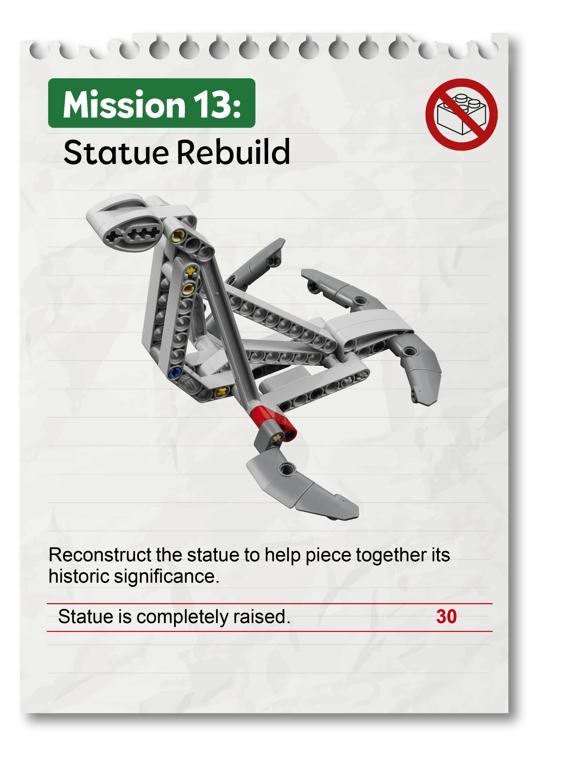
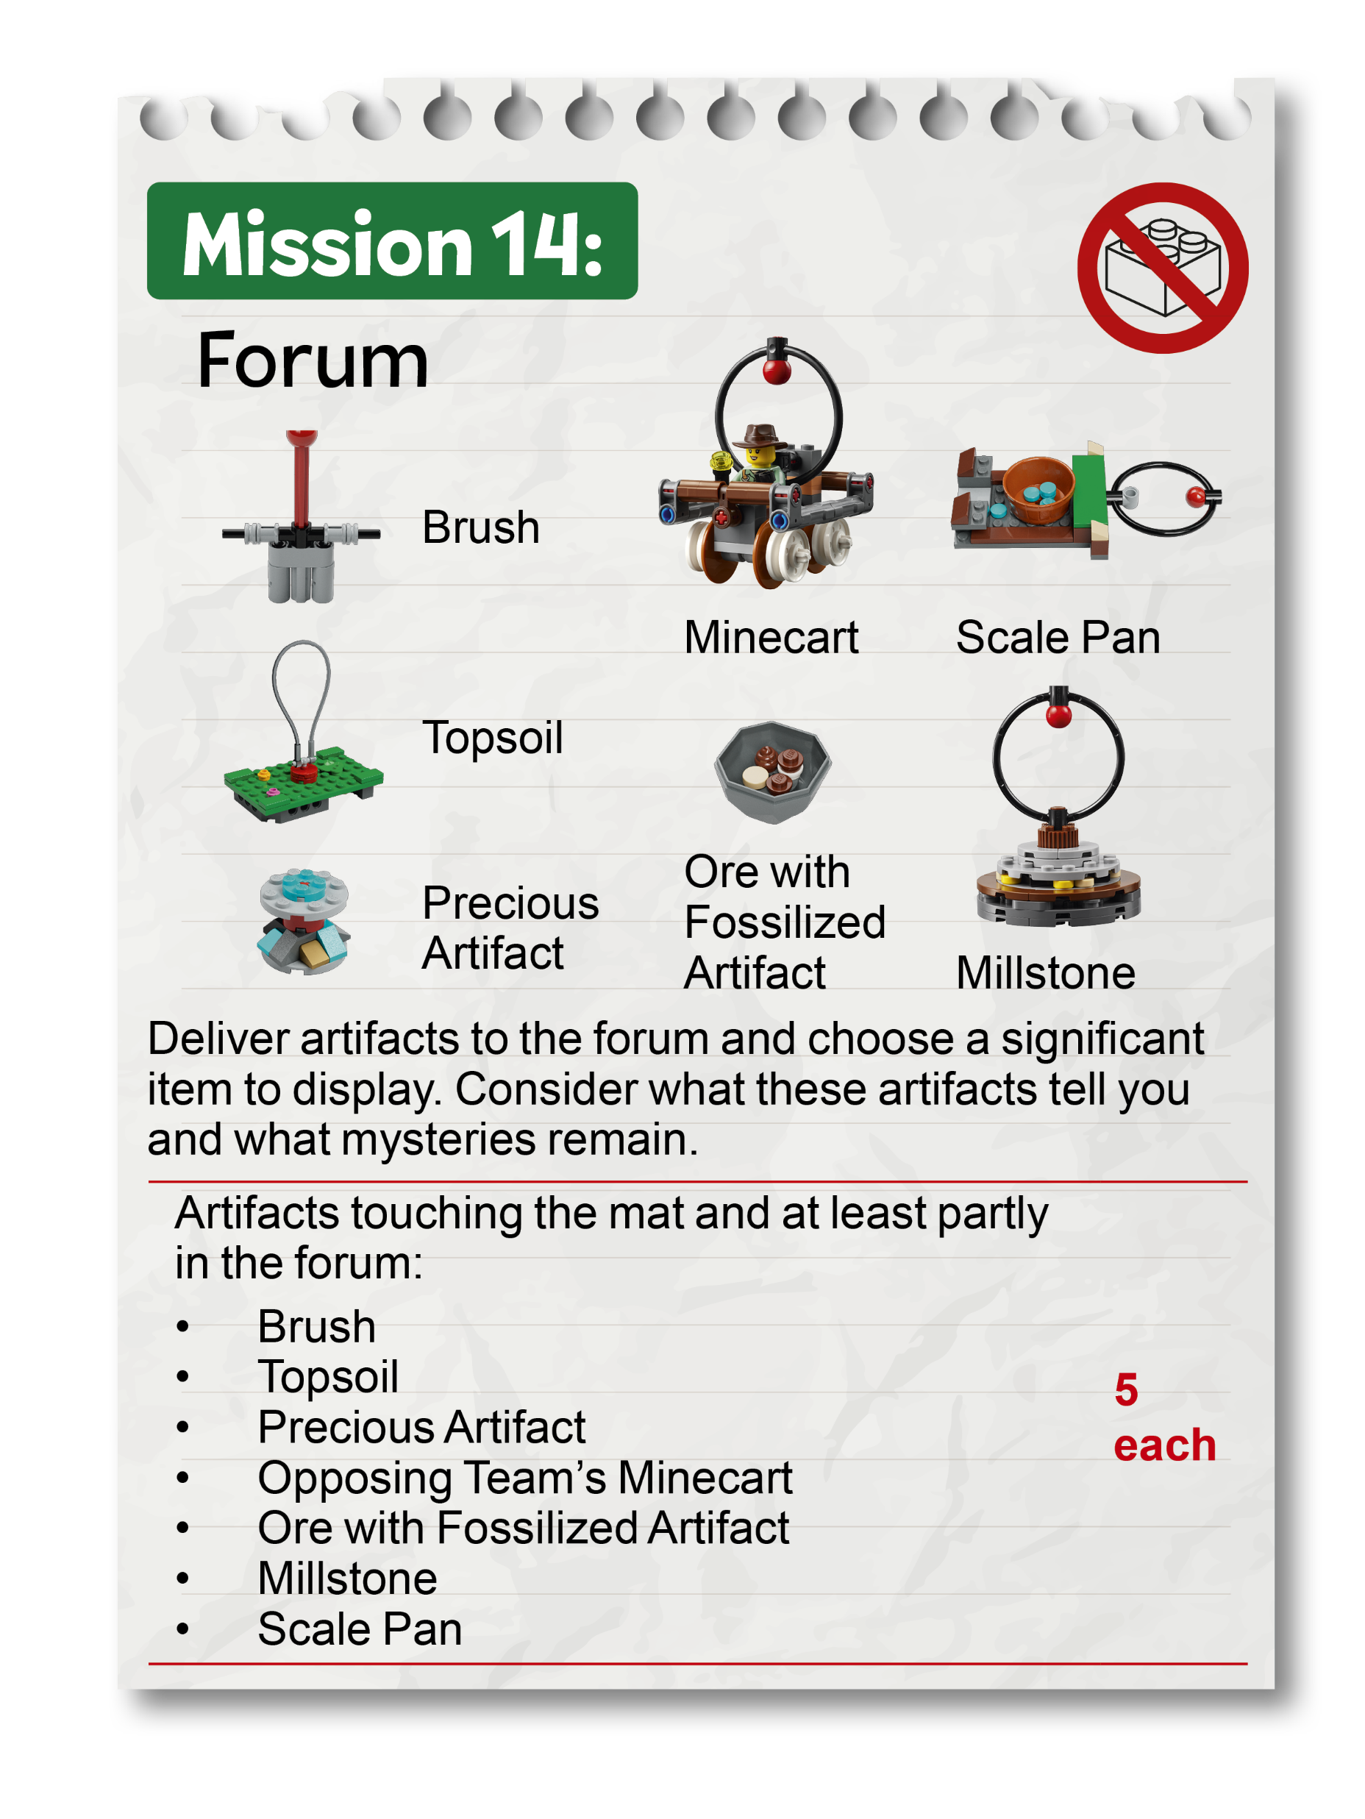
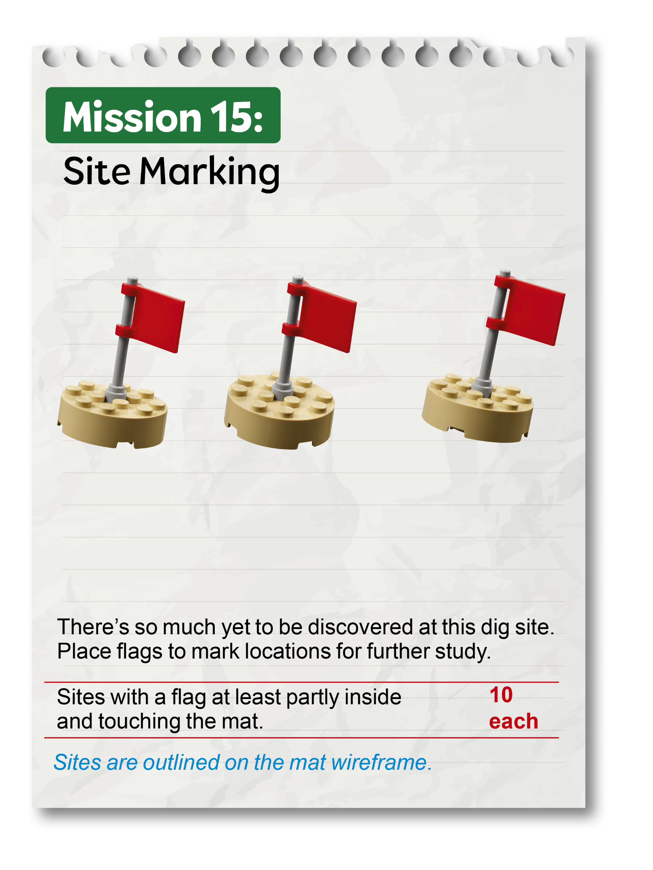

Slide 23
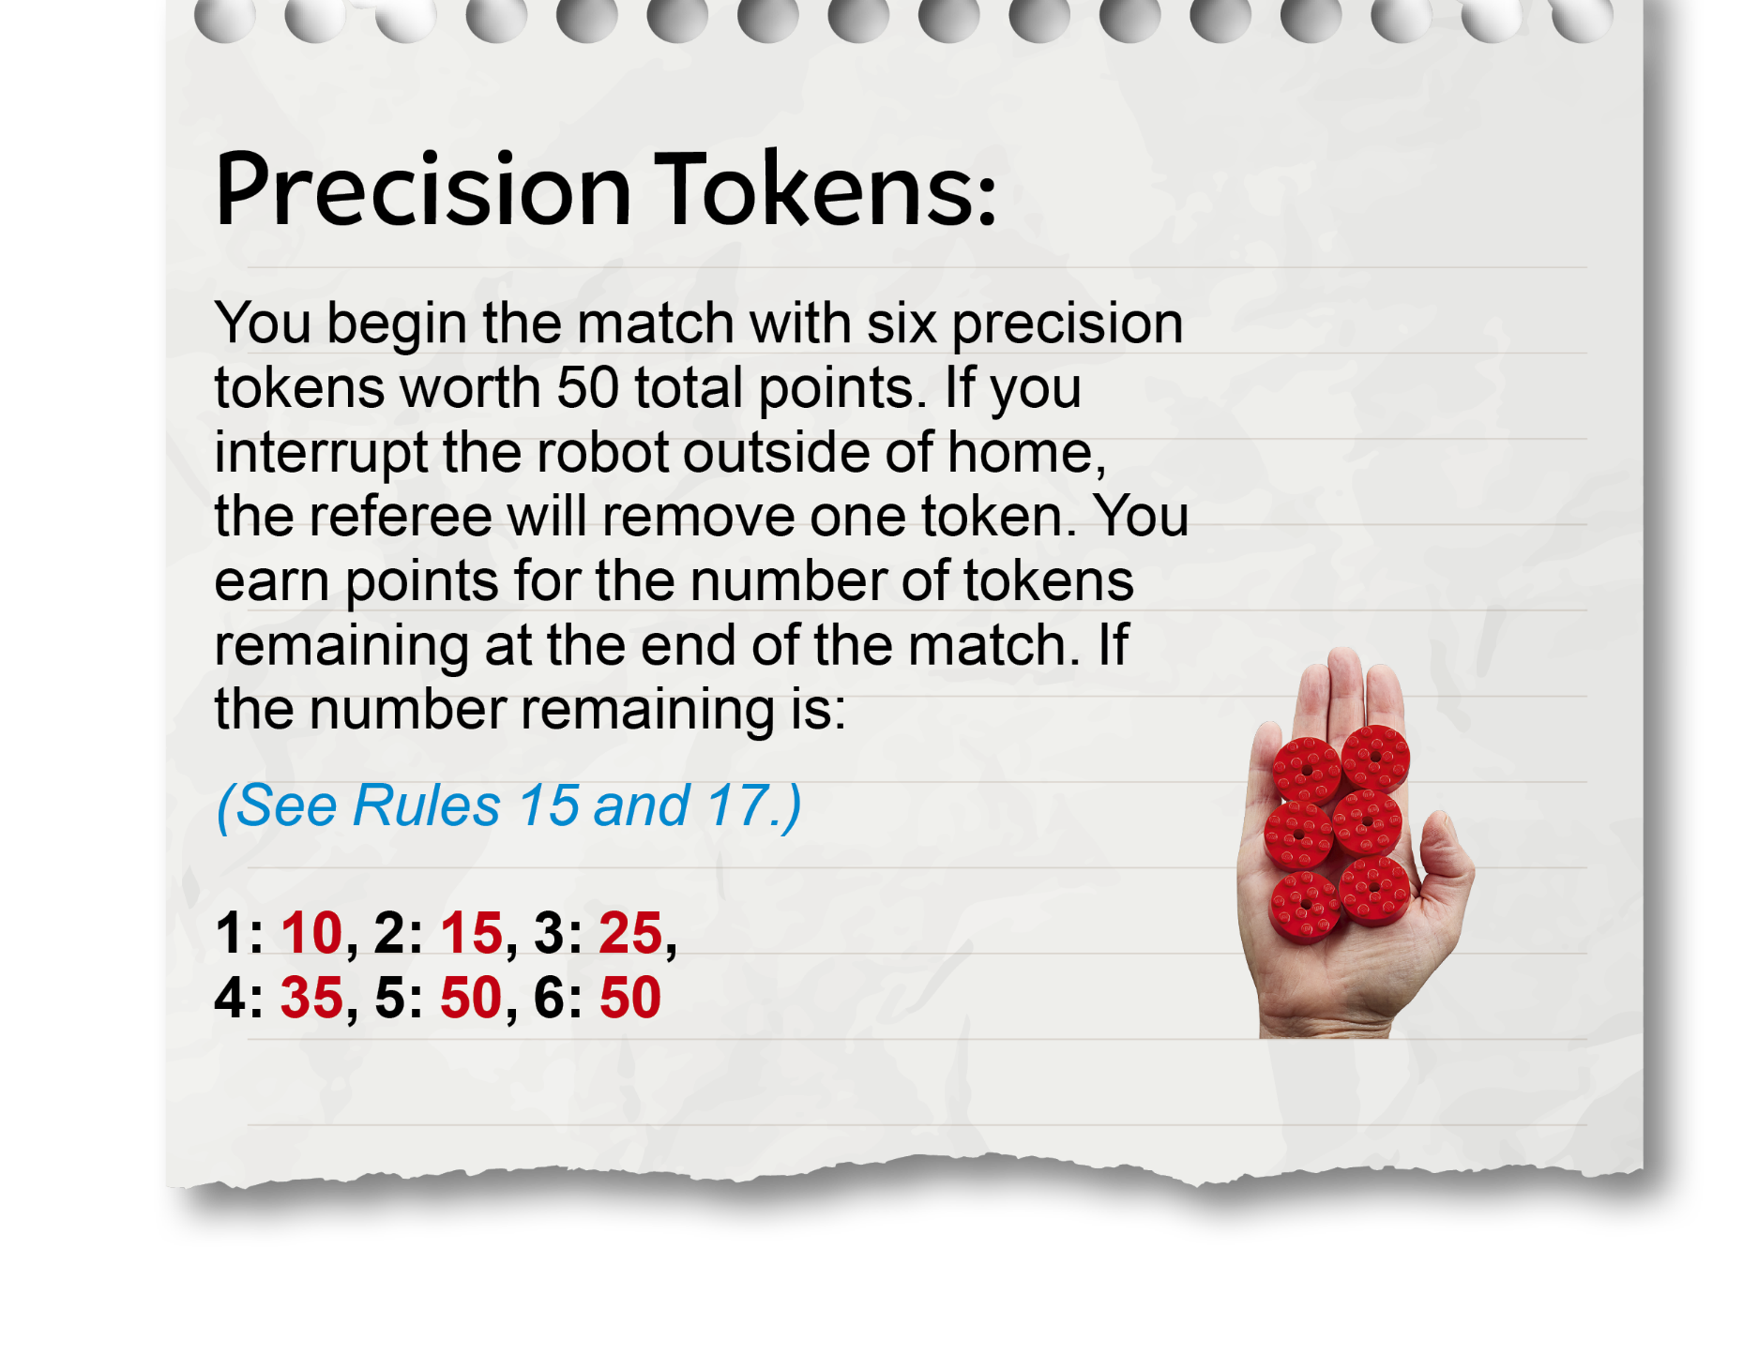
Precision Tokens
Find a convenient place to store precision tokens during the match that is visible to the team
Interruption: Any interaction by technicians with the robot or objects in contact with the robot after it has been launched (See Glossary)
See Rules – During the Match for a complete list of rules that apply during the match

Slide 24
Challenge Updates
Challenge Updates are posted throughout the season and supersede what is written in the Robot Game Rulebook or shown in official videos.

Slide 25
Challenge Updates – as of August 5, 2025
UPDATE 01 – EXTENDING PAST THE WALLS OF HOME UPON RETURN – Extending past any wall of Home upon return counts as “completely in” and can be handled without penalty.
UPDATE 02 – MISSION 02: MAP REVEAL SETUP – 3M™ Dual Lock™ Reclosable Fasteners should be aligned carefully to avoid unintended contact with the topsoil sections. Misalignment may cause sticking or movement issues that could affect the model’s performance. Teams should check for smooth operation during setup.
UPDATE 03 – MISSION 02: TOPSOIL CLEARING CRITERIA – Mission 02 includes three topsoil sections, each requiring a unique action to be considered cleared:
One section (identified by its loop) must be completely removed, so it is no longer touching the model.
The second section must be slid until the latch drops fully.
The third section must be rotated until it is completely past the designated line marked on the mat.
The mission video demonstrates each clearing method and can be used as a reference for intended functionality.

Slide 26
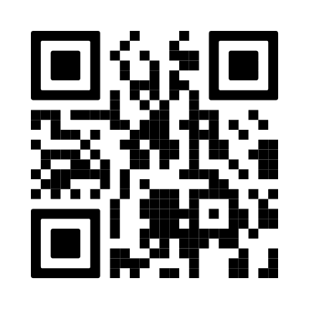
Challenge Updates – Updated throughout the season
Review the most recent version of the Challenge Updates from the Season Resources page.

Slide 27
Remember:
The goal of the day is to CELEBRATE all the team has achieved, no matter the points they score
Your head referee is here to help
When in doubt, give benefit of the doubt

Slide 28
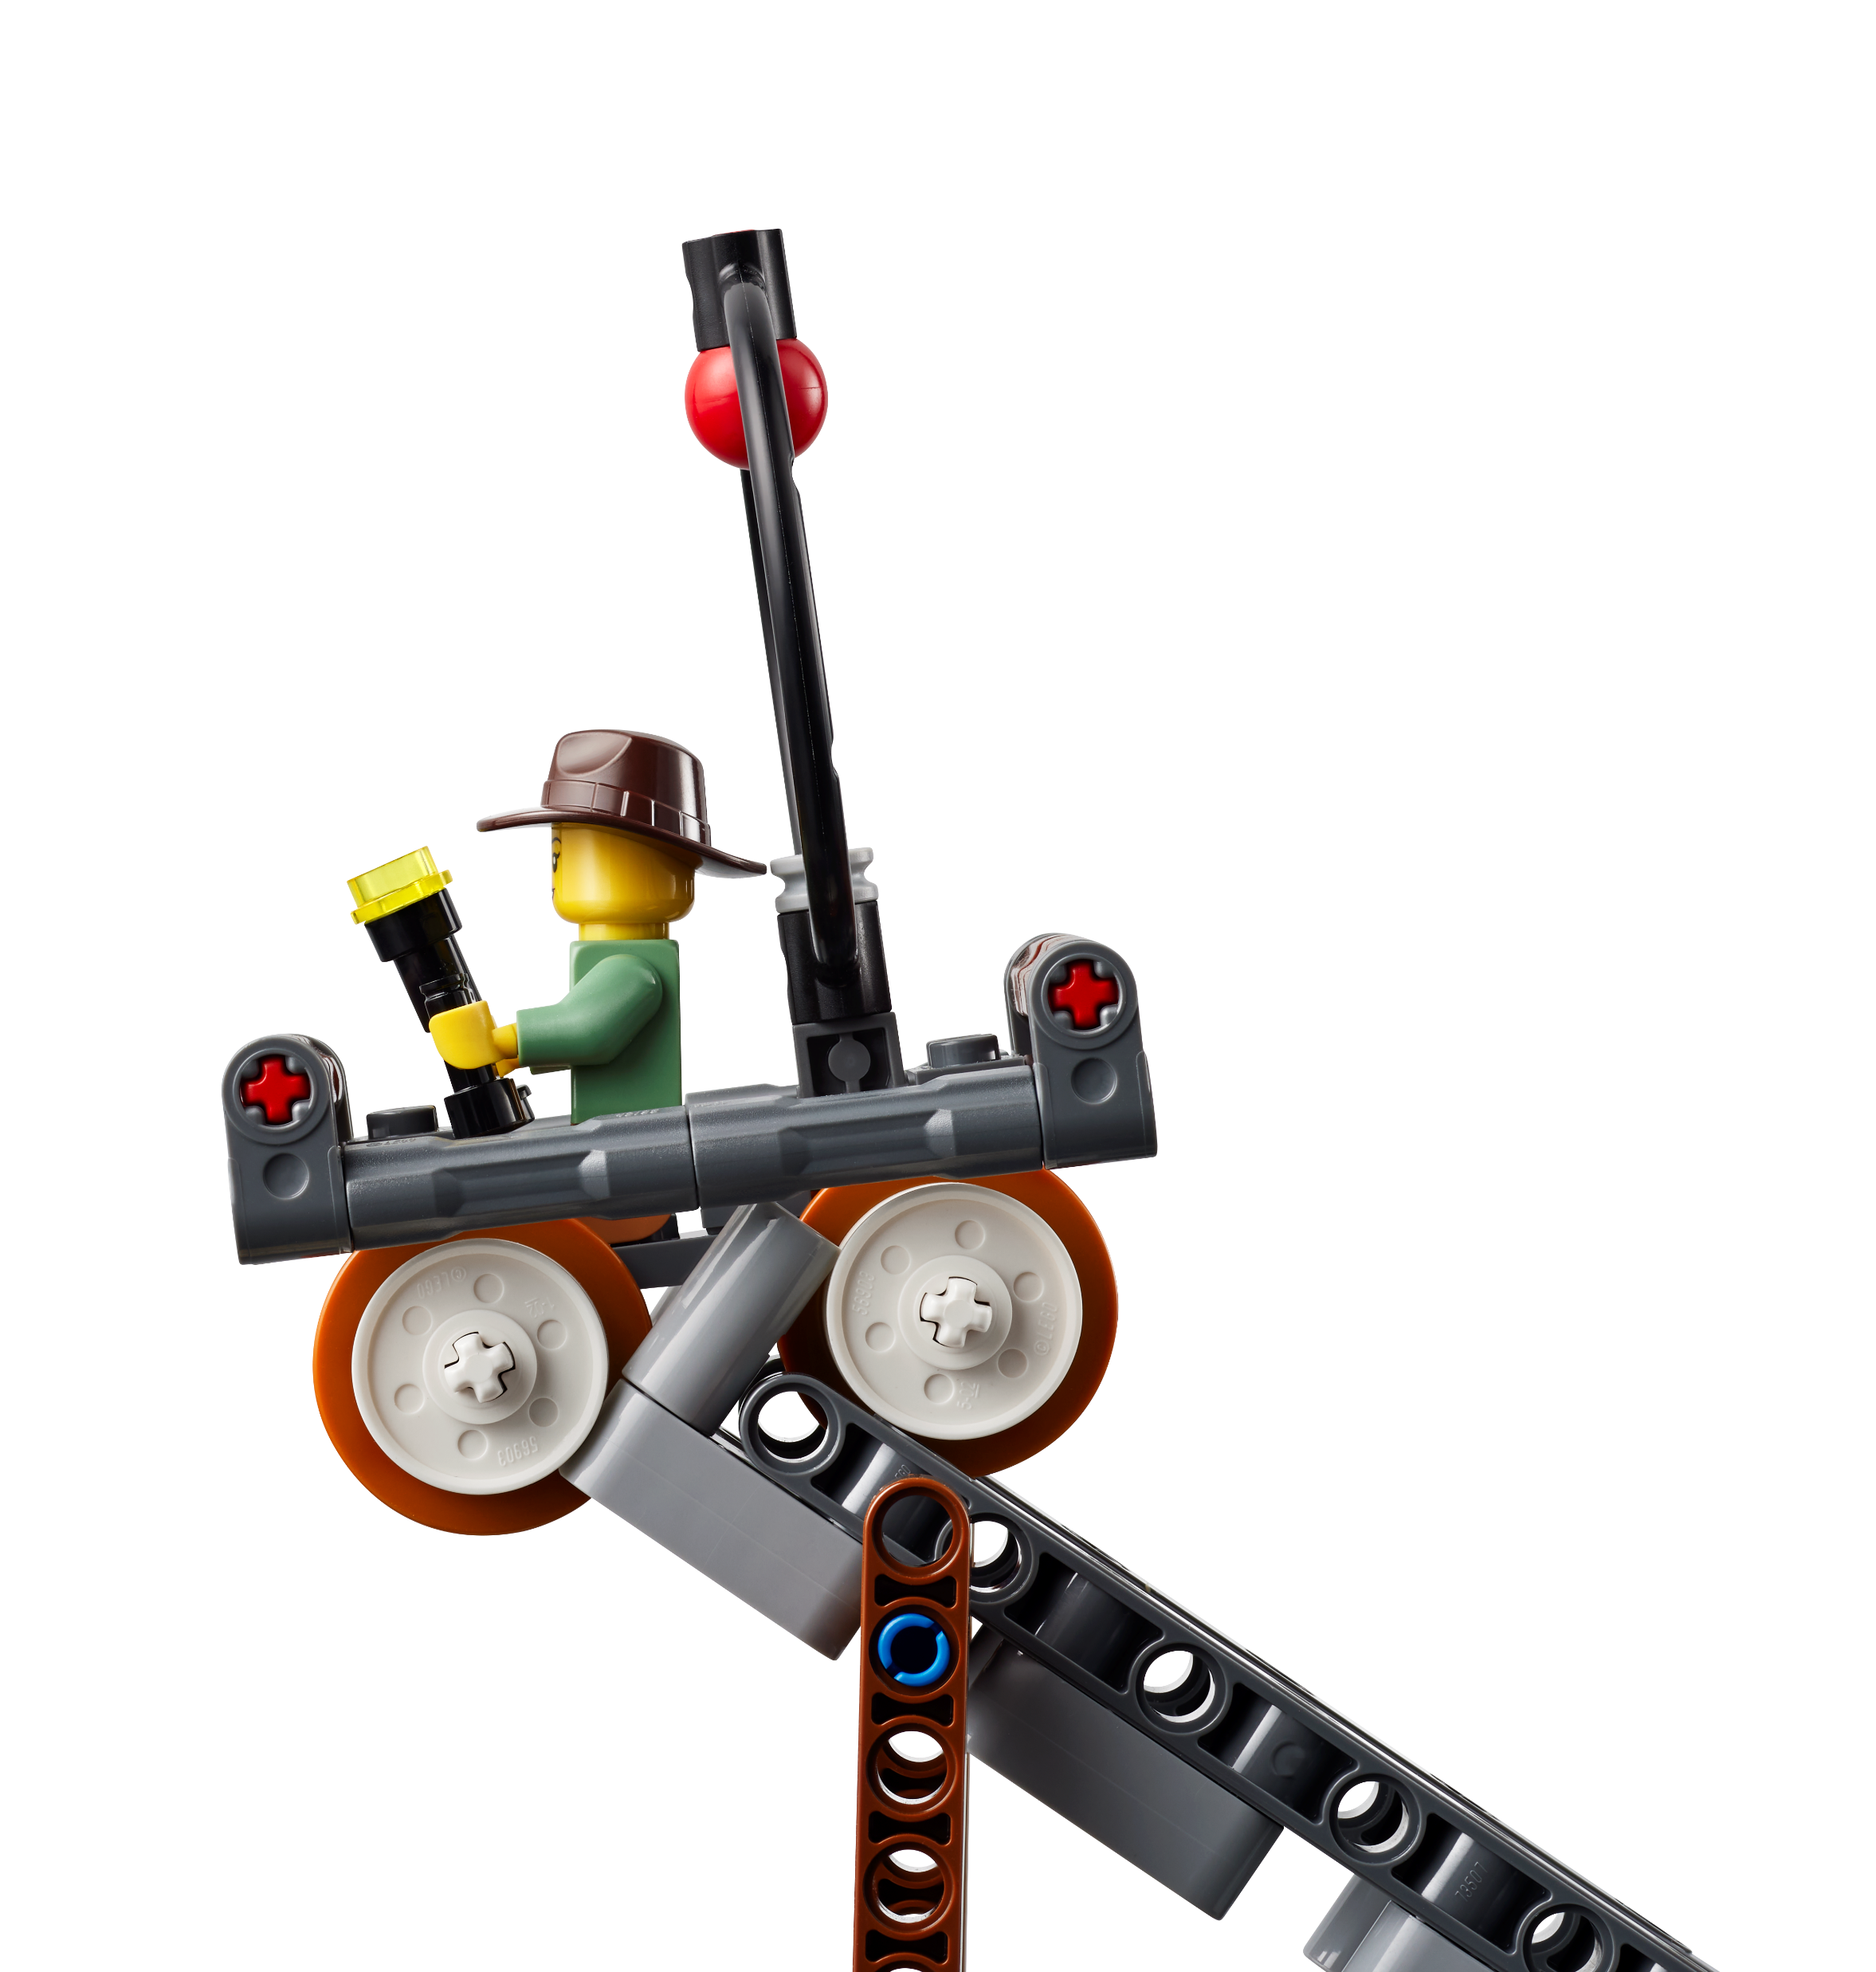
Questions?
Remember, this is a high-level overview of the UNEARTHEDTM Robot Game and Rules.
Be sure to review the Robot Game Rulebook, official videos, and Referee Guide & Quiz for detailed guidance.

Slide 29
Event Information
On the following slides, you may add event-specific information such as referee table assignments, schedules and breaks, etc.
Edit or delete these slides if not used.

Slide 30
Referee Table Assignments
Table | Referee
# | Name
# | Name
# | Name
# | Name

Slide 31
Event Schedule
Add event/match schedule here

Slide 32
Thank you for being a FIRST® LEGO® League Challenge referee!
Remember, this has been a high-level overview of the referee role. Be sure to review the Robot Game Rulebook, official videos, and Referee Guide & Quiz for detailed guidance and training.

