Slide 1
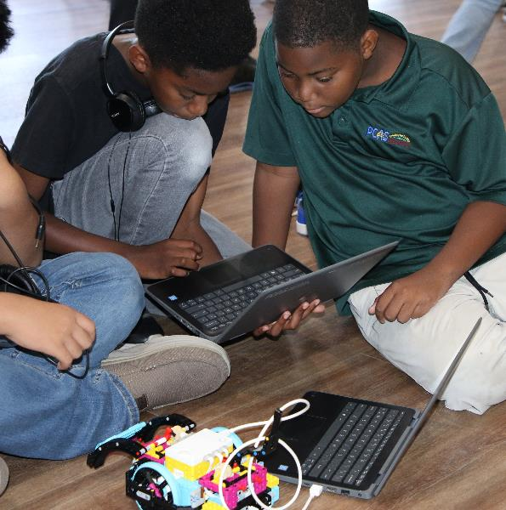
Session 9
Solution Planning
Notes:
Facilitator Tips –
The team will use their art piece and pedestal in Mission 04 of the robot game.
The team can also have a backup of their programs on external drive like a USB stick or an online storage website.
Have a clear strategy for which programs to run and in what order during the robot game.
The Share tasks are important to keep the whole team updated on how the project and the robot are developing.
Provide the team with the Core Values rubric.

Slide 2

Session Overview
Outcomes
The team will code their robot to deliver their Innovation Project model and solve missions.
The team will iterate and improve their Innovation Project solution based on testing and feedback.
Notes:
Facilitator Tips –
The team will use their art piece and pedestal in Mission 04 of the robot game.
The team can also have a backup of their programs on external drive like a USB stick or an online storage website.
Have a clear strategy for which programs to run and in what order during the robot game.
The Share tasks are important to keep the whole team updated on how the project and the robot are developing.
Provide the team with the Core Values rubric.

Slide 3
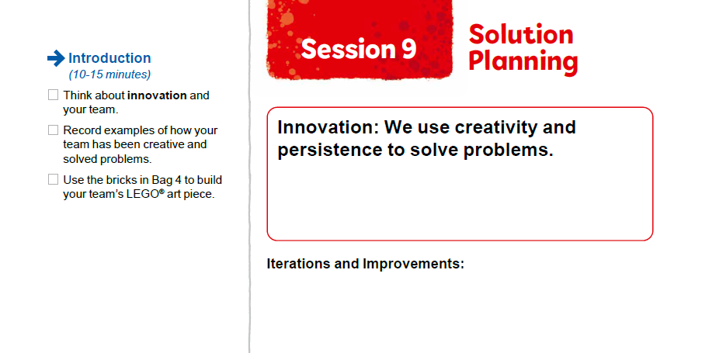


Introduction
Think about innovation and your team.
Record examples of how your team has been creative and solved problems.
Notes:
Introduction (10-15 minutes)
Facilitator Tips –
The team will use their art piece and pedestal in Mission 04 of the robot game.
The team can also have a backup of their programs on external drive like a USB stick or an online storage website.
Have a clear strategy for which programs to run and in what order during the robot game.
The Share tasks are important to keep the whole team updated on how the project and the robot are developing.
Provide the team with the Core Values rubric.

Slide 4
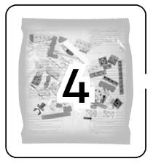
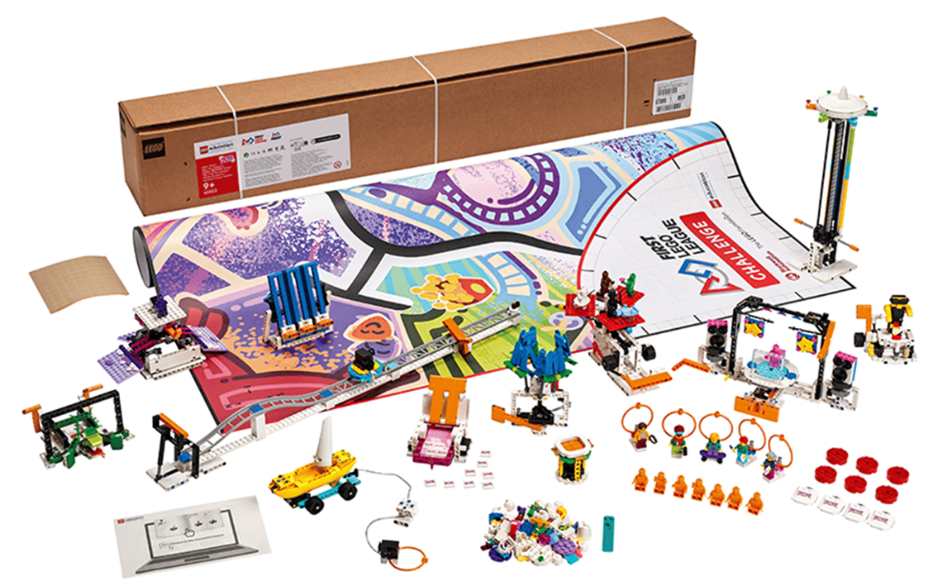

Introduction
Use the bricks in Bag 4 to build your team’s LEGO® art piece.
Notes:
Introduction (10-15 minutes)
Facilitator Tips –
The team will use their art piece and pedestal in Mission 04 of the robot game.
The team can also have a backup of their programs on external drive like a USB stick or an online storage website.
Have a clear strategy for which programs to run and in what order during the robot game.
The Share tasks are important to keep the whole team updated on how the project and the robot are developing.
Provide the team with the Core Values rubric.

Slide 5
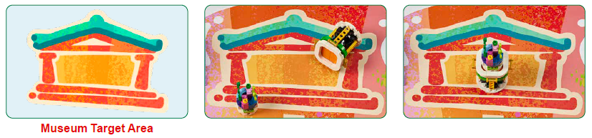
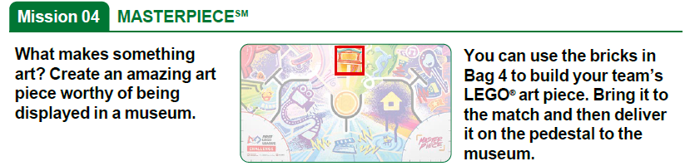
Iterate and Improve Robot Solution
Code your robot to complete the Mission 04 using the art piece you created.
Notes:
Team Tasks (100-120 minutes)
Facilitator Tips –
The team will use their art piece and pedestal in Mission 04 of the robot game.
The team can also have a backup of their programs on external drive like a USB stick or an online storage website.
Have a clear strategy for which programs to run and in what order during the robot game.
The Share tasks are important to keep the whole team updated on how the project and the robot are developing.
Provide the team with the Core Values rubric.

Slide 6
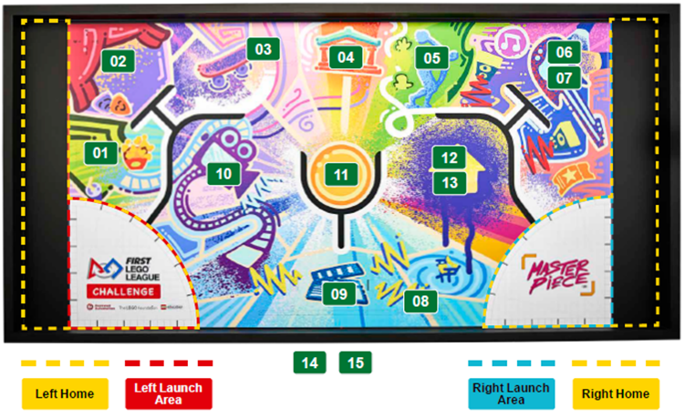
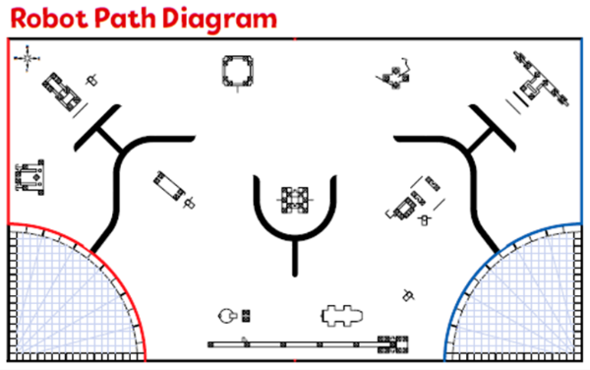
Iterate and Improve Robot Solution
Think about your mission strategy on the mat and the missions you will solve.
Continue to create a solution for each mission as time allows.
Notes:
Team Tasks (100-120 minutes)
Facilitator Tips –
The team will use their art piece and pedestal in Mission 04 of the robot game.
The team can also have a backup of their programs on external drive like a USB stick or an online storage website.
Have a clear strategy for which programs to run and in what order during the robot game.
The Share tasks are important to keep the whole team updated on how the project and the robot are developing.
Provide the team with the Core Values rubric.

Slide 7


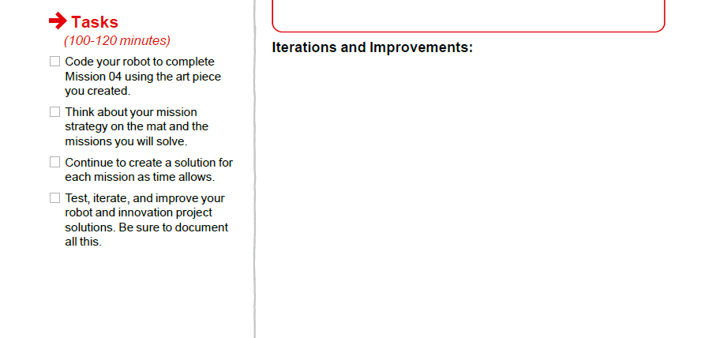

Iterate and Improve Robot Solution
Test, iterate, and improve your robot and Innovation Project solutions. Be sure to document all this.
Notes:
Team Tasks (100-120 minutes)
Facilitator Tips –
The team will use their art piece and pedestal in Mission 04 of the robot game.
The team can also have a backup of their programs on external drive like a USB stick or an online storage website.
Have a clear strategy for which programs to run and in what order during the robot game.
The Share tasks are important to keep the whole team updated on how the project and the robot are developing.
Provide the team with the Core Values rubric.

Slide 8

Share
Get together at the mat.
Share the project presentation work completed.
Share what missions you have completed.
Discuss how everyone will be involved in the presentation.
Discuss the reflection questions and clean up your space.
Notes:
Share (10-15 minutes)
Facilitator Tips –
The team will use their art piece and pedestal in Mission 04 of the robot game.
The team can also have a backup of their programs on external drive like a USB stick or an online storage website.
Have a clear strategy for which programs to run and in what order during the robot game.
The Share tasks are important to keep the whole team updated on how the project and the robot are developing.
Provide the team with the Core Values rubric.

Slide 9
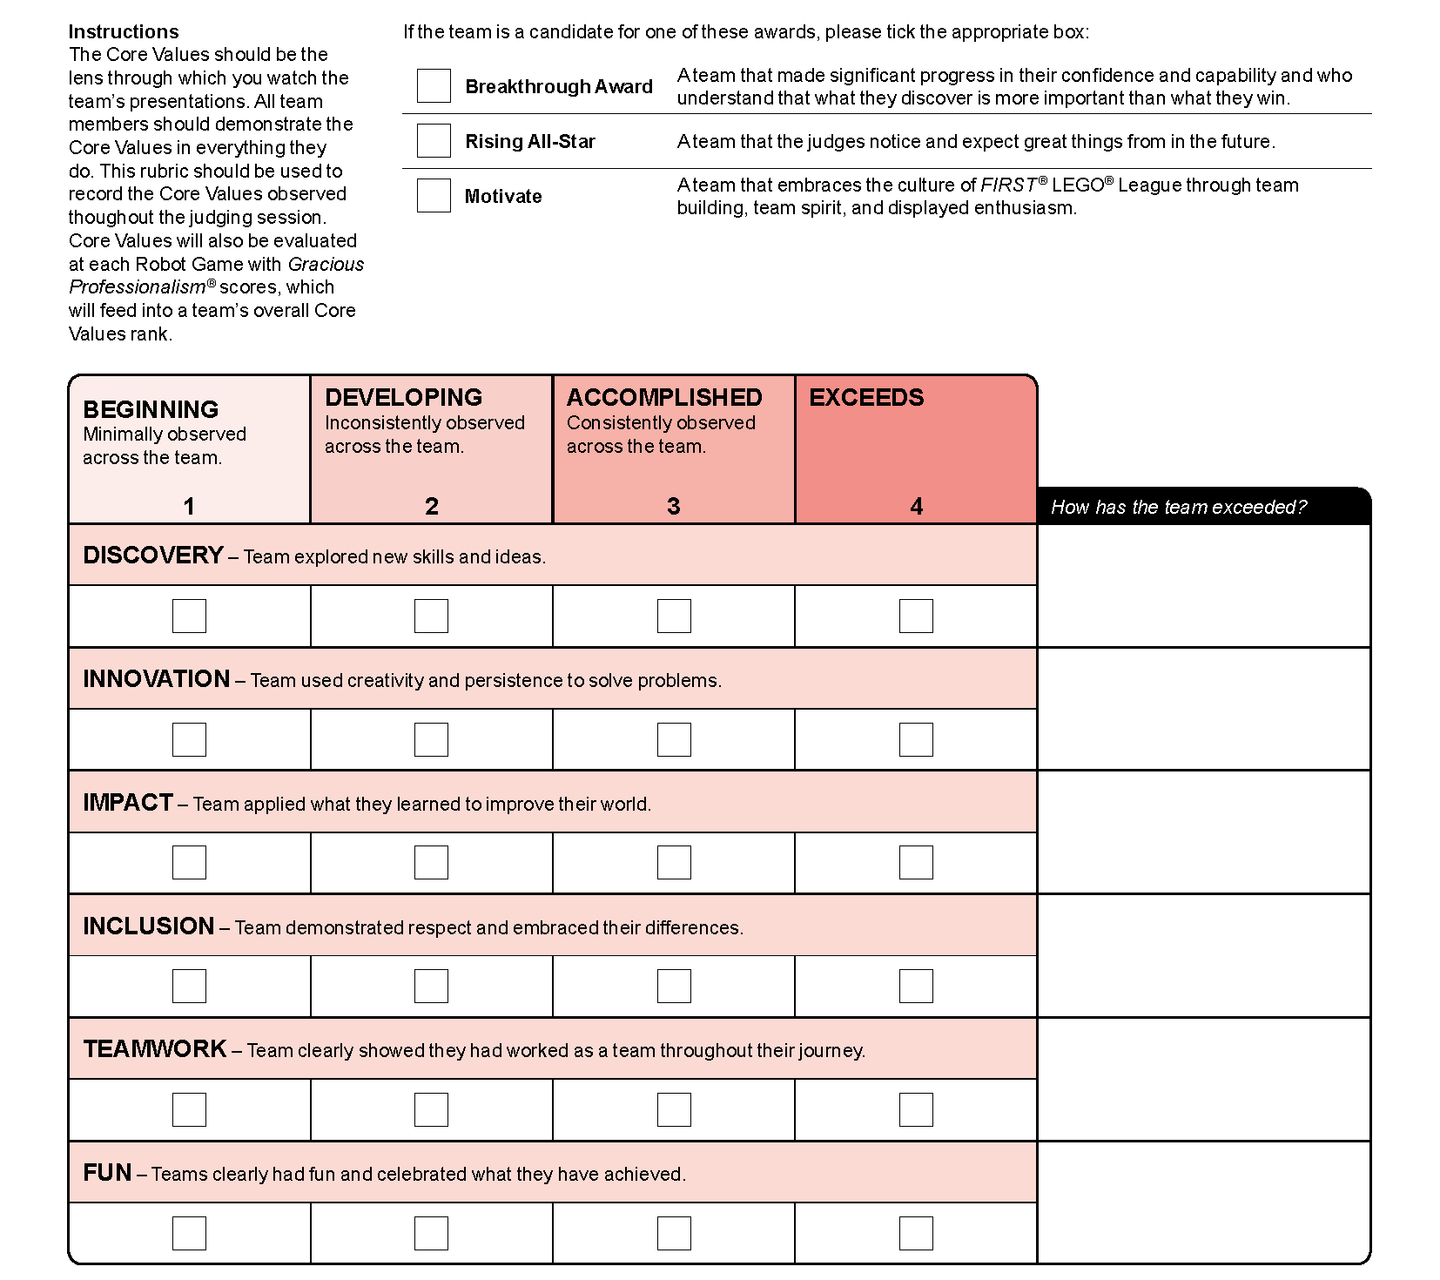

Core Values
Rubric
Notes:
Facilitator Tips –
The team will use their art piece and pedestal in Mission 04 of the robot game.
The team can also have a backup of their programs on external drive like a USB stick or an online storage website.
Have a clear strategy for which programs to run and in what order during the robot game.
The Share tasks are important to keep the whole team updated on how the project and the robot are developing.
Provide the team with the Core Values rubric.

Slide 10

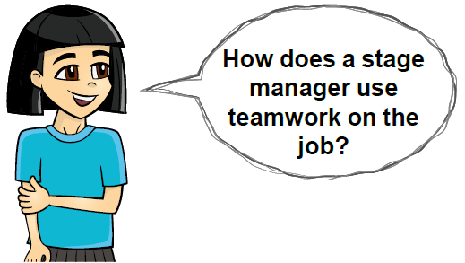
Reflection Questions
What features on your robot show good mechanics?
What changes have you made to your innovation project solution based on feedback from others?
What progress have you made on the goals set in Session 2?
Notes:
Facilitator Tips –
The team will use their art piece and pedestal in Mission 04 of the robot game.
The team can also have a backup of their programs on external drive like a USB stick or an online storage website.
Have a clear strategy for which programs to run and in what order during the robot game.
The Share tasks are important to keep the whole team updated on how the project and the robot are developing.
Provide the team with the Core Values rubric.

Slide 11

Multimedia Resources
You may wish to embed a relevant, age-appropriate video for your students here. See the Notes for an example.
Notes:
Choose a relevant, age-appropriate video for your students.
Example: The Tournament Experience (1:55)

Slide 12

Clean Up
Notes:
Allow time for cleanup and place any unfinished models and their pieces in a sealed plastic bag.
Clean Up Pointers
You may wish to play a video or song during clean up time Link on
GoNoodle: https://family.gonoodle.com/activities/clean-up
Link on YouTube Kids: https://www.youtubekids.com/watch?v=ZJFk87ZsHn0
Link on Youtube: https://youtu.be/ZJFk87ZsHn0

Slide 13


LEGO, the LEGO logo, the SPIKE logo, MINDSTORMS and the MINDSTORMS logo are trademarks of the LEGO Group. ©2023 The LEGO Group. All rights reserved. FIRST®, the FIRST® logo, Coopertition®, Gracious Professionalism®, and FIRST IN SHOWSM, are trademarks of For Inspiration and Recognition of Science and Technology (FIRST). LEGO® is a registered trademark of the LEGO Group. FIRST® LEGO® League and MASTERPIECESM are jointly held trademarks of FIRST and the LEGO Group. All other trademarks are the property of their respective owners. ©2023 FIRST and the LEGO Group. All rights reserved.

