Slide 1
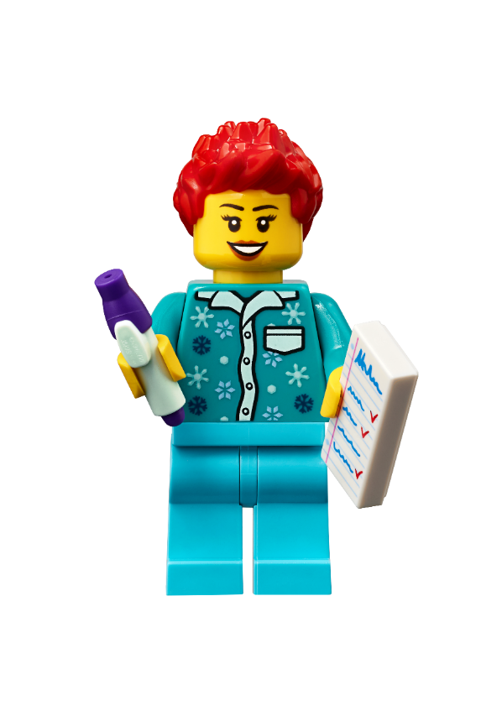
Session 3
Stage Manager
Notes:
Facilitator Tips - As the team completes the sessions, ask them to collect evidence of their use of the Core Values.
What does each Core Value look like?
What does it sound like when people are using the Core Values appropriately?
How do people communicate with each other when they have a disagreement?
Session 3 Tips =
This activity is a great way for the team to collaborate creatively on a piece that represents their shared interests.
Team planning and project management is important to achieve goals and be ready for the tournament.
Have the team check that the wires are plugged into the right ports and that the ports used match their program.
To make missions easier to complete, the team can build LEGO® attachments and fit them onto the robot.
Robot Game Connection: Have the team think about how to use the attachment from the robot lesson to complete missions.

Slide 2
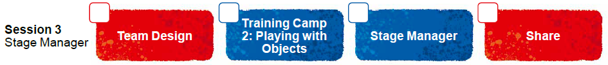
Session Overview
Outcomes
The team will code their robot to avoid obstacles using a sensor and to power an attachment.
The team will make connections from the mission models to the stage manager Project Spark ideas.
Notes:
Facilitator Tips - As the team completes the sessions, ask them to collect evidence of their use of the Core Values.
What does each Core Value look like?
What does it sound like when people are using the Core Values appropriately?
How do people communicate with each other when they have a disagreement?
Session 3 Tips =
This activity is a great way for the team to collaborate creatively on a piece that represents their shared interests.
Team planning and project management is important to achieve goals and be ready for the tournament.
Have the team check that the wires are plugged into the right ports and that the ports used match their program.
To make missions easier to complete, the team can build LEGO® attachments and fit them onto the robot.
Robot Game Connection: Have the team think about how to use the attachment from the robot lesson to complete missions.

Slide 3
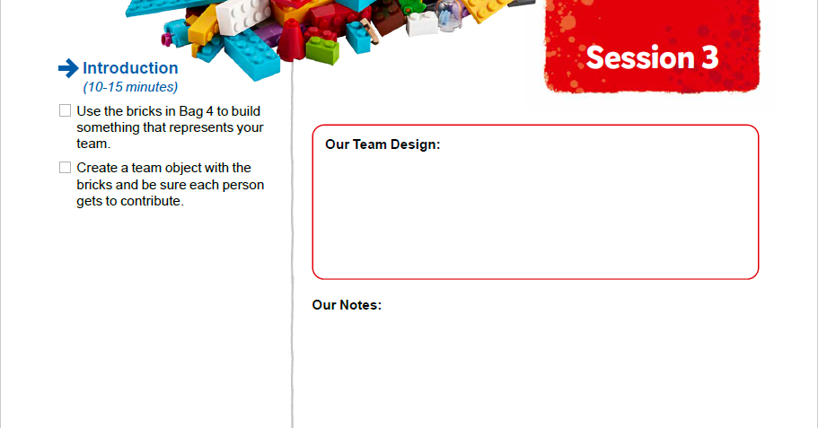
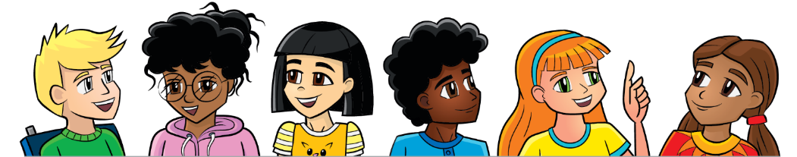
Introduction
Use the bricks in Bag 4 to build something that represents your team. Create a team object with the bricks and be sure each person gets to contribute.
Notes:
Introduction (10-15 minutes)
Facilitator Tips
This activity is a great way for the team to collaborate creatively on a piece that represents their shared interests.
Team planning and project management is important to achieve goals and be ready for the tournament.
Have the team check that the wires are plugged into the right ports and that the ports used match their program.
To make missions easier to complete, the team can build LEGO® attachments and fit them onto the robot.
Robot Game Connection: Have the team think about how to use the attachment from the robot lesson to complete missions.

Slide 4
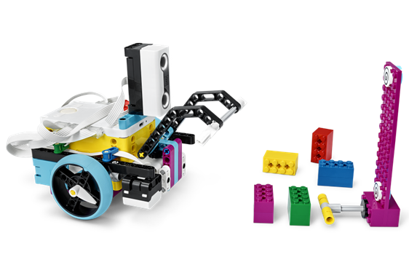

Robot Lesson 3
Open the SPIKE™ Prime app. Find your lesson.
Reflect on the skills you learned that will be beneficial in completing missions.
Try it out! See if you can code your robot to complete a mission.
Notes:
Team Tasks (100-120 minutes) - Training Camp 2: Playing with Objects – https://education.lego.com/en-us/lessons/prime-competition-ready/training-camp-2-playing-with-objects#lesson-plan
URL for SPIKE on-line: https://spike.legoeducation.com (remember to use a Chrome browser)
Facilitator Tips
This activity is a great way for the team to collaborate creatively on a piece that represents their shared interests.
Team planning and project management is important to achieve goals and be ready for the tournament.
Have the team check that the wires are plugged into the right ports and that the ports used match their program.
To make missions easier to complete, the team can build LEGO® attachments and fit them onto the robot.
Robot Game Connection: Have the team think about how to use the attachment from the robot lesson to complete missions.

Slide 5
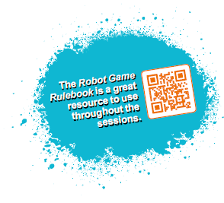

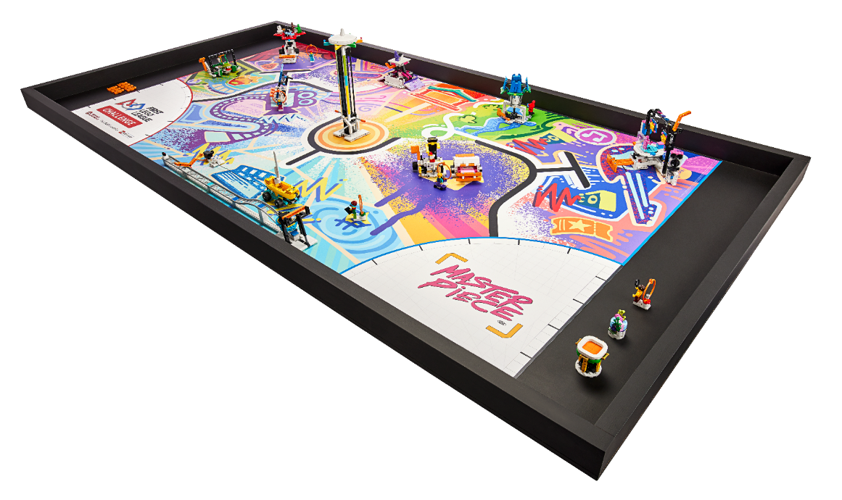
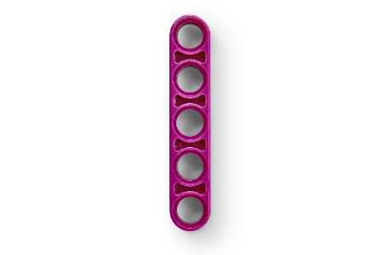
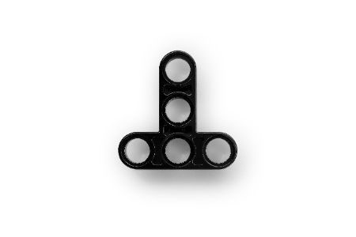
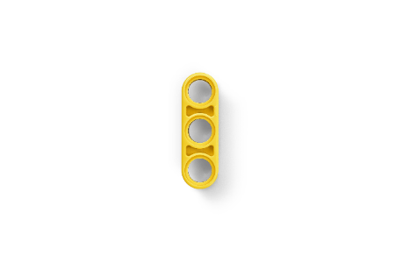
Reflection Questions
How can you drive your robot to deliver your team object to the museum?
What objects does your robot need to avoid?
Notes:
Team Tasks (100-120 minutes)
Facilitator Tips
This activity is a great way for the team to collaborate creatively on a piece that represents their shared interests.
Team planning and project management is important to achieve goals and be ready for the tournament.
Have the team check that the wires are plugged into the right ports and that the ports used match their program.
To make missions easier to complete, the team can build LEGO® attachments and fit them onto the robot.
Robot Game Connection: Have the team think about how to use the attachment from the robot lesson to complete missions.

Slide 6

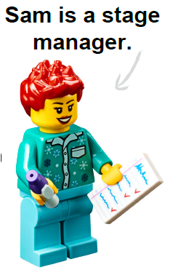
Stage Manager Spark
Project Spark
A stage manager is responsible for ensuring all aspects of a live production are ready for showtime. The set, furniture, props, and costumes used on stage create lots of interest and excitement for the audience.
Notes:
Team Tasks (100-120 minutes) Read the Project Spark.
Facilitator Tips
Provide the digital building instructions for the models for the team.
The team will need Bags 2, 10, and 12 from the Challenge set.
Consider inviting an expert, user, or someone who works in this area to talk about the Project Sparks.
The team will learn about four different Project Sparks to inspire their innovation project. Have them keep notes of their ideas.
The team can think of ways to improve existing solutions to the Project Sparks. Their ideas don’t have to be brand new.

Slide 7
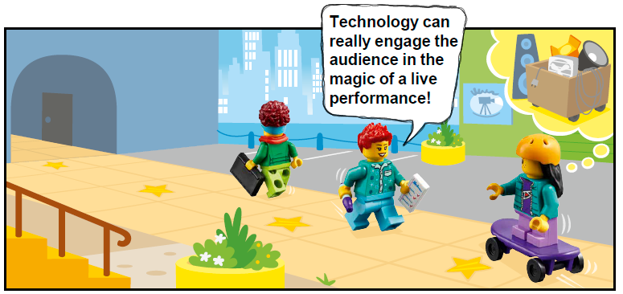
Stage Manager Spark
Think about and research:
How can props and costumes help tell a story during a live performance?
What skills does a stage manager need to be successful?
Who does a stage manager work closely with in a theater?
How could puppets be used on stage to help create excitement for the audience?
Notes:
Team Tasks (100-120 minutes) Read the Project Spark.
Facilitator Tips
Provide the digital building instructions for the models for the team.
The team will need Bags 2, 10, and 12 from the Challenge set.
Consider inviting an expert, user, or someone who works in this area to talk about the Project Sparks.
The team will learn about four different Project Sparks to inspire their innovation project. Have them keep notes of their ideas.
The team can think of ways to improve existing solutions to the Project Sparks. Their ideas don’t have to be brand new.

Slide 8

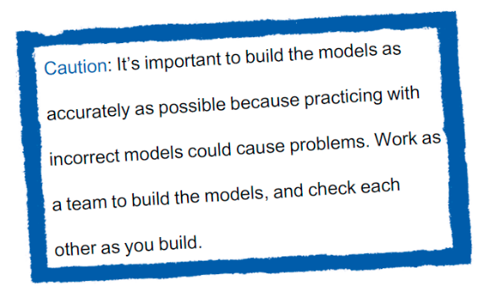

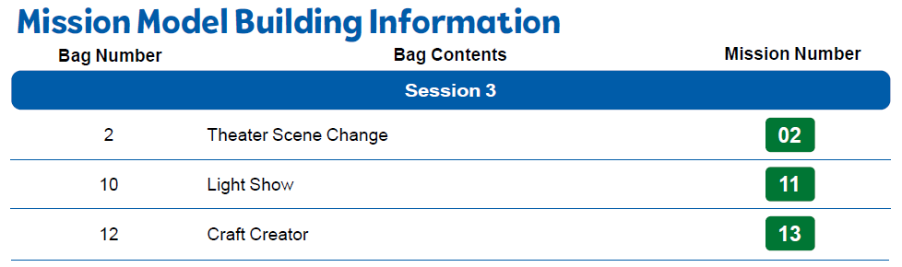
Stage Manager Spark
Build the Stage Manager models in Bags 2, 10, and 12.
Notes:
Team Tasks (100-120 minutes)
Facilitator Tips
Provide the digital building instructions for the models for the team.
The team will need Bags 2, 10, and 12 from the Challenge set.
Consider inviting an expert, user, or someone who works in this area to talk about the Project Sparks.
The team will learn about four different Project Sparks to inspire their innovation project. Have them keep notes of their ideas.
The team can think of ways to improve existing solutions to the Project Sparks. Their ideas don’t have to be brand new.

Slide 9
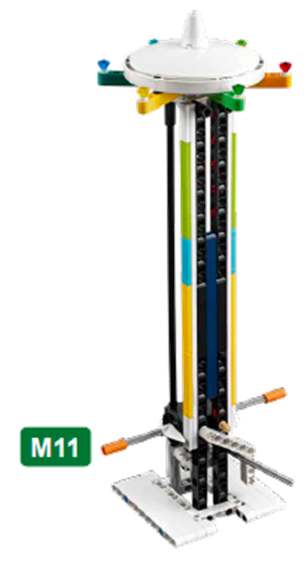
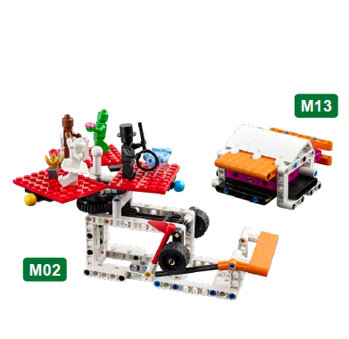
Stage Manager Spark
Identify the missions that relate to the models you built.
Notes:
Team Tasks (100-120 minutes)
Facilitator Tips
Provide the digital building instructions for the models for the team.
The team will need Bags 2, 10, and 12 from the Challenge set.
Consider inviting an expert, user, or someone who works in this area to talk about the Project Sparks.
The team will learn about four different Project Sparks to inspire their innovation project. Have them keep notes of their ideas.
The team can think of ways to improve existing solutions to the Project Sparks. Their ideas don’t have to be brand new.

Slide 10

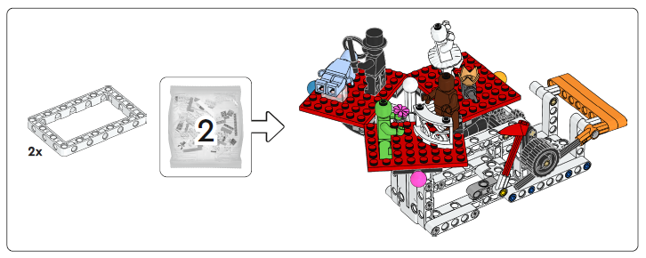
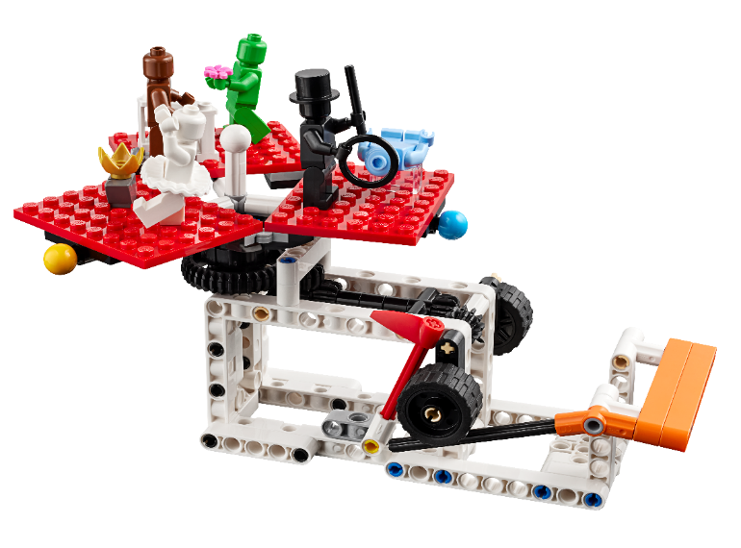
Theater Scene Change
Notes:
Team Tasks (100-120 minutes)
Facilitator Tips
Provide the digital building instructions for the models for the team.
The team will need Bags 2, 10, and 12 from the Challenge set.
Consider inviting an expert, user, or someone who works in this area to talk about the Project Sparks.
The team will learn about four different Project Sparks to inspire their innovation project. Have them keep notes of their ideas.
The team can think of ways to improve existing solutions to the Project Sparks. Their ideas don’t have to be brand new.

Slide 11
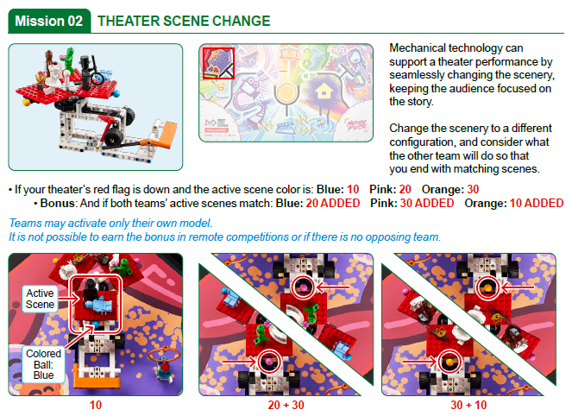
Notes:
Team Tasks (100-120 minutes)
Facilitator Tips
Provide the digital building instructions for the models for the team.
The team will need Bags 2, 10, and 12 from the Challenge set.
Consider inviting an expert, user, or someone who works in this area to talk about the Project Sparks.
The team will learn about four different Project Sparks to inspire their innovation project. Have them keep notes of their ideas.
The team can think of ways to improve existing solutions to the Project Sparks. Their ideas don’t have to be brand new.

Slide 12
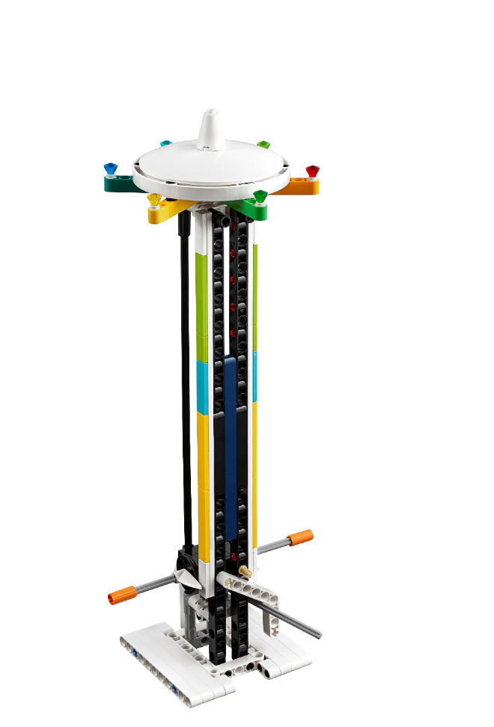
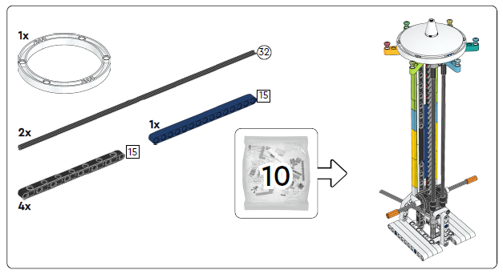
Light Show
Notes:
Team Tasks (100-120 minutes)
Facilitator Tips
Provide the digital building instructions for the models for the team.
The team will need Bags 2, 10, and 12 from the Challenge set.
Consider inviting an expert, user, or someone who works in this area to talk about the Project Sparks.
The team will learn about four different Project Sparks to inspire their innovation project. Have them keep notes of their ideas.
The team can think of ways to improve existing solutions to the Project Sparks. Their ideas don’t have to be brand new.

Slide 13
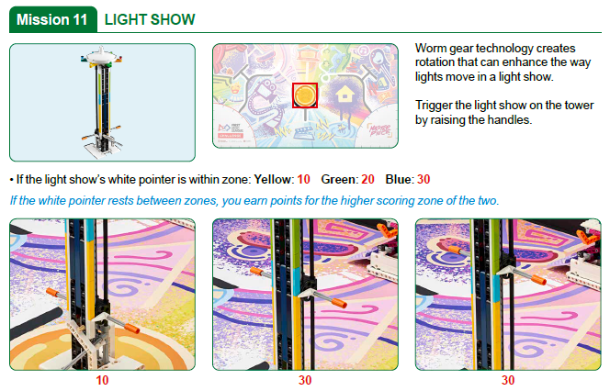
Notes:
Team Tasks (100-120 minutes)
Facilitator Tips
Provide the digital building instructions for the models for the team.
The team will need Bags 2, 10, and 12 from the Challenge set.
Consider inviting an expert, user, or someone who works in this area to talk about the Project Sparks.
The team will learn about four different Project Sparks to inspire their innovation project. Have them keep notes of their ideas.
The team can think of ways to improve existing solutions to the Project Sparks. Their ideas don’t have to be brand new.

Slide 14
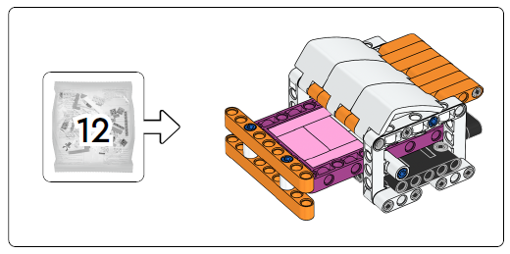
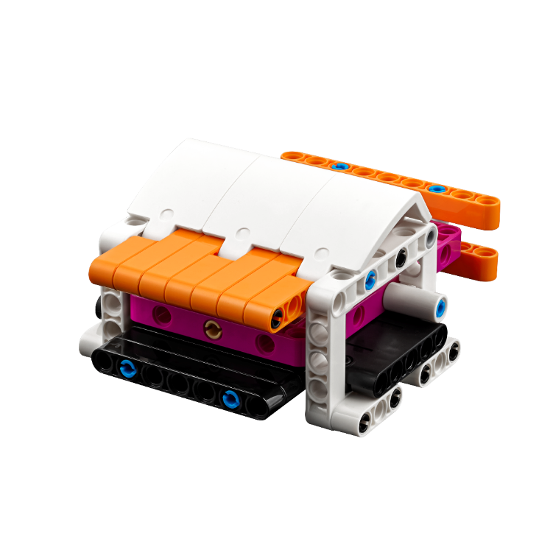
Craft Creator
Notes:
Team Tasks (100-120 minutes)
Facilitator Tips
Provide the digital building instructions for the models for the team.
The team will need Bags 2, 10, and 12 from the Challenge set.
Consider inviting an expert, user, or someone who works in this area to talk about the Project Sparks.
The team will learn about four different Project Sparks to inspire their innovation project. Have them keep notes of their ideas.
The team can think of ways to improve existing solutions to the Project Sparks. Their ideas don’t have to be brand new.

Slide 15
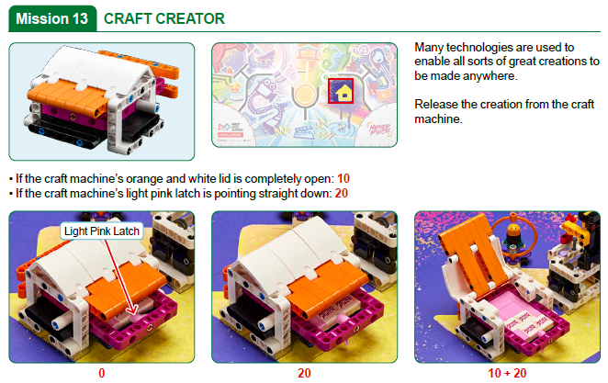
Notes:
Team Tasks (100-120 minutes)
Facilitator Tips
Provide the digital building instructions for the models for the team.
The team will need Bags 2, 10, and 12 from the Challenge set.
Consider inviting an expert, user, or someone who works in this area to talk about the Project Sparks.
The team will learn about four different Project Sparks to inspire their innovation project. Have them keep notes of their ideas.
The team can think of ways to improve existing solutions to the Project Sparks. Their ideas don’t have to be brand new.

Slide 16

Stage Manager Spark
Identify the missions that relate to the models you built.
Discuss how the Project Spark and models are linked.
Capture your ideas.
Notes:
Team Tasks (100-120 minutes)
Facilitator Tips
Provide the digital building instructions for the models for the team.
The team will need Bags 2, 10, and 12 from the Challenge set.
Consider inviting an expert, user, or someone who works in this area to talk about the Project Sparks.
The team will learn about four different Project Sparks to inspire their innovation project. Have them keep notes of their ideas.
The team can think of ways to improve existing solutions to the Project Sparks. Their ideas don’t have to be brand new.

Slide 17

Share
Get together at the mat.
Place each model where it belongs.
Share how the models work and the robot skills you learned.
Demonstrate the models’ functions and how they connect to the Project Spark.
Talk about reflection questions.
Clean up your space.
Notes:
Share (10-15 minutes)
Facilitator Tips
Provide the digital building instructions for the models for the team.
The team will need Bags 2, 10, and 12 from the Challenge set.
Consider inviting an expert, user, or someone who works in this area to talk about the Project Sparks.
The team will learn about four different Project Sparks to inspire their innovation project. Have them keep notes of their ideas.
The team can think of ways to improve existing solutions to the Project Sparks. Their ideas don’t have to be brand new.

Slide 18
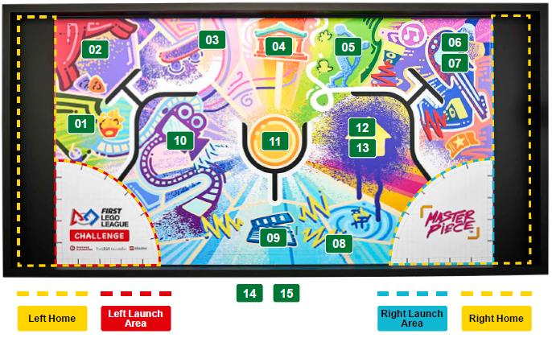
Models built this session are for the circled missions.
Notes:
Facilitator Tips
Provide the digital building instructions for the models for the team.
The team will need Bags 2, 10, and 12 from the Challenge set.
Consider inviting an expert, user, or someone who works in this area to talk about the Project Sparks.
The team will learn about four different Project Sparks to inspire their innovation project. Have them keep notes of their ideas.
The team can think of ways to improve existing solutions to the Project Sparks. Their ideas don’t have to be brand new.

Slide 19


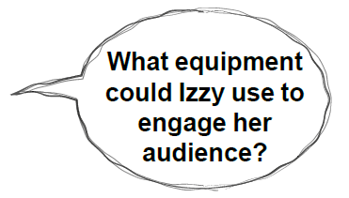
Reflection Questions
What challenges could a stage manager encounter when getting ready for a show?
What examples of live theater do you have in your community?
Notes:
Facilitator Tips
Provide the digital building instructions for the models for the team.
The team will need Bags 2, 10, and 12 from the Challenge set.
Consider inviting an expert, user, or someone who works in this area to talk about the Project Sparks.
The team will learn about four different Project Sparks to inspire their innovation project. Have them keep notes of their ideas.
The team can think of ways to improve existing solutions to the Project Sparks. Their ideas don’t have to be brand new.

Slide 20
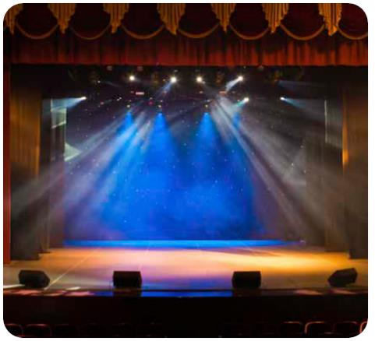


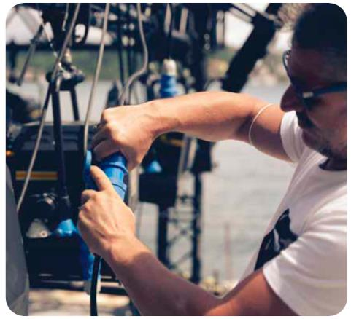
Career Connections
Stage Manager
Role:
A stage manager is responsible for making sure the lights, sound, and props are working properly and in the right place.

Slide 21
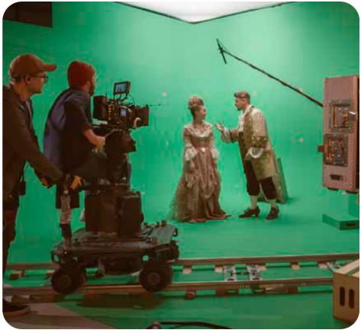

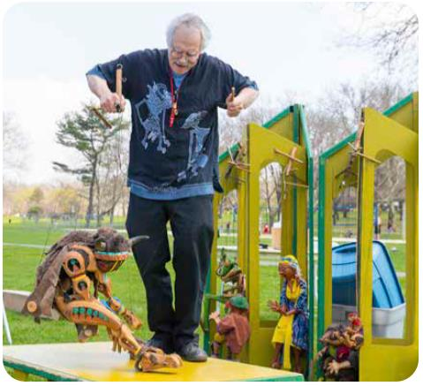
Career Connections
Actor
Role:
An actor is an artist that performs in front of a camera or an audience. Actors often use costumes, makeup, puppets, or other props to help bring their character to life.

Slide 22

Multimedia Resources
You may wish to embed a relevant, age-appropriate video for your students here. See the Notes for an example.
Notes:
Choose a relevant, age-appropriate video for your students.
Example: Setting the Stage (average video length is 5:00)

Slide 23

Clean Up
Notes:
Allow time for cleanup and place any unfinished models and their pieces in a sealed plastic bag.
Clean Up Pointers
You may wish to play a video or song during clean up time Link on
GoNoodle: https://family.gonoodle.com/activities/clean-up
Link on YouTube Kids: https://www.youtubekids.com/watch?v=ZJFk87ZsHn0
Link on Youtube: https://youtu.be/ZJFk87ZsHn0

Slide 24


LEGO, the LEGO logo, the SPIKE logo, MINDSTORMS and the MINDSTORMS logo are trademarks of the LEGO Group. ©2023 The LEGO Group. All rights reserved. FIRST®, the FIRST® logo, Coopertition®, Gracious Professionalism®, and FIRST IN SHOWSM, are trademarks of For Inspiration and Recognition of Science and Technology (FIRST). LEGO® is a registered trademark of the LEGO Group. FIRST® LEGO® League and MASTERPIECESM are jointly held trademarks of FIRST and the LEGO Group. All other trademarks are the property of their respective owners. ©2023 FIRST and the LEGO Group. All rights reserved.

