Slide 1

Session 1
Museum Curator
Notes:
Session 1 Tips =
Have the team watch the season videos on the FIRST® LEGO® League YouTube channel and read pages 3-9 in their Engineering Notebooks.
Two devices are suggested, one for the robot and one for project work. Additional devices for the mission model building are useful.
Activities in the sessions use the LEGO Education SPIKE™ Prime app.
Make sure the controller and device are plugged in and charging at the end of the session.
Robot Game Connection: Have the team think about how a sensor could be helpful to get the robot to stop in the right place to engage with a mission model on the mat.

Slide 2
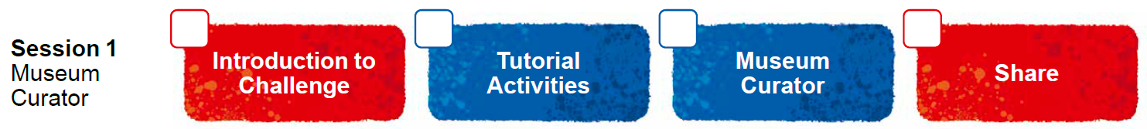
Session Overview
Outcomes
The team will learn how to connect and use the sensors and motors.
The team will make connections from the mission models to the museum curator Project Spark ideas.
Notes:
Facilitator Tips
Each session in this guide takes two hours. If needed, split each session into two separate 60-minute meetings by having the team complete each page in a 60-minute meeting.
Sessions 1-4 may take additional time to complete the builds.
Session 1 Tips =
Have the team watch the season videos on the FIRST® LEGO® League YouTube channel and read pages 3-9 in their Engineering Notebooks.
Two devices are suggested, one for the robot and one for project work. Additional devices for the mission model building are useful.
Activities in the sessions use the LEGO Education SPIKE™ Prime app.
Make sure the controller and device are plugged in and charging at the end of the session.
Robot Game Connection: Have the team think about how a sensor could be helpful to get the robot to stop in the right place to engage with a mission model on the mat.

Slide 3
Introduction
Read pages 3-9 explaining how FIRST® LEGO® League Challenge works.
Now that you have read about MASTERPIECESM, you are ready to get started.
Notes:
Introduction (10-15 minutes)
Have the team watch the season videos on the FIRST® LEGO® League YouTube channel and read pages 3-9 in their Engineering Notebooks.
Visit the FIRST® LEGO ® League YouTube Channel to watch the MASTERPIECESM season launch video
Session 1 Tips =
Have the team watch the season videos on the FIRST® LEGO® League YouTube channel and read pages 3-9 in their Engineering Notebooks.
Two devices are suggested, one for the robot and one for project work. Additional devices for the mission model building are useful.
Activities in the sessions use the LEGO Education SPIKE™ Prime app.
Make sure the controller and device are plugged in and charging at the end of the session.
Robot Game Connection: Have the team think about how a sensor could be helpful to get the robot to stop in the right place to engage with a mission model on the mat.

Slide 4


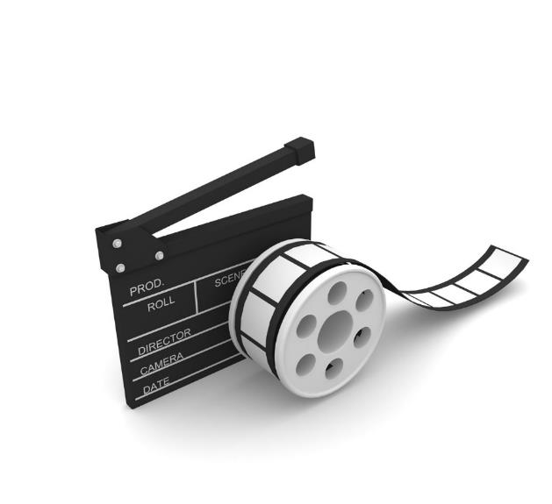
Visit the
FIRST® LEGO® League
YouTube Channel
to watch the
MASTERPIECESM season launch video
Notes:
Introduction (10-15 minutes)
Watch the season videos and read pages 3-9 on how FIRST® LEGO® League Challenge works and the MASTERPIECESM challenge.
Facilitator Tips
Share the season videos on the FIRST® LEGO® League YouTube Channel with the team.
If you have already watched the season launch video in the introductory slides, you may choose to skip it here.

Slide 5

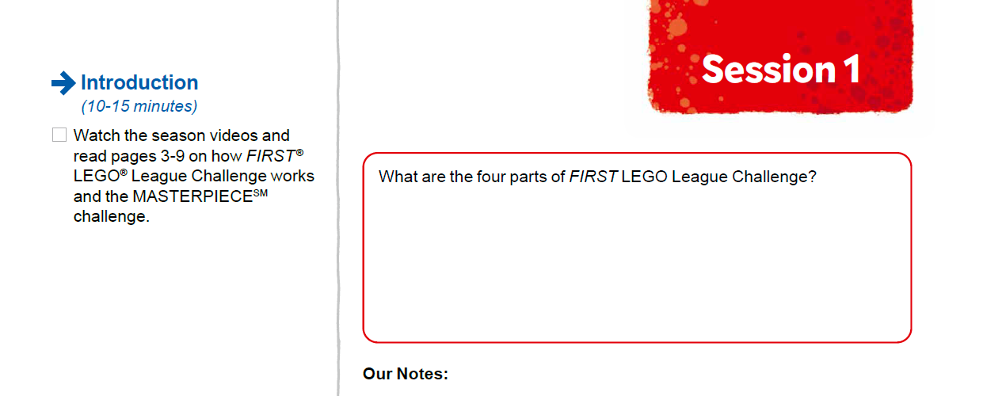

Introduction
Watch the season videos and read pages 3-9 on how FIRST® LEGO® League Challenge works and the MASTERPIECESM challenge.
Notes:
Visit the FIRST® LEGO ® League YouTube Channel to watch the MASTERPIECESM season launch video
Facilitator Tips
Each session in this guide takes two hours. If needed, split each session into two separate 60-minute meetings by having the team complete each page in a 60-minute meeting.
Sessions 1-4 may take additional time to complete the builds.
Session 1 Tips =
Have the team watch the season videos on the FIRST® LEGO® League YouTube channel and read pages 3-9 in their Engineering Notebooks.
Two devices are suggested, one for the robot and one for project work. Additional devices for the mission model building are useful.
Activities in the sessions use the LEGO Education SPIKE™ Prime app.
Make sure the controller and device are plugged in and charging at the end of the session.
Robot Game Connection: Have the team think about how a sensor could be helpful to get the robot to stop in the right place to engage with a mission model on the mat.

Slide 6
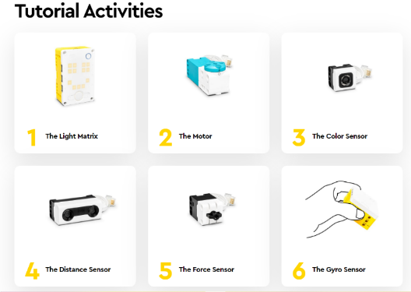

Robot Lesson 1
Open the SPIKE™ Prime app. Click the Start button.
Check out the Robot Game Rulebook for mission details.
Notes:
URL for SPIKE on-line: https://spike.legoeducation.com (remember to use a Chrome browser)
Team Tasks (100-120 minutes)
Facilitator Tips
Have the team watch the season videos on the FIRST® LEGO® League YouTube channel and read pages 3-9 in their Engineering Notebooks.
Two devices are suggested, one for the robot and one for project work. Additional devices for the mission model building are useful.
Activities in the sessions use the LEGO Education SPIKE™ Prime app.
Make sure the controller and device are plugged in and charging at the end of the session.
Robot Game Connection: Have the team think about how a sensor could be helpful to get the robot to stop in the right place to engage with a mission model on the mat.

Slide 7
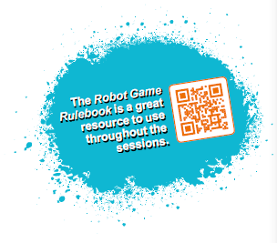


Reflection Questions
How could stopping a motor help you solve a mission with your robot?
What do you know about your teammates’ interests and hobbies?
What are resources that can help you learn more?
Read over the Robot Game Rulebook for all the details on the missions.
Notes:
Team Tasks (100-120 minutes)
Facilitator Tips
Have the team watch the season videos on the FIRST® LEGO® League YouTube channel and read pages 3-9 in their Engineering Notebooks.
Two devices are suggested, one for the robot and one for project work. Additional devices for the mission model building are useful.
Activities in the sessions use the LEGO Education SPIKE™ Prime app.
Make sure the controller and device are plugged in and charging at the end of the session.
Robot Game Connection: Have the team think about how a sensor could be helpful to get the robot to stop in the right place to engage with a mission model on the mat.

Slide 8


Museum Curator Spark
Project Spark
Museums are places where people learn about art, culture, science, history, and more. Technology is often used to make learning more interesting and engaging.
Notes:
Team Tasks (100-120 minutes) Read the Project Spark.
Facilitator Tips
Provide the digital building instructions for the models to the team.
The team will need Bags 3, 5, and 11 from the Challenge set. Larger pieces may be in an unnumbered LEGO® bag.
The Project Sparks are designed to give the team ideas about technology they could explore for their solution.
Encourage the team to investigate the mat and the mission models to inspire them. The team should record ideas for possible innovation projects that they could choose.
Place the completed models on the mat with Dual Lock squares according to the field setup in the Robot Game Rulebook.

Slide 9
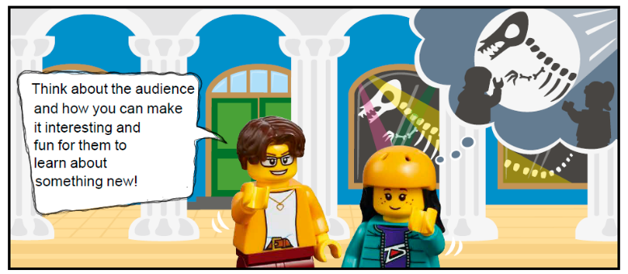
Museum Curator Spark
Think about and research:
Who visits museums and why?
What kind of technology is used to help people interact with a museum exhibit?
Who are the people that work behind the scenes at a museum?
How do museums protect and preserve their exhibits and artifacts?
Notes:
Team Tasks (100-120 minutes) Read the Project Spark.
Facilitator Tips
Provide the digital building instructions for the models to the team.
The team will need Bags 3, 5, and 11 from the Challenge set. Larger pieces may be in an unnumbered LEGO® bag.
The Project Sparks are designed to give the team ideas about technology they could explore for their solution.
Encourage the team to investigate the mat and the mission models to inspire them. The team should record ideas for possible innovation projects that they could choose.
Place the completed models on the mat with Dual Lock squares according to the field setup in the Robot Game Rulebook.

Slide 10

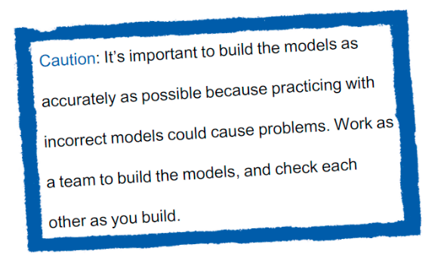

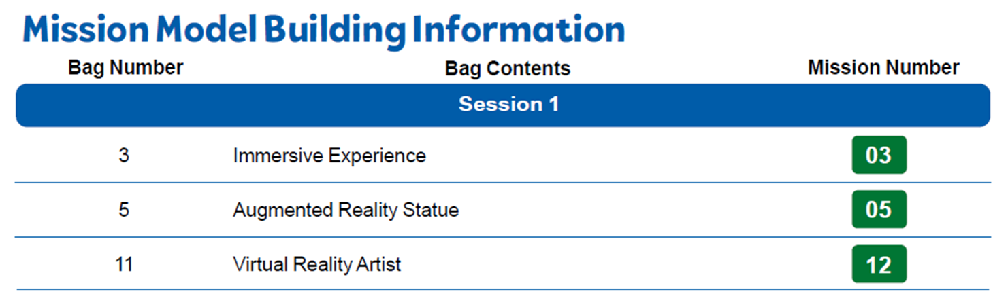
Museum Curator Spark
Build the Museum Curator models in Bags 3, 5, and 11.
Notes:
Team Tasks (100-120 minutes) Read the Project Spark.
Facilitator Tips
Provide the digital building instructions for the models to the team.
The team will need Bags 3, 5, and 11 from the Challenge set. Larger pieces may be in an unnumbered LEGO® bag.
The Project Sparks are designed to give the team ideas about technology they could explore for their solution.
Encourage the team to investigate the mat and the mission models to inspire them. The team should record ideas for possible innovation projects that they could choose.
Place the completed models on the mat with Dual Lock squares according to the field setup in the Robot Game Rulebook.

Slide 11
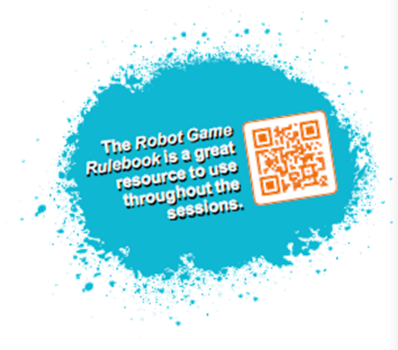
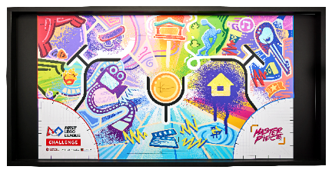
Robot Game Rulebook
Check out the Robot Game Rulebook. This will be a great resource throughout the sessions.
Review the missions that relate to the models you built.
Notes:
Team Tasks (100-120 minutes)
Facilitator Tips
Provide the digital building instructions for the models to the team.
The team will need Bags 3, 5, and 11 from the Challenge set. Larger pieces may be in an unnumbered LEGO® bag.
The Project Sparks are designed to give the team ideas about technology they could explore for their solution.
Encourage the team to investigate the mat and the mission models to inspire them. The team should record ideas for possible innovation projects that they could choose.
Place the completed models on the mat with Dual Lock squares according to the field setup in the Robot Game Rulebook.

Slide 12

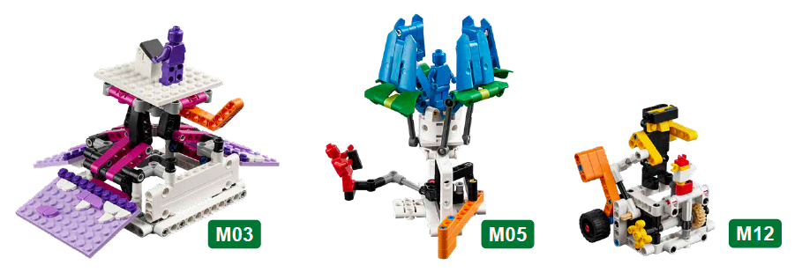
Museum Curator Spark
Review the missions that relate to the models you built.
Notes:
Team Tasks (100-120 minutes)
Facilitator Tips
Provide the digital building instructions for the models to the team.
The team will need Bags 3, 5, and 11 from the Challenge set. Larger pieces may be in an unnumbered LEGO® bag.
The Project Sparks are designed to give the team ideas about technology they could explore for their solution.
Encourage the team to investigate the mat and the mission models to inspire them. The team should record ideas for possible innovation projects that they could choose.
Place the completed models on the mat with Dual Lock squares according to the field setup in the Robot Game Rulebook.

Slide 13

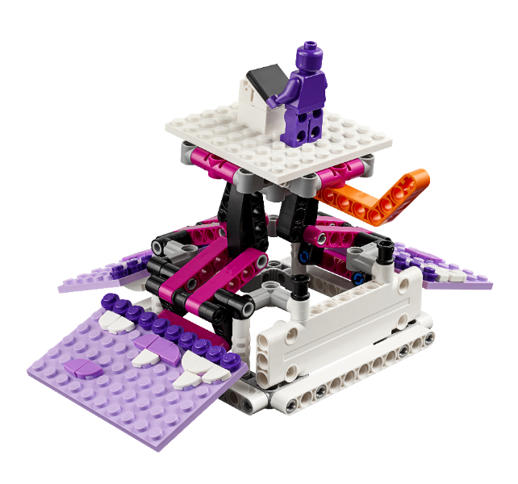
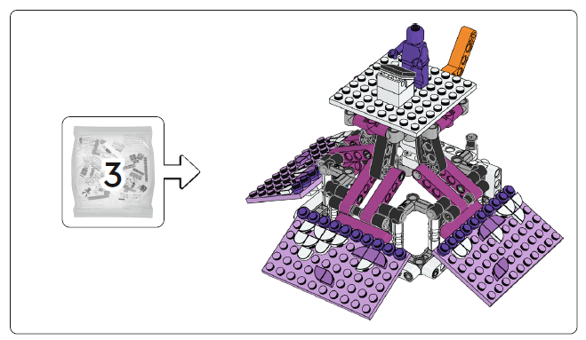
Immersive Experience
Notes:
Team Tasks (100-120 minutes)
Facilitator Tips
Provide the digital building instructions for the models to the team.
The team will need Bags 3, 5, and 11 from the Challenge set. Larger pieces may be in an unnumbered LEGO® bag.
The Project Sparks are designed to give the team ideas about technology they could explore for their solution.
Encourage the team to investigate the mat and the mission models to inspire them. The team should record ideas for possible innovation projects that they could choose.
Place the completed models on the mat with Dual Lock squares according to the field setup in the Robot Game Rulebook.

Slide 14
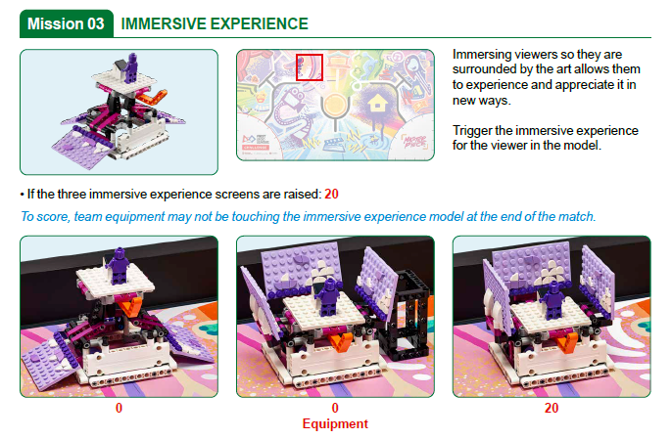
Notes:
Team Tasks (100-120 minutes)
Facilitator Tips
Provide the digital building instructions for the models to the team.
The team will need Bags 3, 5, and 11 from the Challenge set. Larger pieces may be in an unnumbered LEGO® bag.
The Project Sparks are designed to give the team ideas about technology they could explore for their solution.
Encourage the team to investigate the mat and the mission models to inspire them. The team should record ideas for possible innovation projects that they could choose.
Place the completed models on the mat with Dual Lock squares according to the field setup in the Robot Game Rulebook.

Slide 15
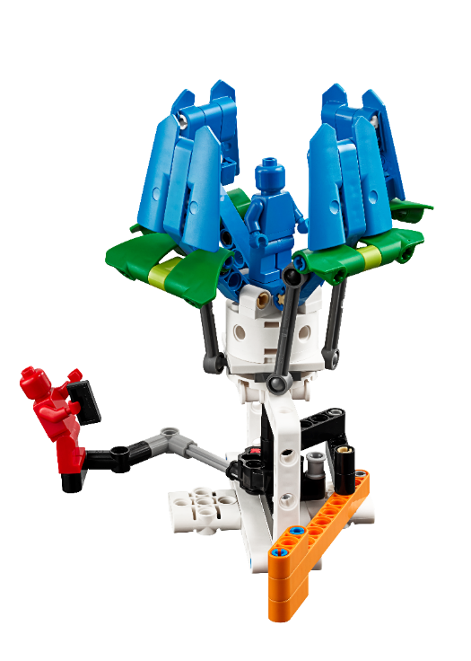
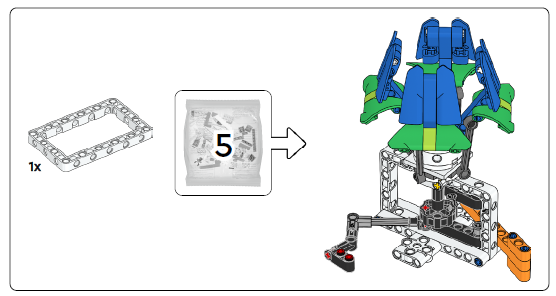
Augmented Reality Statue
Notes:
Team Tasks (100-120 minutes)
Facilitator Tips
Provide the digital building instructions for the models to the team.
The team will need Bags 3, 5, and 11 from the Challenge set. Larger pieces may be in an unnumbered LEGO® bag.
The Project Sparks are designed to give the team ideas about technology they could explore for their solution.
Encourage the team to investigate the mat and the mission models to inspire them. The team should record ideas for possible innovation projects that they could choose.
Place the completed models on the mat with Dual Lock squares according to the field setup in the Robot Game Rulebook.

Slide 16
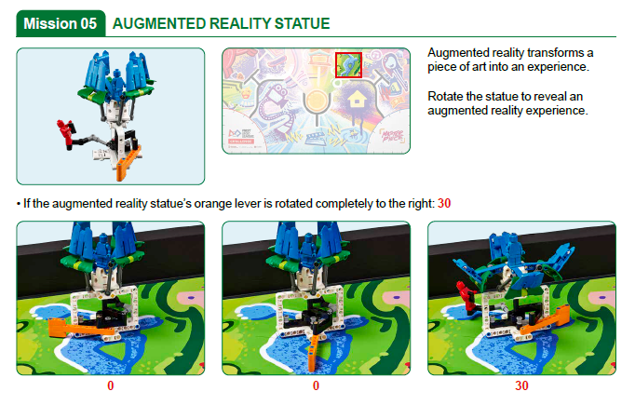
Notes:
Team Tasks (100-120 minutes)
Facilitator Tips
Provide the digital building instructions for the models to the team.
The team will need Bags 3, 5, and 11 from the Challenge set. Larger pieces may be in an unnumbered LEGO® bag.
The Project Sparks are designed to give the team ideas about technology they could explore for their solution.
Encourage the team to investigate the mat and the mission models to inspire them. The team should record ideas for possible innovation projects that they could choose.
Place the completed models on the mat with Dual Lock squares according to the field setup in the Robot Game Rulebook.

Slide 17
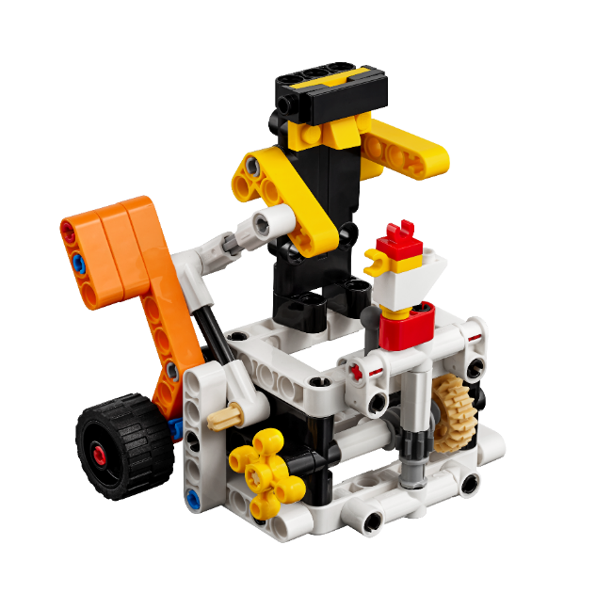
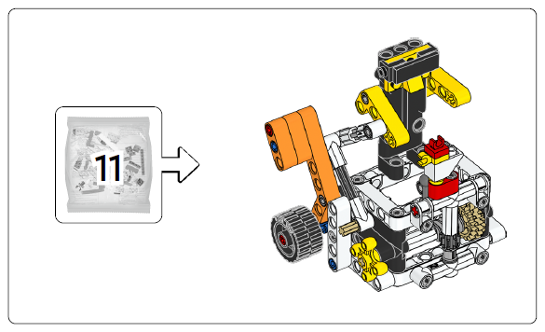
Virtual Reality Artist
Notes:
Team Tasks (100-120 minutes)
Facilitator Tips
Provide the digital building instructions for the models to the team.
The team will need Bags 3, 5, and 11 from the Challenge set. Larger pieces may be in an unnumbered LEGO® bag.
The Project Sparks are designed to give the team ideas about technology they could explore for their solution.
Encourage the team to investigate the mat and the mission models to inspire them. The team should record ideas for possible innovation projects that they could choose.
Place the completed models on the mat with Dual Lock squares according to the field setup in the Robot Game Rulebook.

Slide 18
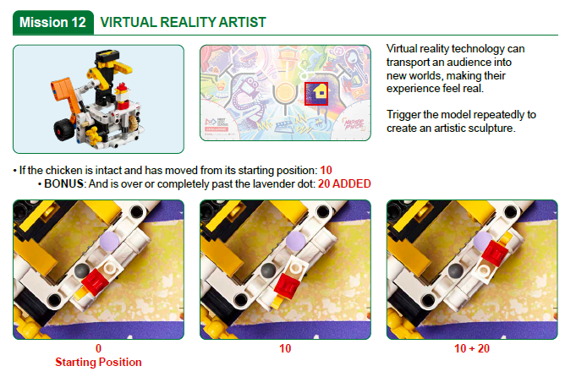
Notes:
Team Tasks (100-120 minutes)
Facilitator Tips
Provide the digital building instructions for the models to the team.
The team will need Bags 3, 5, and 11 from the Challenge set. Larger pieces may be in an unnumbered LEGO® bag.
The Project Sparks are designed to give the team ideas about technology they could explore for their solution.
Encourage the team to investigate the mat and the mission models to inspire them. The team should record ideas for possible innovation projects that they could choose.
Place the completed models on the mat with Dual Lock squares according to the field setup in the Robot Game Rulebook.

Slide 19

Museum Curator Spark
Review the missions that relate to the models you built.
Discuss how the mission models are linked to the Project Spark.
Capture your ideas.
Notes:
Team Tasks (100-120 minutes)
Facilitator Tips
Provide the digital building instructions for the models to the team.
The team will need Bags 3, 5, and 11 from the Challenge set. Larger pieces may be in an unnumbered LEGO® bag.
The Project Sparks are designed to give the team ideas about technology they could explore for their solution.
Encourage the team to investigate the mat and the mission models to inspire them. The team should record ideas for possible innovation projects that they could choose.
Place the completed models on the mat with Dual Lock squares according to the field setup in the Robot Game Rulebook.

Slide 20

Share
Get together at the mat.
Refer to the field setup section of the Robot Game Rulebook for the models pictured below.
Place each model where it belongs. Show the robot skills you learned.
Show how the models work and explain how they relate to the Project Spark.
Discuss the reflection questions.
Clean up your space.
Notes:
Share (10-15 minutes)
Facilitator Tips
Provide the digital building instructions for the models to the team.
The team will need Bags 3, 5, and 11 from the Challenge set. Larger pieces may be in an unnumbered LEGO® bag.
The Project Sparks are designed to give the team ideas about technology they could explore for their solution.
Encourage the team to investigate the mat and the mission models to inspire them. The team should record ideas for possible innovation projects that they could choose.
Place the completed models on the mat with Dual Lock squares according to the field setup in the Robot Game Rulebook.

Slide 21
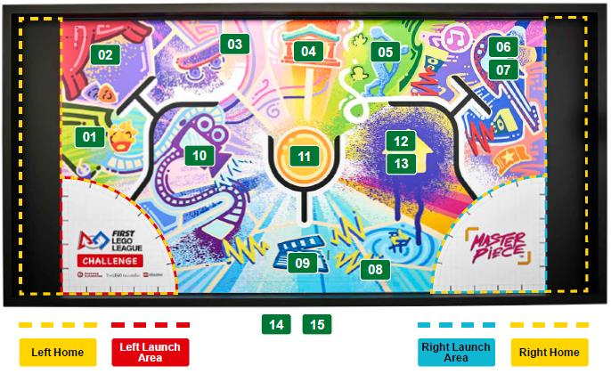
Models built this session are for the circled missions.
Notes:
Facilitator Tips
Provide the digital building instructions for the models to the team.
The team will need Bags 3, 5, and 11 from the Challenge set. Larger pieces may be in an unnumbered LEGO® bag.
The Project Sparks are designed to give the team ideas about technology they could explore for their solution.
Encourage the team to investigate the mat and the mission models to inspire them. The team should record ideas for possible innovation projects that they could choose.
Place the completed models on the mat with Dual Lock squares according to the field setup in the Robot Game Rulebook.

Slide 22


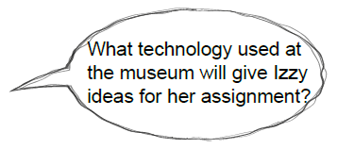
Reflection Questions
What Innovation Project ideas do the mission models spark?
What kind of technology do museums in your community use?
Notes:
Facilitator Tips
Provide the digital building instructions for the models to the team.
The team will need Bags 3, 5, and 11 from the Challenge set. Larger pieces may be in an unnumbered LEGO® bag.
The Project Sparks are designed to give the team ideas about technology they could explore for their solution.
Encourage the team to investigate the mat and the mission models to inspire them. The team should record ideas for possible innovation projects that they could choose.
Place the completed models on the mat with Dual Lock squares according to the field setup in the Robot Game Rulebook.

Slide 23
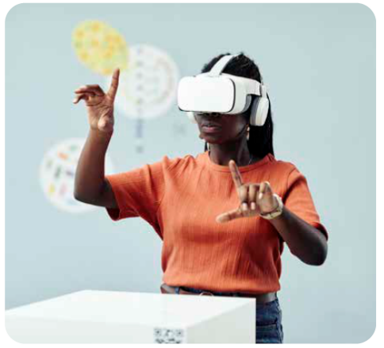


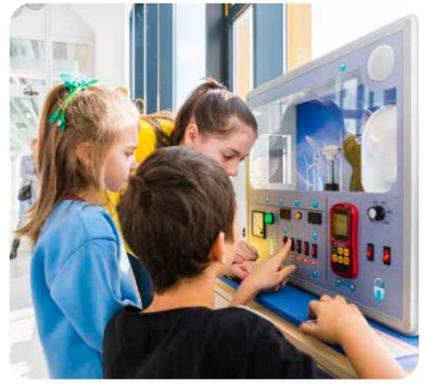
Career Connections
Museum Curator
Role:
A museum curator selects which objects will be featured in an exhibit that will help teach people about history or the future.

Slide 24

Multimedia Resources
You may wish to embed a relevant, age-appropriate video for your students here. See the Notes for an example.
Notes:
Choose a relevant, age-appropriate video for your students.
Example: MUSEUM CAREERS 101 | Types of Museums (14:37)

Slide 25

Clean Up
Notes:
Allow time for cleanup and place any unfinished models and their pieces in a sealed plastic bag.
Clean Up Pointers
You may wish to play a video or song during clean up time Link on
GoNoodle: https://family.gonoodle.com/activities/clean-up
Link on YouTube Kids: https://www.youtubekids.com/watch?v=ZJFk87ZsHn0
Link on Youtube: https://youtu.be/ZJFk87ZsHn0

Slide 26

LEGO, the LEGO logo, the SPIKE logo, MINDSTORMS and the MINDSTORMS logo are trademarks of the LEGO Group. ©2023 The LEGO Group. All rights reserved. FIRST®, the FIRST® logo, Coopertition®, Gracious Professionalism®, and FIRST IN SHOWSM, are trademarks of For Inspiration and Recognition of Science and Technology (FIRST). LEGO® is a registered trademark of the LEGO Group. FIRST® LEGO® League and MASTERPIECESM are jointly held trademarks of FIRST and the LEGO Group. All other trademarks are the property of their respective owners. ©2023 FIRST and the LEGO Group. All rights reserved.

